Slide 1




Flavor Physics at e⁺e⁻ Colliders
Boštjan Golob
University of Ljubljana/Jožef Stefan Institute
& Belle/Belle II Collaboration
Status & Plans
Examples of measurements
Summary
University
of Ljubljana
“Jožef Stefan”
Institute
Alps 2017:
an Alpine LHC
Physics Summit

Slide 2
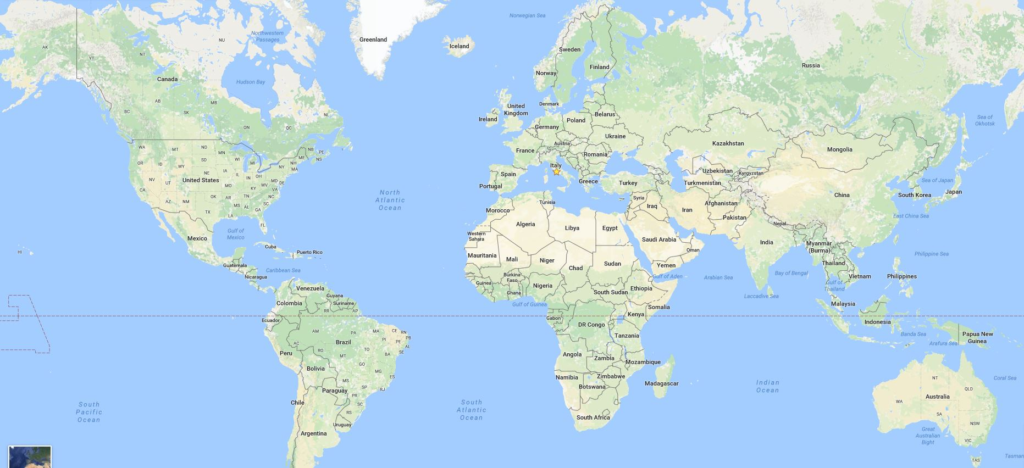
Status
Status | Inclusive
 | Neutrals
E_{miss} | Summary
e⁺e⁻ Accelerators?
VEPP-4M
VEPP-4M
LEP(2)
PEP-II
BEPC-II
CESR-C
DAΦNE
DAΦNE
SuperKEKB
Eastbound →
considering acc. relevant (subjective) to this talk → Far East

Slide 3

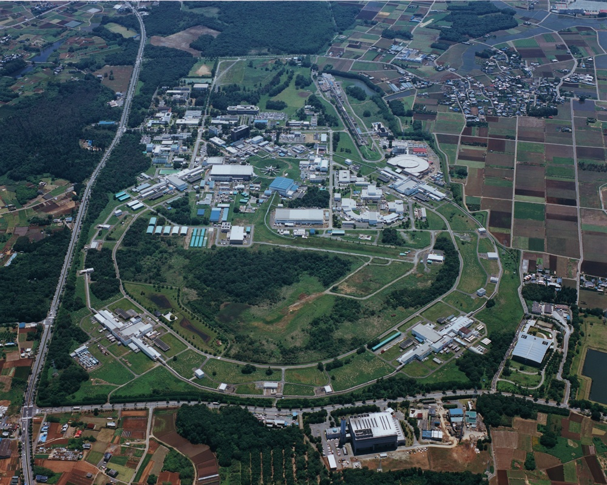
Status
Status | Inclusive
 | Neutrals
E_{miss} | Summary
Accelerator
“SuperKEKB”
Tokyo (40 mins by Tsukuba Exps)
SuperKEKB:
e⁻ (HER): 7.0 GeV
e⁺ (LER): 4.0 GeV
E_{CMS}=M(Υ(4S))c²
(→BB)
[M(Υ(1S))c² ,M(Υ(6S))c²]
dN_{f} / dt = σ(e⁺e⁻→f)L
L =8x10³⁵ cm⁻² s⁻¹
LER
HER
e⁻
Belle 2
e⁺

Slide 4
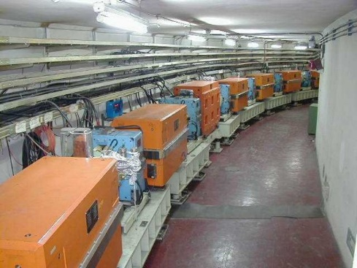
Status
Status | Inclusive
 | Neutrals
E_{miss} | Summary
Accelerator
“BEPC - II”
BEPC-II:
E_{CMS}=2.0 – 4.6 GeV
M(ψ(3770))c², M(ψ(4040))c²
(→DD) (→DD*)
L =1x10³³ cm⁻² s⁻¹

Slide 5
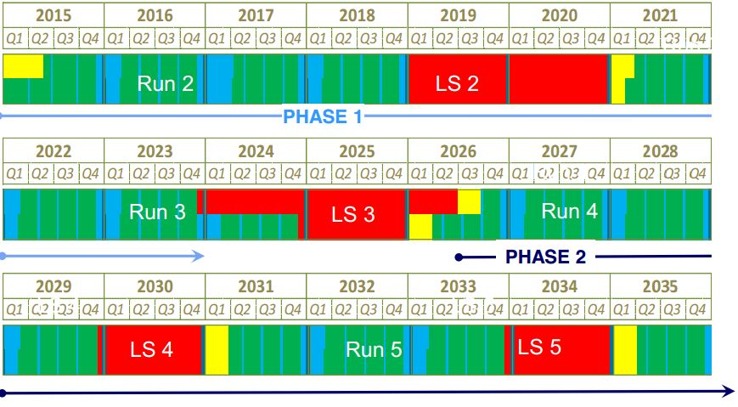
Status
Status | Inclusive
 | Neutrals
E_{miss} | Summary
Super KEKB luminosity planning
5 ab⁻¹
20 ab⁻¹
Phase 1:
w/o QCS
w/o Belle 2
Phase 2:
w/ QCS
w/ Belle 2
(no VXD)
Phase 3:
full Belle 2
Phase 1
Phase 2
Phase 3
QCS, Belle 2
VXD
35 ab⁻¹
50 ab⁻¹
http://lhc-commissioning.web.cern.ch/lhc-commissioning/schedule/LHC%20schedule%20beyond%20LS1%20MTP%202015_Freddy_June2015.pdf

Slide 6
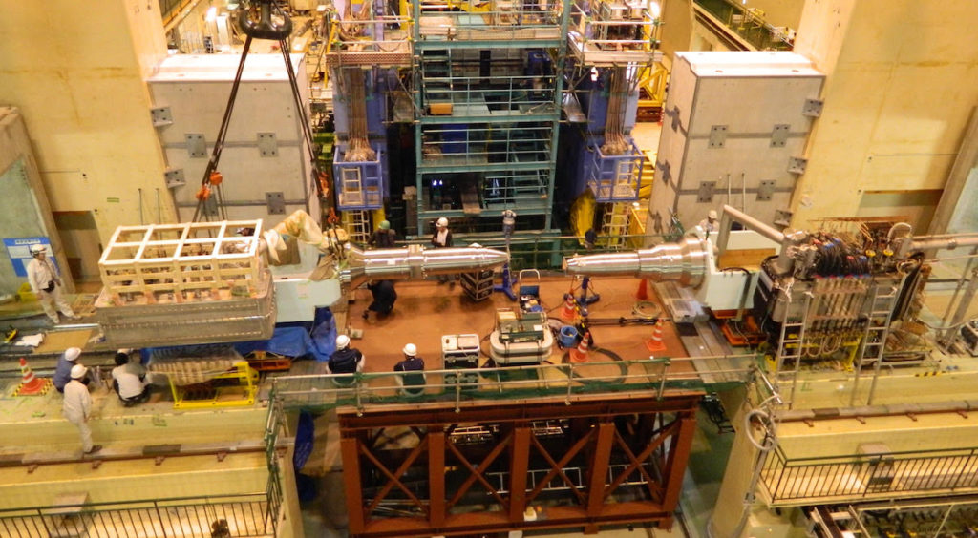
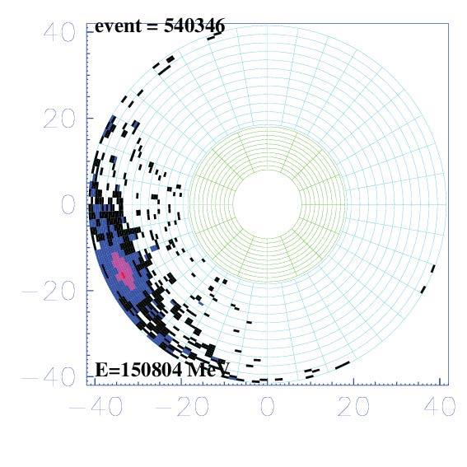
Status
Status | Inclusive
 | Neutrals
E_{miss} | Summary
Belle 2 planning
Final focusing superconducting magnets
150 GeV Cosmic ray in ECL
BEAST PHASE I: Simple background
commissioning
detector
(diodes, TPCs,
crystals). No final
focus (i.e. no
luminosity, single
beam background
studies possible).
BEAST PHASE II: More elaborate inner background commissioning detector & full Belle II outer detector.
Superconducting final focus, no vertex detectors.
Physics Running
Feb – Jun 2016
Oct 2017 –
Jan 2018
Oct 2018 →

Slide 7
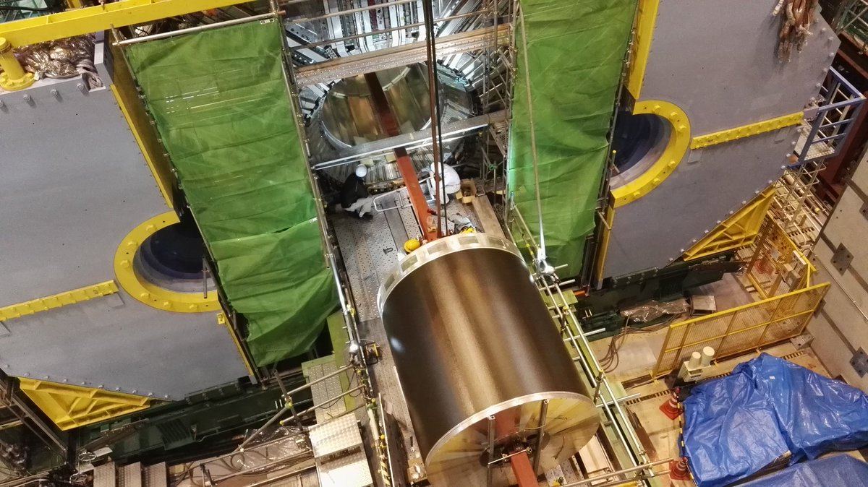
Status
Status | Inclusive
 | Neutrals
E_{miss} | Summary
Belle 2 Roll-in (April 11th)
to beam lines
CDC
Oct 2016

Slide 8
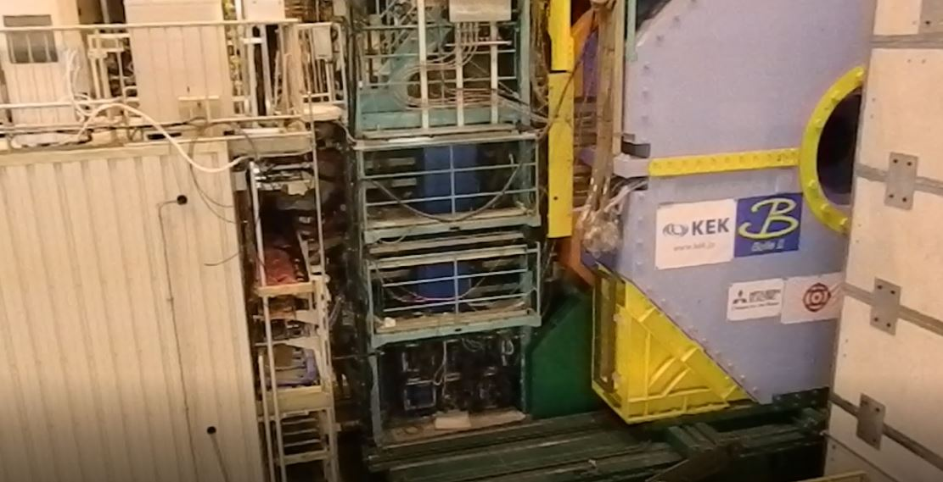
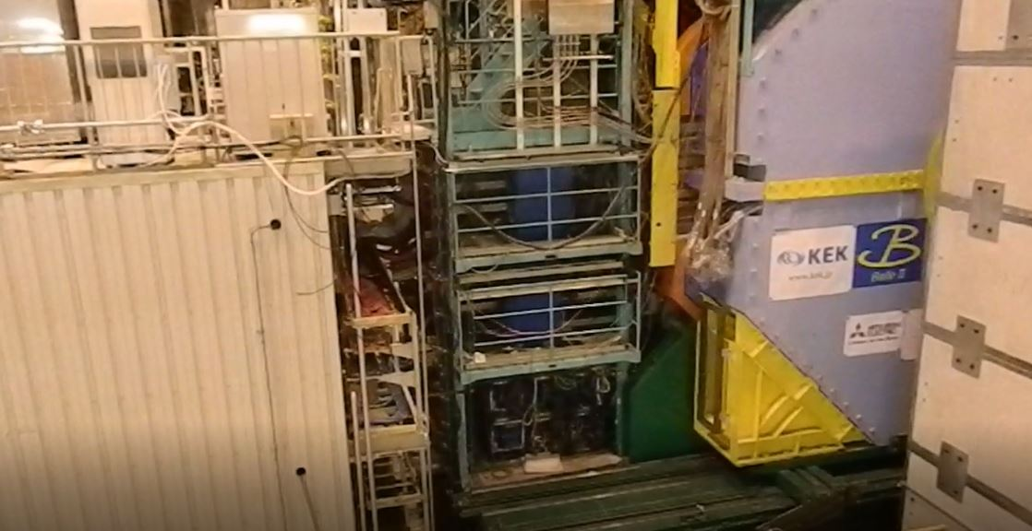
Status
Status | Inclusive
 | Neutrals
E_{miss} | Summary
Belle 2 Roll-in (April 11th)
after
1 minute
30 seconds

Slide 9
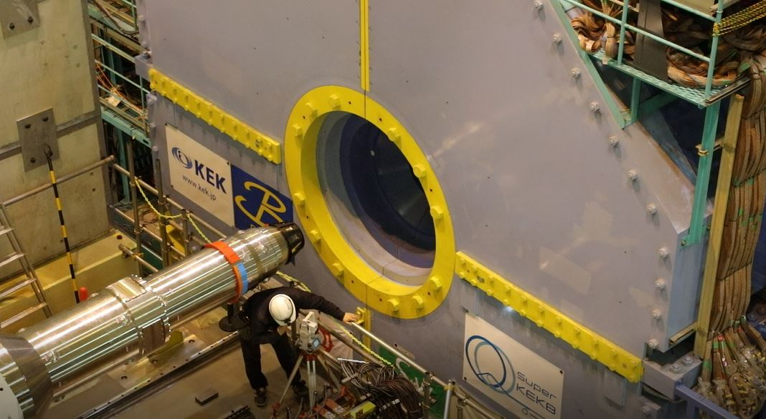
Status
Status | Inclusive
 | Neutrals
E_{miss} | Summary
Belle 2 Roll-in (April 11th)

Slide 10
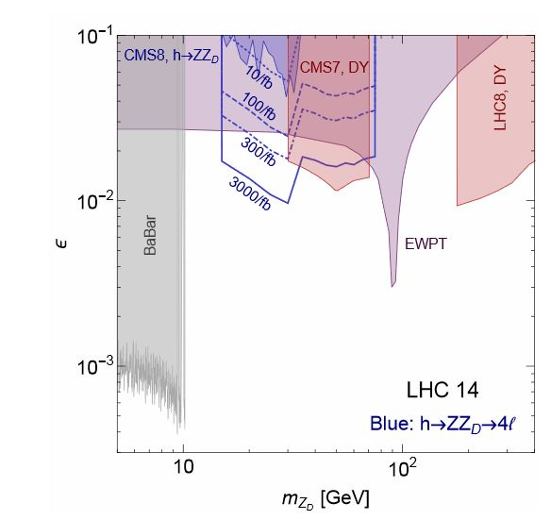
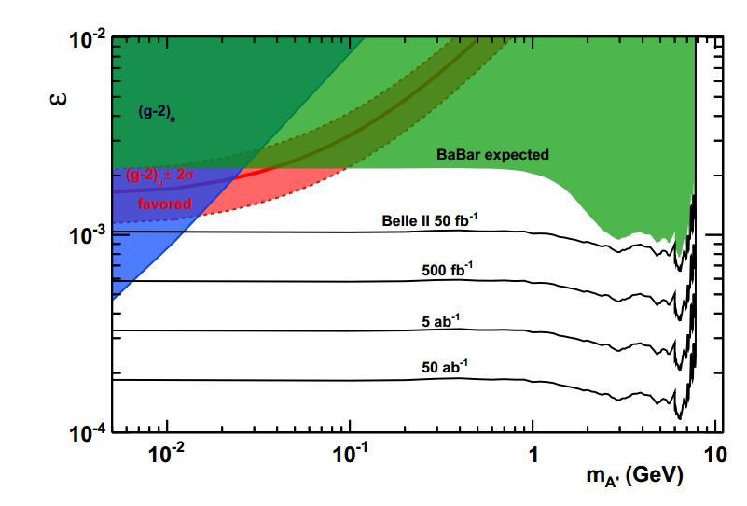
Status
Status | Inclusive
 | Neutrals
E_{miss} | Summary
Properties of e⁺e⁻ Colliders
(as compared to LHC)
low energy
10⁻¹
10⁻²
10⁻³
D. Curtin et al., arXiv:1412.0018
ε: γΑ‘ coupling
A. Bondar et al., Belle2-note-ph-2015-003
10⁻¹ 1 10 100

Slide 11
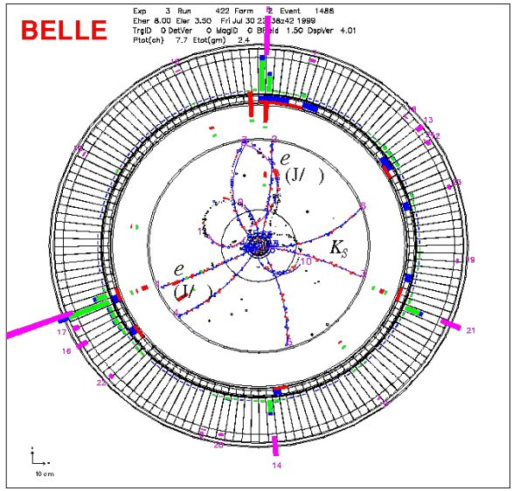
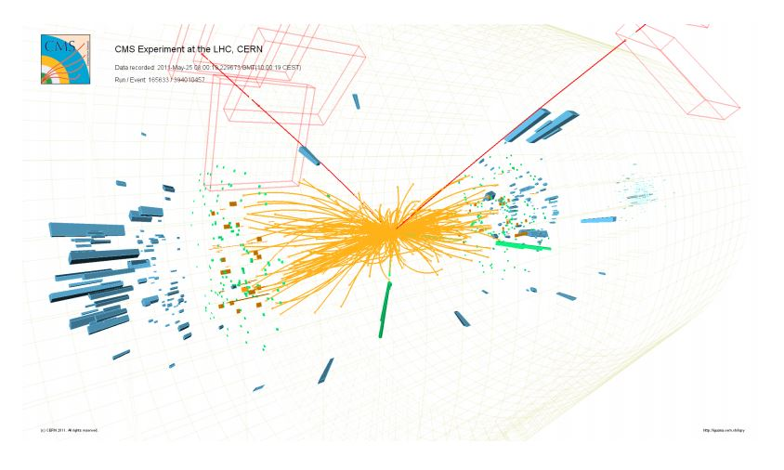
Status
Status | Inclusive
 | Neutrals
E_{miss} | Summary
Properties of e⁺e⁻ Colliders
(as compared to LHC)
low energy
low trigger rate / Event size
(30 kHz 1st level, 5 kHz high level; 300 kB event size)
low multiplicity (O(10))

Slide 12
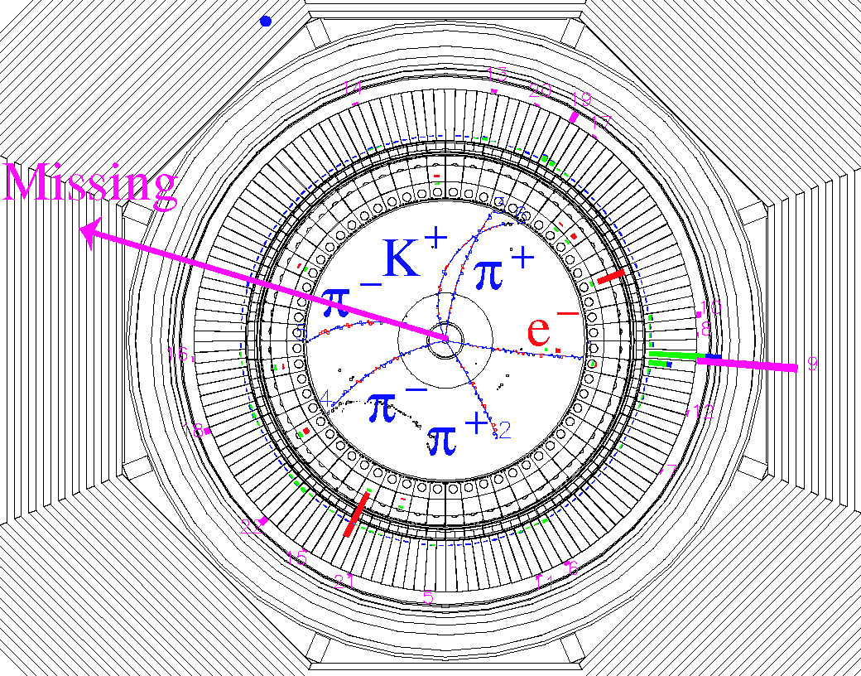
Status
Status | Inclusive
 | Neutrals
E_{miss} | Summary
Properties of e⁺e⁻ Colliders
(as compared to LHC)
low energy
low trigger rate / Event size
(30 kHz 1st level, 5 kHz high level; 300 kB event size)
low multiplicity (O(10))
good hermiticity
specific methods for
full event
reconstruction
Missing E
(ν)
fully (partially) reconstruct B_{tag};
reconstruct h from e.g. B_{sig}→hνν
or B_{sig}→ τ(→ hν)ν;
no additional energy in EM calorim.;
signal at E_{ECL}~0;
B_{tag} full reconstruction (NeuroBayes)
B_{tag}
B_{sig}
B_{sig} → τν
candidate
event

Slide 13
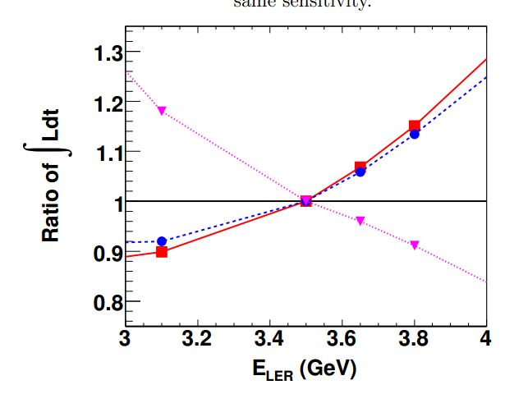
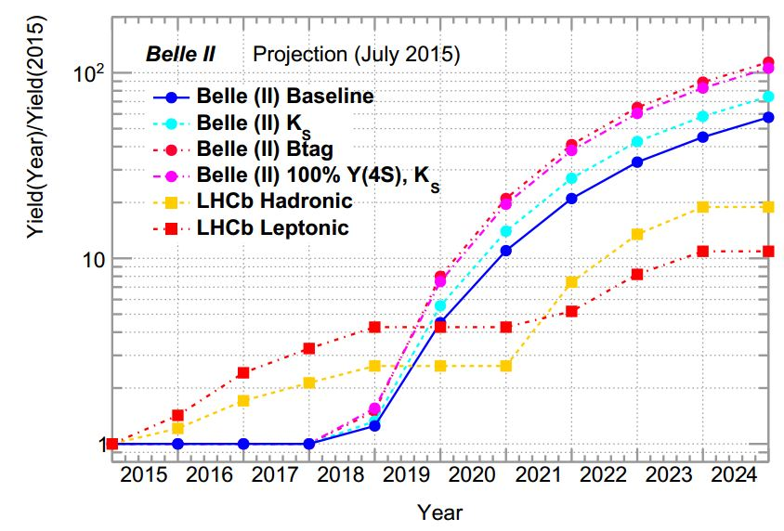
Plans
Introduction | Inclusive
Plans | Neutrals
E_{miss} | Summary
Lumi ratio for same sensitivity
B → φK_{s}
B → J/ψK_{s}
Belle II
B-tagged
LHCb
Hadronic
B → τν
Belle
Belle 2
E^{e+}_{beam}
boost
Relative yield increase
E^{e-}_{beam} from Υ(4S) mass
B. Golob, K. Trabelsi, P. Urquijo, Belle2-note-ph-2015-002
Belle 2: improved K_{S} reconstr.;
improved hadr. B tagging;
LHCb: σ ∝√s;
run 2 50% less eff. for hadronic triggers
than run 1;
run 3 increase eff. for hadr. triggers by
2x w.r.t. run 1;
LHCb EPJC 73, 2373

Slide 14
Plans
Introduction | Inclusive
Plans | Neutrals
E_{miss} | Summary
BEPC-II / BES-III planning
part of existing data sets:
proposal until 2020 (3 years):
10¹⁰ J/ψ
3 fb⁻¹ 4.6-4.65 GeV (Λ_{c})
5 fb⁻¹ 4.25-4.6 GeV (XYZ)
data lumin.[fb-1] year
ψ(3770) 2.9 2010/11
ψ(4040) 0.5 2011
4.18 GeV 3.1 2016

Slide 15

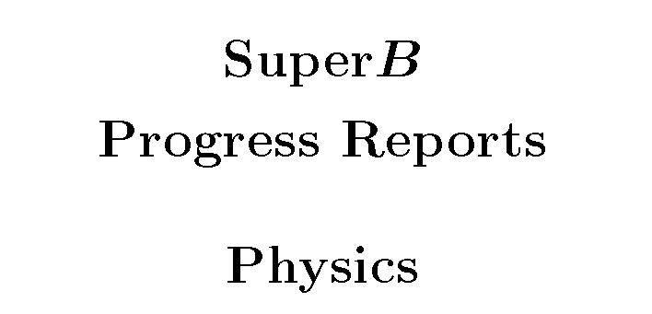
Subjects
Introduction | Inclusive
 | Neutrals
E_{miss} | Summary
Methods and processes where Belle 2 can provide
important insight into NP complementary to other experiments:
E_{miss}:
B(B→ τν), B(B → X_{c}τν), B(B → hνν), B(B → X_{u} l ν)...
(Semi)Inclusive:
B(B → sγ), A_{CP}(B → sγ), B(B → sll ), ...
Neutrals:
S(B → K_{S}π⁰γ), S(B → η’ K_{S}), S(B → K_{S}K_{S}K_{S}), B(τ → μγ), B(B_{s} → γγ), ...
Detailed description of physics program at Belle 2 in:
Physics of B Factories
A.G. Akeroyd et al., arXiv: 1002.5012
B.G.,, K, Trabelsi, P. Urquijo, BE LLE2-NOTE- PH-2015-002
Impact of Belle II on Flavor Physics
B. O’Leary et al., arXiv: 1008.1541
P. Urquijo, BE LLE2-NOTE- PH-2015-002
Belle I I - LHCb measurement
extrapolation comparisons
Ed. A.J. Bevan, B. Golob, Th. Mannel, S. Prell, and B.D. Yabsley,
Eur. Phys. J. C74 (2014) 3026

Slide 16

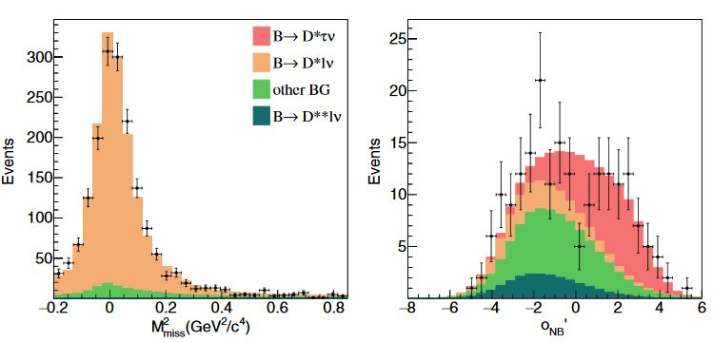
Missing energy
Introduction | Inclusive
 | Neutrals
E_{miss} | Summary
B → D*τν
R(D⁽*⁾)= B(B → D*τν) / B(B → D* l ν)
R(D)_{SM}=0.300 ±0.008
R(D*)_{SM} =0.252 ±0.003
use NN with M²_{miss},
E_{vis}, cosθ_{B-D* l} ^{sig}.
data sample with
low M²_{miss} used to
fit the background
contribution
Belle, PRD 94, 072007, 700 fb⁻¹
l =e,μ Test of LFU
H. Na et al., Phys.Rev.D 92, 054410 (2015)
S.Fajfer et al., Phys.Rev.D85(2012) 094025
231±23
D* τν
2800±57
D* l ν
signal is to the
right →
NN output for data
with M²_{miss} >
0.85 GeV²

Slide 17
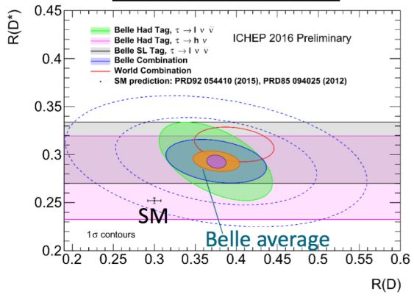
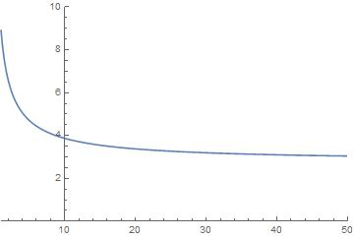
Missing energy
Introduction | Inclusive
 | Neutrals
E_{miss} | Summary
B → D*τν
R(D*)=0.302±0.030±0.011
Belle, PRD 94, 072007, 700 fb⁻¹
current
Belle II 5 ab-¹
Belle II 50 ab-¹
σ(R(D⁽*⁾))/R(D⁽*⁾)[%]
3.5 σ @ 5 ab⁻¹
N_{μ}/N_{e} ∝(Br^{μ}/Br^{e})² semil. tag
N_{μ}/N_{e} ∝Br^{μ}/Br^{e} had. tag
σ_{stat}(e/μ) ∼ 5%
σ_{stat}(τ/e,μ) ∼ 11%
(semil. tag)
5 σ @ 20 ab⁻¹
L [ab⁻¹]

Slide 18
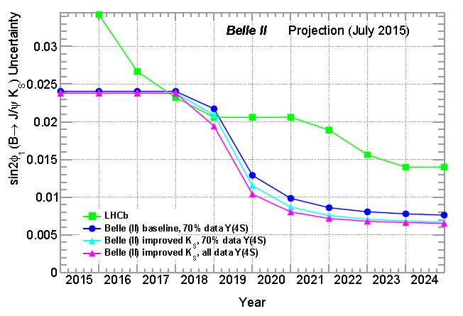
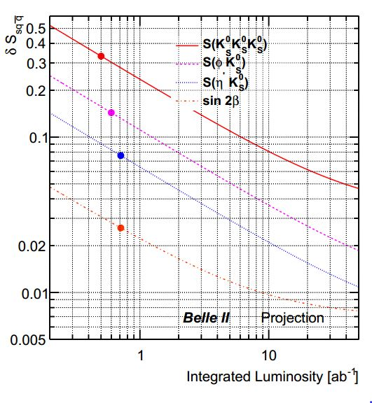
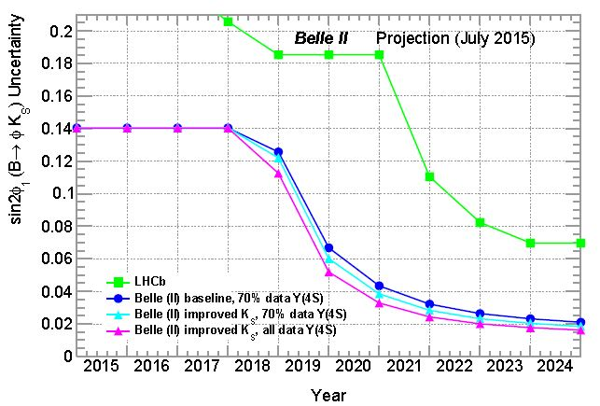
Neutrals
Introduction | Inclusive
 | Neutrals
E_{miss} | Summary
CPV in b → sqq
some uncertainties cancel in ΔS
(vtx reconstr., flavor tag, likelihood fit) ;
better K_{S} eff. with vtx hits - larger vtx radius,
30%);
vtx reconstr. improved with better tracking;
B → J/ψ K_{s}
for comparison
41 new phases in MSSM
ΔS=sin2φ₁^{eff} -sin2φ₁
B → K_{s}K_{s}K_{s}
0.007
B → φ K_{s}
0.045
B → φ K_{s}
B → η‘ K_{s}
0.020
0.010
P. Urquijo,
Belle2-note-ph-2015-004
0.02
B. Golob, K. Trabelsi, P. Urquijo,
Belle2-note-ph-2015-002

Slide 19
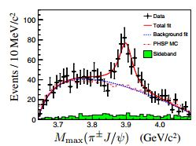
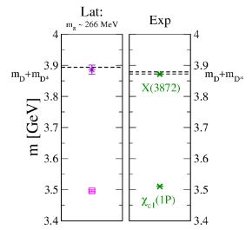
Neutrals
Introduction | Inclusive
 | Neutrals
E_{miss} | Summary
Exotic states
Belle II / BES III
γ ISR
X(3872) discovery by Belle (2003)
(meson molecule?)
clear that exotic ( ≠ qq, qqq) states exist
PQ discovery by LHCb (2015)
Belle II & BES III can produce those
clearly and abundantly
e.g. Y states in e+e-
(quark gluon hybrids?)
Y(4260); BESIII 0.8 fb⁻¹ at E_{cms}=4.26 GeV
→ J/ψ π⁺π⁻
studies of properties (combined with
LQCD?) may reveal nature of exotic states
e+
Y
e-
Z_{c}⁺(3900)
BESIII, PRL 110, 252001 (2013)
M. Padmanath et al., PRD92, 034501 (2015)

Slide 20
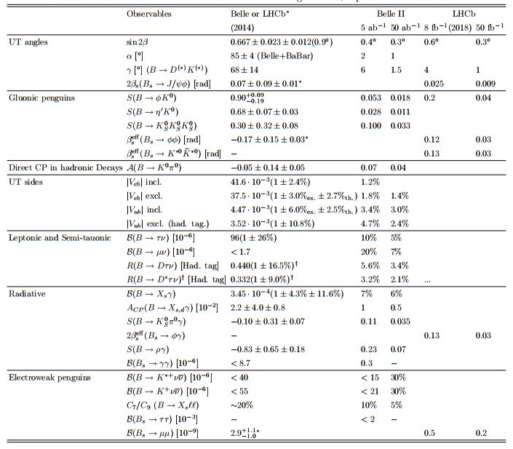
Summary
Introduction | Inclusive
 | Neutrals
E_{miss} | Summary
complementarity is
an absolute must in
intensity frontier
need to do some
(re)analysis of Belle
data
hardly waiting to start
datataking with
Belle II
B. Golob, K. Trabelsi, P. Urquijo, Belle2-note-ph-2015-002
20.. 20 23 18 27?

Slide 21
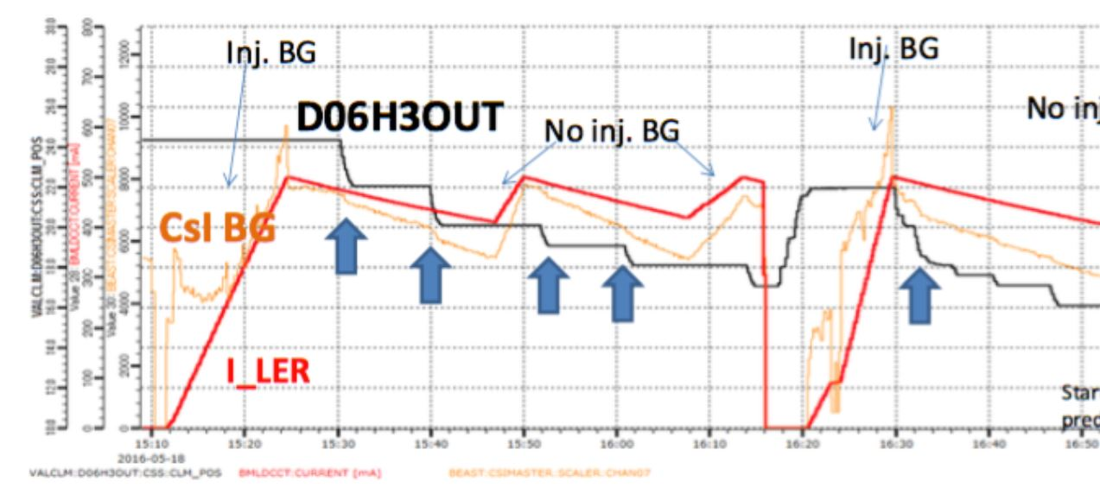
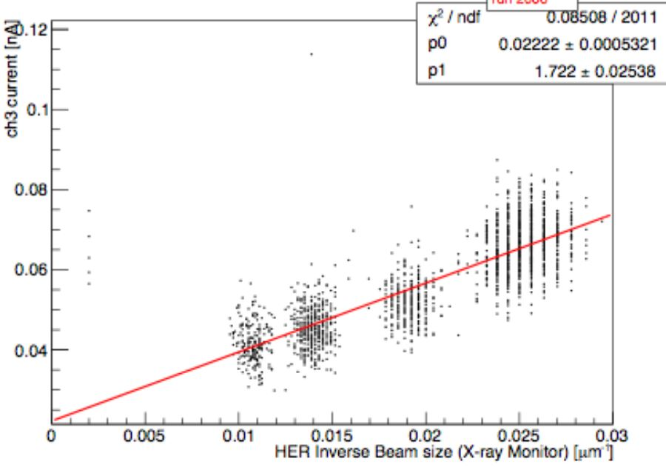
Beast phase 1
Introduction | Inclusive
 | Neutrals
E_{miss} | Summary
Beast phase 1
background
drop
backgrounds in ECL
responding to colimator
settings
colimator
closing
Touschek background
( ∝ 1/σ_{y})
reason for lower boost

Slide 22

Semil. tagging
Introduction | Inclusive
 | Neutrals
E_{miss} | Summary
B → τν, hνν, X_{c}τν,...
possible to reconstruct
events with ν‘s;
fully (partially) reconstruct
B_{tag};
reconstruct h± from B_{sig};
no additional energy in
EM calorim.;
signal at E_{ECL}~0;
Partial reconstruction (semileptonic tagging):
ε_{tag}~1%
Missing E
(ν)
B_{tag}
B_{sig}
B_{sig} → τν
candidate
event
D*±
B_{sig}
l±
B_{tag}
ν

Slide 23
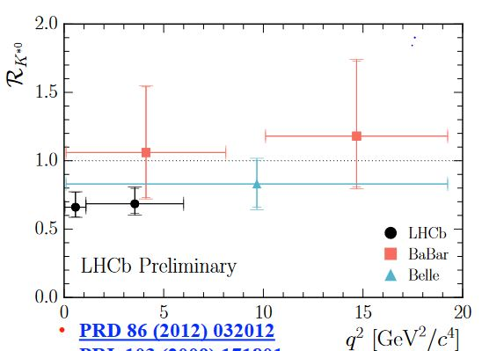

LFU/B →K* l l
Introduction | Inclusive
 | Neutrals
E_{miss} | Summary
B → K*l l
R(K*)=
N(B → K*μμ)
N(B → K*ee)
approximate stat.
uncertainty on
R(K*), very roughly
Belle, 0.7 ab⁻¹
Belle II, 10 ab⁻¹
Belle, arXiv:1604.04042, 700 fb⁻¹

Slide 24
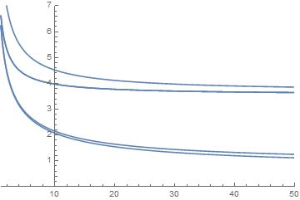
LFU charm
Introduction | Inclusive
 | Neutrals
E_{miss} | Summary
σ(X)/X[%]
D_{s} → l ν
B.G.,, K, Trabelsi, P. Urquijo, BE LLE2-NOTE- PH-2015-002
R^{Ds}_{τ/μ}
Br(D_{s} → μν)
Br(D_{s} → τν)
R^{Ds}_{τ/μ}= Br(D_{s} → τν) / Br(D_{s} → μν)
R^{Ds}_{τ/μ}=10.73 ± 0.69 ± 0.55
(R^{Ds}_{τ/μ})_{SM}= 9.762 ± 0.031
Belle, JHEP09, 139 (2013), 900 fb⁻¹
L [ab⁻¹]
n.b.: σ(R(D*))/R(D⁽*⁾) ~4% @20 ab⁻¹

Slide 25
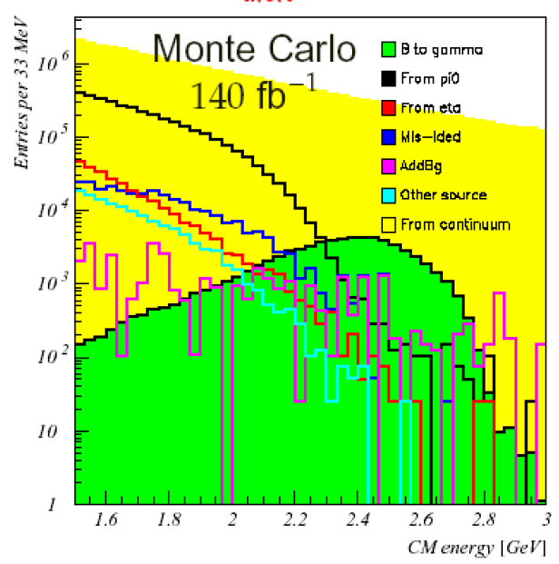
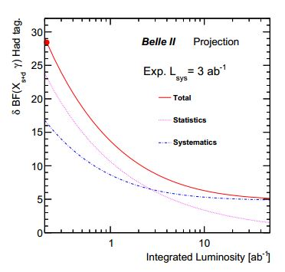
Inclusive
Introduction | Inclusive
 | Neutrals
E_{miss} | Summary
B → s(+d) γ
experimental challenge:
huge bkg;
only γ reconstructed in the signal side
continuum
π⁰ → γγ
η → γγ
b → sγ
B_{sig}
γ
B_{tag}
X_{s}
l± 1.26 GeV < E < 2.20 GeV
Belle, PRL103, 241801, (2008), 605 fb⁻¹
different method: hadronic tagging (= full
reconstruction of B_{tag});
reduction of system.uncertainty on the account
of lower efficiency (ε_{had} ~ 0.5%);
K
:
B_{sig}
γ
π
B_{tag}
X_{s}
5%
π
B. Golob, K. Trabelsi, P. Urquijo,, Belle2-note-ph-2015-002

Slide 26
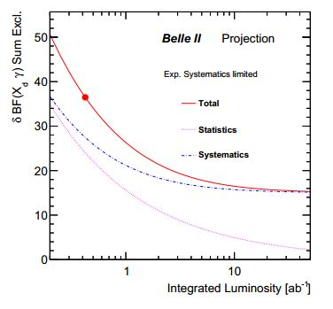
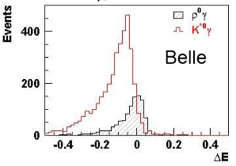
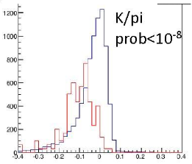
Inclusive
Introduction | Inclusive
 | Neutrals
E_{miss} | Summary
b → d γ
within SM: Br(B → dγ) / Br(B → sγ) =(3.8 ±0.5) ⋅10⁻²
(ratio can be used to determine |V_{td}/V_{ts}|)
Br(B → sγ) = 3.4⋅10⁻⁴
Br(B → dγ) should be measured with an accuracy of ~2⋅10⁻⁶
sum of exclusive modes: σ(Br(dγ)) = (±3±1)⋅10⁻⁷ low X_{d} mass region
σ(Br(dγ)) = (±20±22)⋅10⁻⁷ high X_{d} mass region
T. Hurth et al., Nucl.Phys. B704, 56 (2005)
BaBar, PRD82, 051101 (2010), 0.4ab-1
largest syst. uncertainty:
B → s γ bkg.;
missing (>= 5 body) modes;
significant improvement necessary
Belle/Belle 2 full simulation:
Belle 2
15%
B⁰ →K*(Kπ)γ, B⁰ → ρ(ππ)γ,
ΔE= E_{B}* - E_{beam}

Slide 27
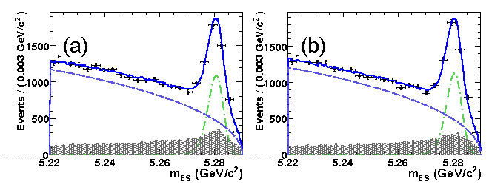
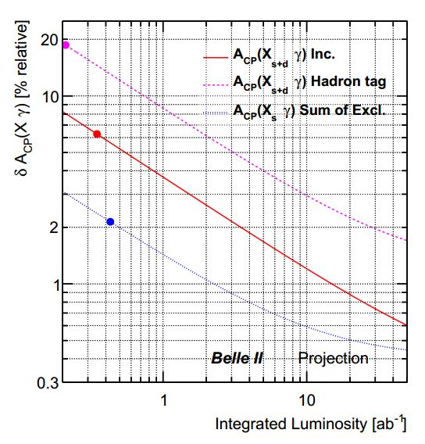
Inclusive
Introduction | Inclusive
 | Neutrals
E_{miss} | Summary
B → sγ
direct CPV
Semi-inclusive, sum of many
exclusive states:
all flavor specific final
states;
<D>: average dilution due to
flavour mistag, ∼1
ΔD: difference between
flavour mistag for
b and b, << 1
A_{det}: detector induced
asymmetry
BaBar, PRL101, 171804(2008),350 fb⁻¹
b → sγ
b → sγ
A_{det}: careful study of
K/π asymmetries in (p,θ_{lab})
using D decays or inclusive
tracks from fragmentation;
lots of work on system.,
→ few 10⁻³
exp. sensitivity
HFAG, 2014
SM: A_{CP} ~ (0.44±^{0.24}_{0.14})%
T. Hurth et al., Nucl.Phys. B704, 56 (2005)
5x10⁻³

Slide 28
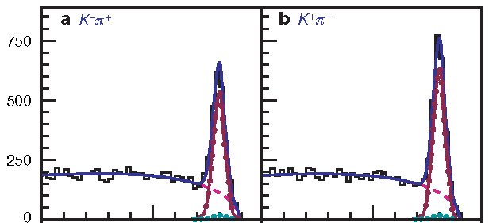
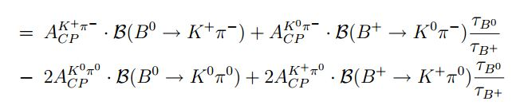
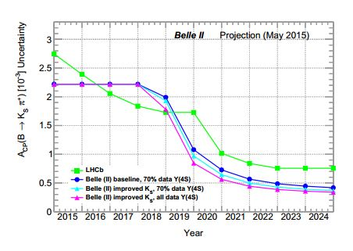
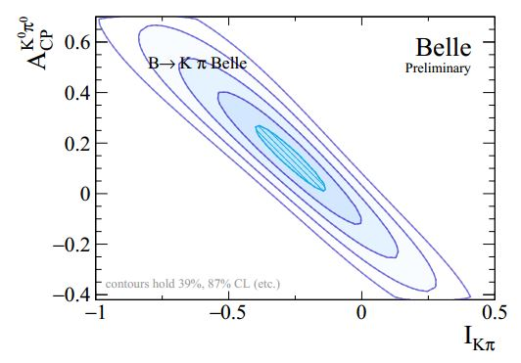
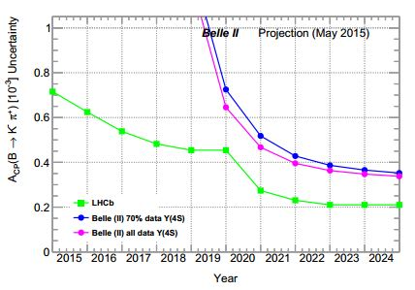
Neutrals
Introduction | Inclusive
 | Neutrals
E_{miss} | Summary
DCPV puzzle:
tree+penguin processes, B⁺⁽⁰⁾→K⁺π⁰⁽⁻⁾
ΔA_{Kπ}= A(K⁺π ⁻)- A(K⁺π ⁰)= -0.147±0.028
B⁰ →K⁺π⁻
Belle, Nature 452, 332 (2008), 480 fb⁻¹
I_{Kπ} B (B⁰ → K⁺π ⁻)
M_{bc}
M. Gronau, PLB627, 82 (2005);
D. Atwood, A. Soni, PRD58, 036005 (1998)
σ(A_{CP}(K_{S}π⁺))
Belle 2 K⁰π⁰
50 ab⁻¹
σ(A_{CP}(K⁻π⁺))
B. Golob, K. Trabelsi, P. Urquijo,, Belle2-note-ph-2015-002

Slide 29
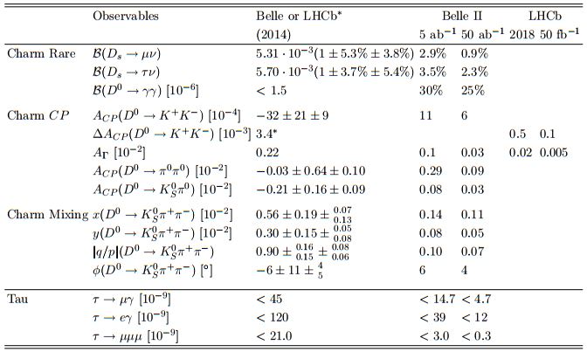
Summary (Belle perspective)
Introduction | Inclusive
 | Neutrals
E_{miss} | Summary
B. Golob, K. Trabelsi, P. Urquijo, Belle2-note-ph-2015-002

Slide 30
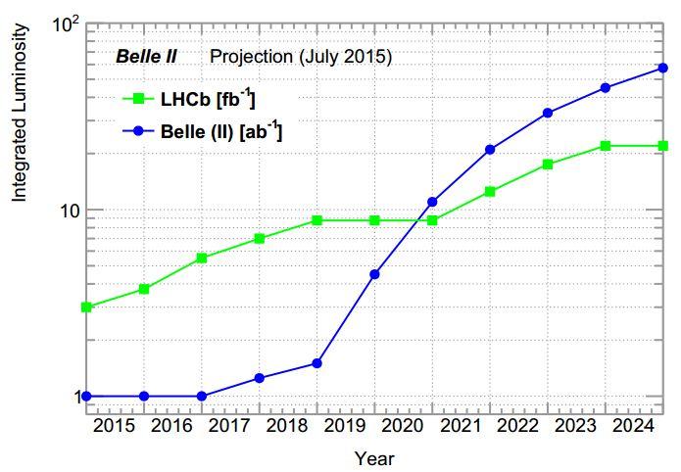
Introduction
Introduction | Inclusive
 | Neutrals
E_{miss} | Summary
Lumi ratio for same sensitivity
B → φK_{s}
B → J/ψK_{s}
P. Urquijo,
Belle2-note-ph-2015-004
B → τν
Belle
Belle 2
E^{e+}_{beam}
E^{e-}_{beam} from Υ(4S) mass
B. Golob, K. Trabelsi, P. Urquijo, Belle2-note-ph-2015-002
Belle 2: improved K_{S} reconstr.;
improved hadr. B tagging;
LHCb: σ ∝√s;
run 2 50% less eff. for hadronic triggers
than run 1;
run 3 increase eff. for hadr. triggers by
2x w.r.t. run 1;
Belle II
B-tagged
LHCb
Hadronic
Relative yield increase
LHCb EPJC 73, 2373

Slide 31
Early running
Introduction | Inclusive
 | Neutrals
E_{miss} | Summary
Early running
need time for calibration of detectors
at Υ(4S);
measurements not requiring sophisticated
PID and/or vertex determination;
maximize impact on existing data samples
(e.g. Υ(3S));
A. Bondar et al., Belle2-note-ph-2015-003
Dark matter
e⁺e⁻ → γ A‘→ γ χχ
(m_{χ} < m_{A‘}/2)
single γ trigger required;
simplified: single γ, E_{γ} > E_{cut};
high bkg, low ε
high trigger rate
E_{cut}
main backgrounds:
e⁺e⁻ → γ e⁺e⁻
e⁺e⁻ → γγ
ε: γΑ‘ coupling

Slide 32
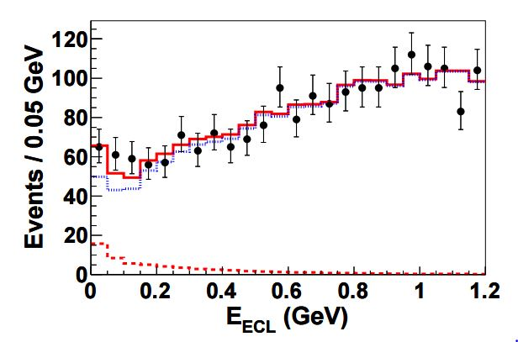
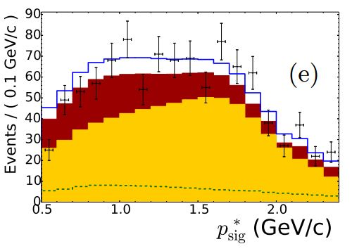
Missing energy
Introduction | Inclusive
 | Neutrals
E_{miss} | Summary
B → τν, hνν, ...
fully (hadron tag) or partially (semil.tag) reconstruct B_{tag};
N_{sig}=62 ± 24
hadronic tag
B → τν
main syst. is reducible: bkg. ECL shape, ε B_{tag})
B(B⁺ →τ⁺ν)=(0.72 ± 0.26 ± 0.11) ∙10⁻⁴
Belle, PRL110, 131801 (2013), 700 fb⁻¹
N_{sig}=222 ± 50
B(B⁺ →τ⁺ν)=(1.25 ± 0.28 ± 0.27) ∙10⁻⁴
Belle, arXiv:1503.05613, 700 fb⁻¹
semil. tag

Slide 33
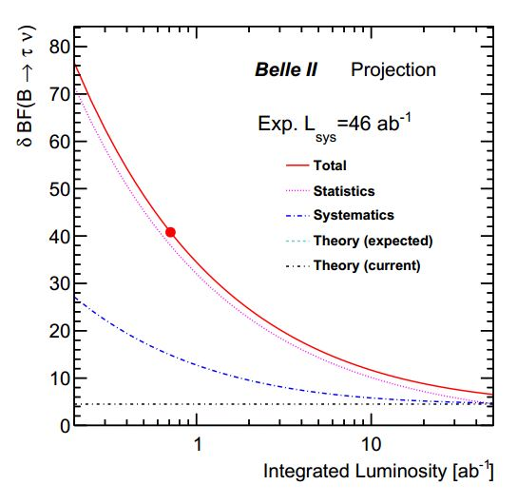

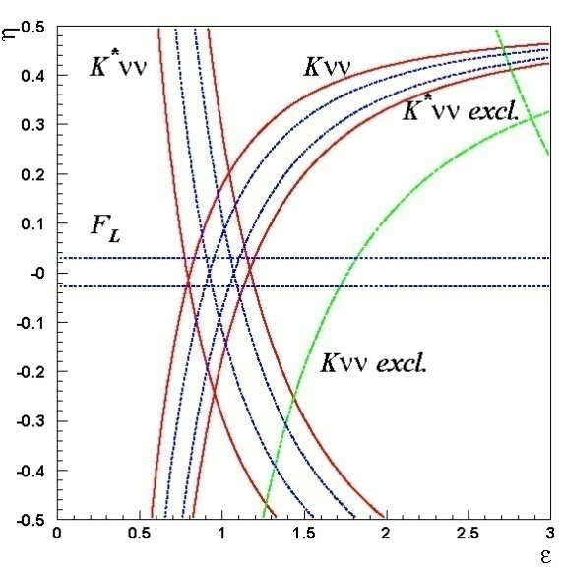
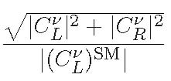
Missing energy
Introduction | Inclusive
 | Neutrals
E_{miss} | Summary
B⁺ → τν
projected accuracy on B(B⁺ →τ⁺ν)
corresponding |V_{ub}| uncertainty
(experimental):
semil. tag, 50 ab⁻¹: 4.5%
hadr. tag, 50 ab⁻¹: 3.5%
B. Golob, K. Trabelsi, P. Urquijo,, Belle2-note-ph-2015-002
B →K(*)νν
Br‘s expected to be „measured“ to 30%
5x10⁻⁶
approx. expected
precision @ 50 ab⁻¹
SM
W. Altmannshofer et al., arXiv:0902.0160

Slide 34





Introduction | Inclusive
 | Neutrals
E_{miss} | Summary
SuperKEKB
SuperKEKB
σ_{x}~10μm,σ_{y}~60nm
σ_{x}~100μm,σ_{y}~2μm
Nano beams design
(P. Raimondi)
e⁻
e⁺
∫L dt
[ab⁻¹]
β*: beta-function (trajectories
envelope) at IP
ξ_{y}: beam-beam parameter
∫L dt=50 ab⁻¹ (2022-2023)
small β_{y}*
large ξ_{y} ∝ √(β_{y}*/ε_{y}) ⇒ small ε_{y}
hourglass effect ⇒ small β_{x}*
increase I
∫L dt=10 ab⁻¹ (2018-2019)
current B factories
L
[s⁻¹cm⁻²]
design L=8·10³⁵ s⁻¹cm⁻²
magnet installation
for SuperKEKB;
Being built on schedule

Slide 35









Introduction | Inclusive
 | Neutrals
E_{miss} | Summary
Introduction
SuperKEKB
e⁺
Belle II
New IR
New superconducting /permanent final focusing quads near the IP
New beam pipe
& bellows
Replace short dipoles with longer ones (LER)
e⁻
Add / modify RF systems for higher beam current
Low emittance positrons to inject
Redesign the lattices of HER & LER to squeeze the emittance
Positron source
Damping ring
Low emittance gun
Low emittance electrons to inject
New positron target / capture section
TiN-coated beam pipe with antechambers

Slide 36




Introduction | Inclusive
 | Neutrals
E_{miss} | Summary
Introduction
Installation of 100 new long LER bending magnets done
Installation of HER wiggler chambers in Oho straight section is done.
Damping ring tunnel: built!

Slide 37



Accelerator
Introduction | Inclusive
sin2φ₁ | Neutrals
E_{miss} | General requirements
Accelerator
BF, KEKB @ KEK / PEPII @ SLAC
Belle ∫Ldt ≈ 1020 fb⁻¹
BaBar ∫Ldt ≈ 550 fb-1
b
B_{d}⁰, B⁺
b
energ. threshold
for BB production
Υ(4S)
u,d
b
σ(e⁺e⁻→hadrons) [nb]
b
B_{d}⁰, B⁻
u,d
“on resonance” production
e⁺e⁻ → Υ(4S) → B_{d}⁰B_{d}⁰, B⁺B⁻
σ(e⁺e⁻ → BB) ≈ 1.1 nb (~10⁹ BB pairs Belle)
”continuum” production, qq, ll, ττ
σ(e⁺e⁻ → c c) ≈ 1.3 nb (~1.3x10⁹ X_{c}Y_{c} pairs Belle)
e⁻
γ*
f
(hadrons)
e⁺
f
(hadrons)
running at Y(nS), e.g. Y(5S) (B_{s}B_{s})

