Slide 1


The Software Library of the Belle II Experiment
Doris Yangsoo Kim
Soongsil University
On behalf of the Belle II Software Group
July 4, 2014
ICHEP 2014 Valencia Spain

Slide 2

The Super B Factory Project
Upgrade of KEKB/Belle
 | KEKB |  | SuperKEKB
Luminosity: | 2.1x10³⁴ | → | 8x10³⁵ | (x 40)
Total Data: | 1 ab⁻¹ | → | 50 ab⁻¹ | (x 50)
Detector: | Belle | → | Belle II
For details, please refer to Prof. Thomas E. Browder’s
Plenary Session talk on July 7 9:00 am
“CP violation and B physics: Experimental results and future prospects”

Slide 3
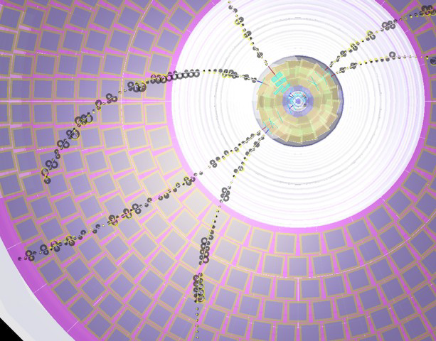
The Belle II Software System
A “framework” system with dynamic module loading, parallel processing, Python steering, and ROOT I/O
Use of GRID with Dirac (Dr. Silvio Pardi’s talk on July 3)
Full detector simulation with Geant4
Tracking with
  Old Belle algorithm
  New including Legendre finder
Alignment with Millepede II
  Testbeam utilized.
Dedicated Database studies
PID tools
Analysis tools

Slide 4
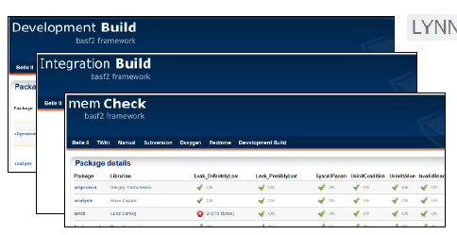
User Interface
Code management systems at KEK: The Subversion software
All common linux operating systems supported: SL, Fedora, Ubuntu, etc
C++ 11 and gcc 4.7
Formatting tool: astyle
Building: scons and buildbot system
Documentation: Doxygen, Twiki
Issue tracking: Redmine

Slide 5
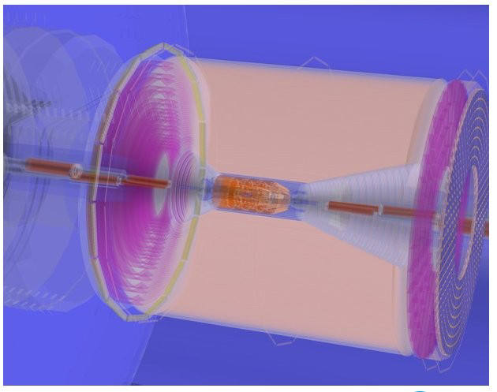
The Upgrade of the Software from Belle
BASF2 (Belle AnalysiS Framework 2)
Basic ideas from the Belle software system + Constructed from scratch.
Old system: C++. Custom storage format to store data.
New system: C++ based. ROOT I/O
Imported useful concepts from
other experiments:
ILC, LHCb, CDF, and Alice
Third-party software libraries:
Geant4, ROOT, boost, CLHEP,
and many others.
Software developers are from all around the world.

Slide 6
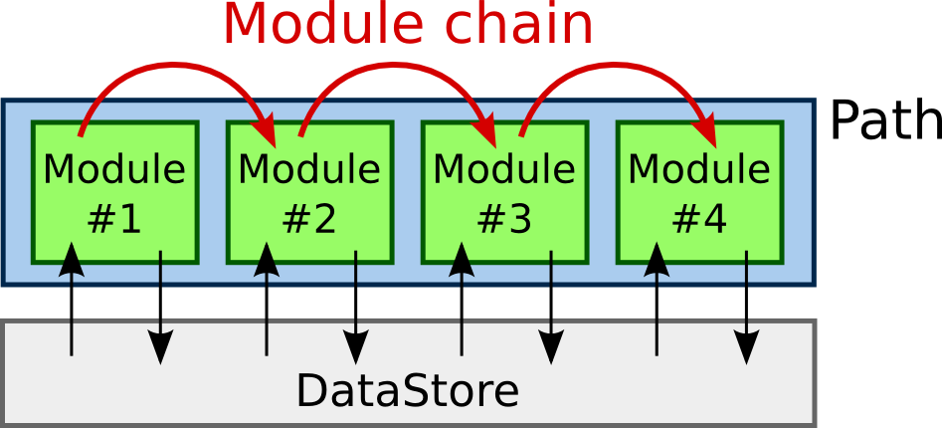
The Basic Structure of BASF2
Module: The basic processing unit
  Examples: As simple as reading data from a file
  to complex ones like simulation or tracking
  All the works are done in modules.
  Selection and arrangement of the modules are done by a user.
A typical event processing = a linear chain of modules on a path
Datastore: A common storage for data

Slide 7
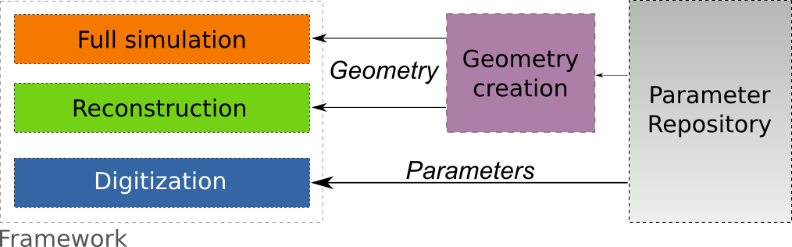
Geometry Handling System
VGM
C++
XML
All the geometry parameter values are stored in the central repository.
The actual geometry for simulation is created from the repository parameters via C++ algorithms.
For reconstruction, it is converted to ROOT TGeo via VGM library.
Parameter values are directly available to users. Easy maintenance and quick updates possible.

Slide 8
Scheme of Detector Simulation
Simulation Steering File
from basf2 import *
# geometry parameter database
…
# detector geometry
…
# detector simulation
…
# background mixing
…
# PXD simulation (digitization, clustering )
…
# SVD simulation (digitization, clustering)
…
# Other sub-detectors here.
…
Main Steering File
from basf2 import *
main = create_path()
# event meta data
main.add_module(event_meta_demo)
# generator (evtgen, particle gun, etc.)
…
# simulation
…
# reconstruction
…
# output
…
process(main)

Slide 9
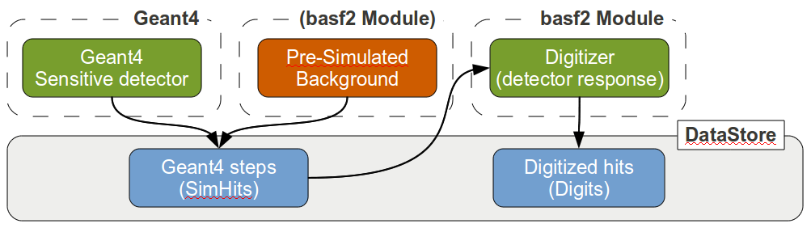
Background Mixing
Pre-simulated Geant4 background hits are added as SimHits
(Geant4 steps) to the already existing SimHits from the signal event.
The background event could be fromTouscheck, Bhabha, etc.
Then both contributions are merged and digitized at the same time.
Pros: Closer to reality.
Cons: Can’t be used for measured background data.

Slide 10
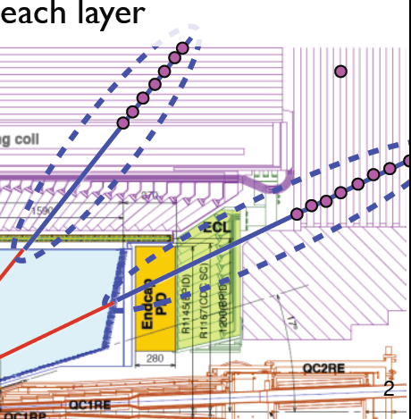
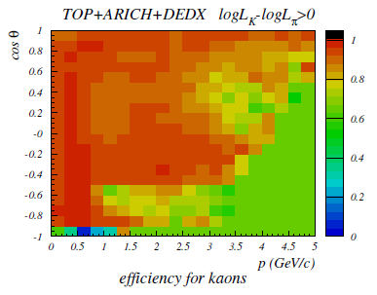
PID Tools
Tools in development:
Neutrals (π⁰, photon, K_{L}, K_{S})
Charged (e, μ, π±, K±, p), deuteron
Central track + muon hits with Kalman filter

Slide 11
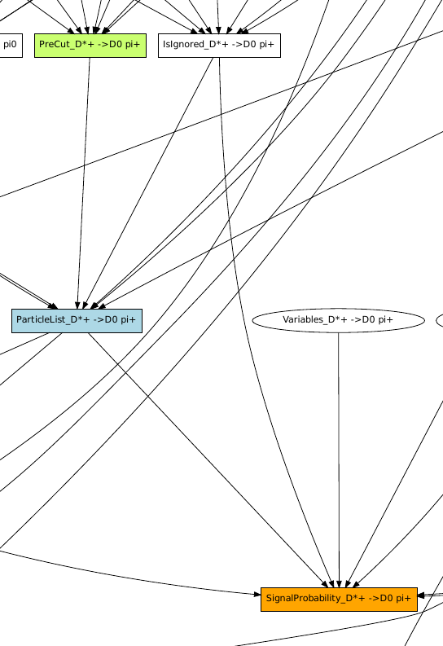
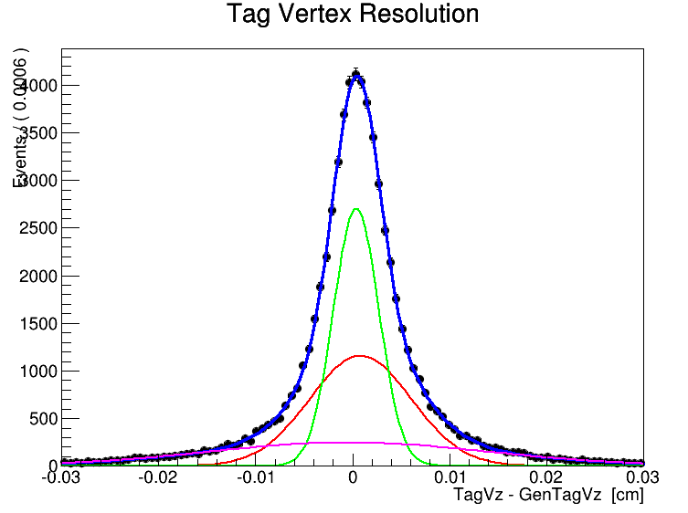
Analysis Tools for Physics
Tools in development:
Particle Class
Continuum suppression
B Tag vertexing
Flavor tagging
Full reconstruction
Many others.

Slide 12
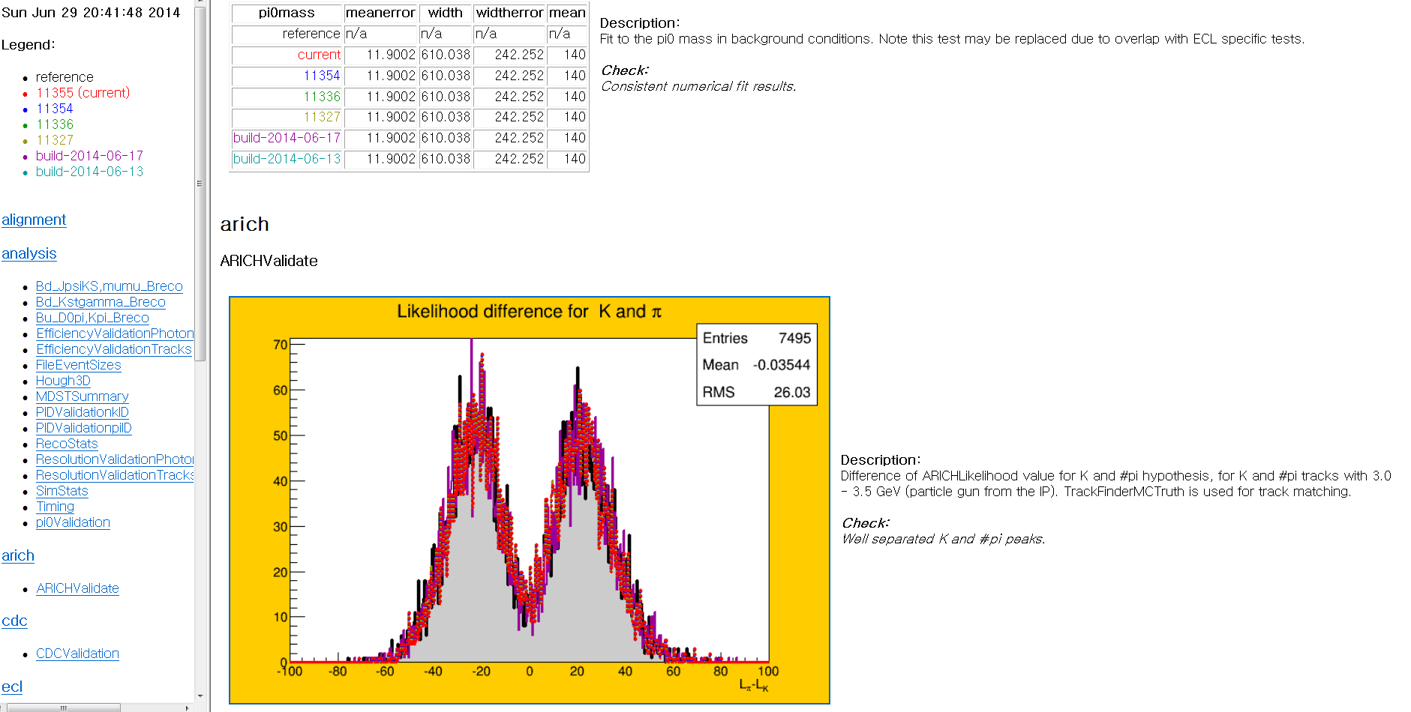
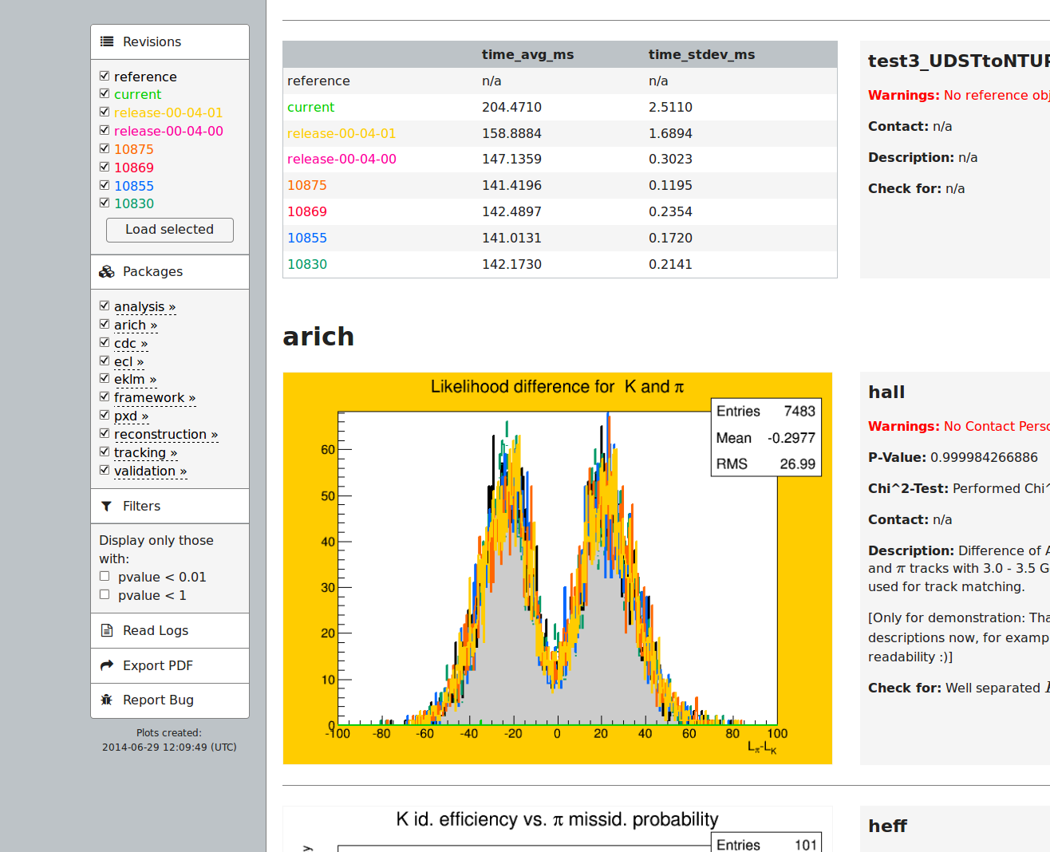
Validation

Slide 13
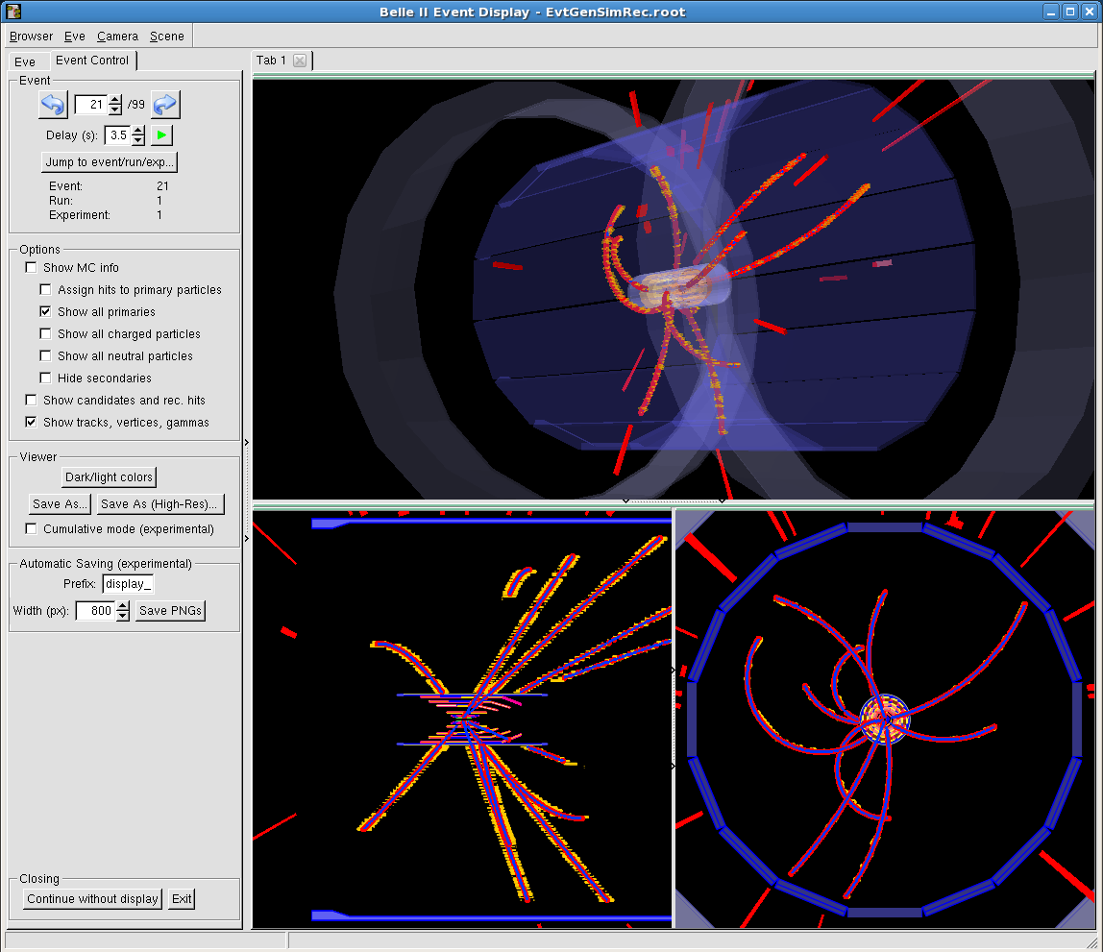
Event Display
Basf2 + ROOT with OpenGL support

Slide 14
Summary
Belle II Experiment:
Over 600 scientists. 96 institutions. 26 countries.
Active development in software:
Many ideas are tested and merged into stable library packages.
Regular runs of MC campaign as challenge data
(Dr. Silvio Pardi’s talk on July 3).
The basf2 library = ~250k lines of C++ code (excl. comments)
+ Python, external sw libraries, etc.
Many thanks for the colleagues who provided valuable ideas, data and plots for this talk.
14

Slide 15
Extra Slides

Slide 16
Challenges to Belle II
Higher background ( × 10~20 of KEKB).
  Touscheck scattering
  Radiative Bhabha
  2-photon
  More radiation damage, fake hits, pile-up
Higher event rate ( ×10)
  L1 trigger rate: ~20 kHz
Improvements planned:
  Better hermitricity.
  Better IP and secondary vertex resolution.
  Better PID.
II

Slide 17
The Belle II Detector
KL and muon detector:
Resistive Plate Counter (barrel outer layers)
Scintillator + WLSF + MPPC (end-caps , inner 2 barrel layers)
7.4 m
EM Calorimeter:
CsI(Tl), waveform sampling (barrel)
Pure CsI + waveform sampling (end-caps)
Particle Identification
Time-of-Propagation counter (barrel)
Prox. focusing Aerogel RICH (fwd)
electrons (7GeV)
Beryllium beam pipe
2cm diameter
Vertex Detector
2 layers DEPFET + 4 layers DSSD
positrons (4GeV)
Central Drift Chamber
He(50%):C2H6(50%), small cells, long lever arm, fast electronics

Slide 18
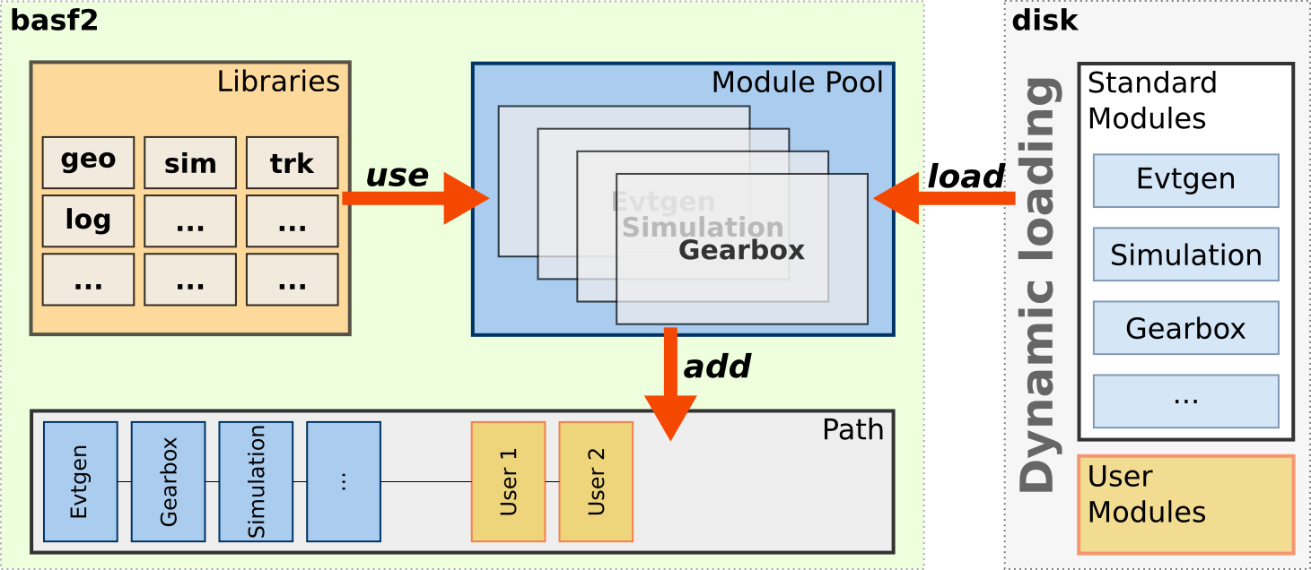
Libraries vs Modules
Libraries: Separated from modules to increase reusability.
  Methods and algorithms are encapsulated in libraries.
  A library (i.e, algorithm) can be used/shared by several modules.

Slide 19
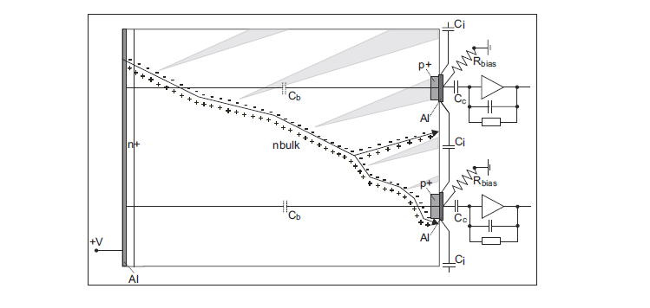
Digitization Software
Detailed information on the detector material and electronics is needed: Sub-detector experts write the digitization code.
Coded as modules rather than complete integration into Geant4: Different versions of sub-detector digitization would be available.
Digitization in the silicon vertex detectors.

