Slide 1
SuperKEKB/Belle II upgrades
T. Browder, University of Hawai’i, Belle II
Review of SuperKEKB/Belle II
Current Performance (Where we are so far).
Program for the next ten years to reach Int(Ldt) =50ab⁻¹ at the ϒ(4S), which will enable major breakthroughs in NP searches. See the 689 page Belle II physics book,
https://arxiv.org/abs/1808.10567
Electron beam Polarization upgrade
Linac energy upgrade to reach the Lambda_b-pair threshold (11.24 GeV)
We welcome international collaboration on SuperKEKB and its upgrades. Synergies with other accelerator projects can be discussed further (e.g.FCC-ee, LHC, EIC etc) within the Snowmass process.
N.B. the crab-waist, implemented at SuperKEKB in 2020, was one of the concrete results of such synergistic discussions in recent years.

Slide 2
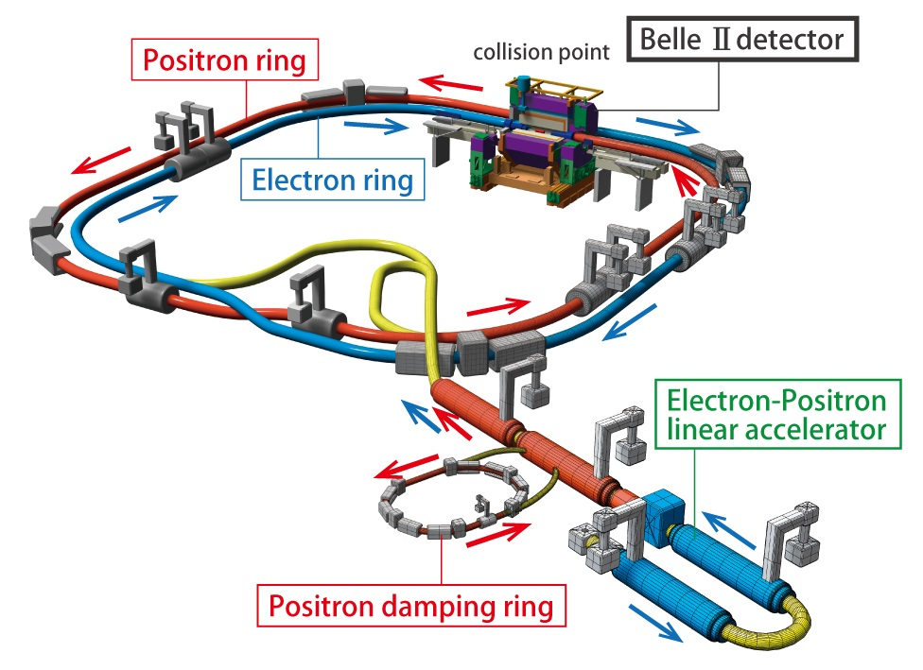
SuperKEKB, the first new collider in particle physics since the LHC in 2008 (electron-positron (e⁺e⁻) rather than proton-proton (pp)). The beam energies are 7 GeV e⁻ on 4 GeV e⁺ with a boost (βγ~0.28).
Phase 1: Background, Optics
Commissioning
Feb-June 2016.
Brand new
3 km positron ring.
Phase 2: Pilot run without VXD, add
Superconducting Final Focus, add positron damping ring,
First Collisions (0.5 fb⁻¹).
April 27-July 17, 2018
Phase 3: → Physics running (spring 2019, fall 2019, spring 2020).
Have integrated 74 fb⁻¹ so far.
Accelerator innovations: nano-beams and crab waist optics (implemented in 2020)
Notes:
Only read the underlined points. This ~400 oku-yen (million dollar) upgrade was provided entirely by KEK and Japan. Cooperation with industrial partners, Hitachi and Mitsubishi is essential.

Slide 3
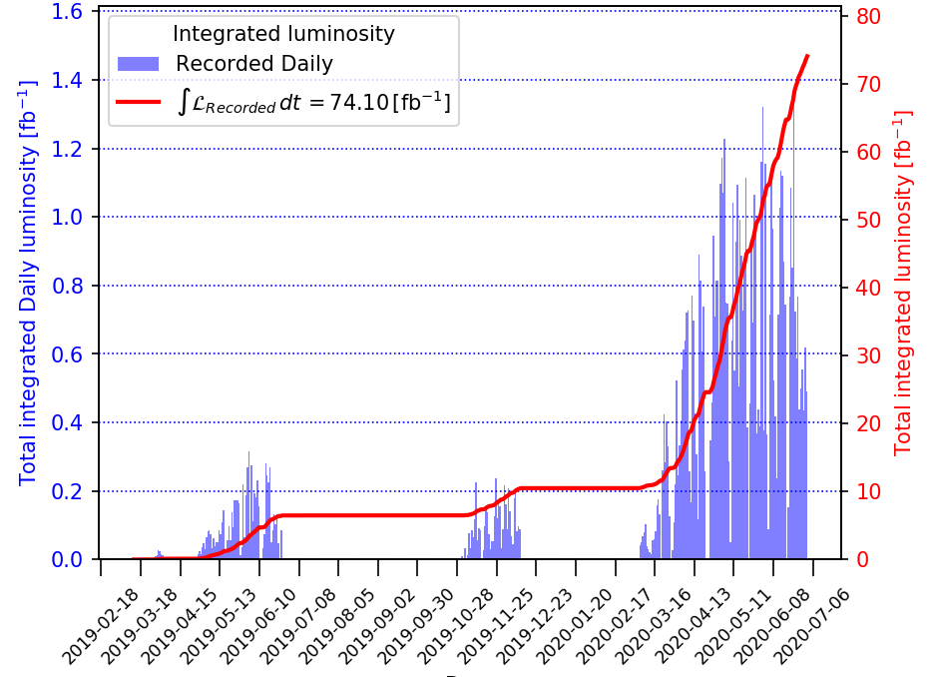
Belle II Integrated Luminosity
Operates primarily at ϒ(4S), with 10% of data taken on continuum,
New world record, above the B factories (twice PEP-II) and LHC. Product of beam currents a factor of ~5 lower.
Smallest β*_{y} =1mm.
L_{peak}=2.4 x 10³⁴/cm²/sec
Belle II routinely integrates more than 1 fb⁻¹/day,
peak so far 1.3 fb⁻¹/day (c.f. PEP-II 0.911 fb⁻¹/day, KEKB 1.5 fb⁻¹/day)
Also see https://cerncourier.com/a/kek-reclaims-luminosity-record/
Notes:
This new scheme of operation worked well. World record and a data sample a factor of ten larger than what was integrated in the fall.

Slide 4
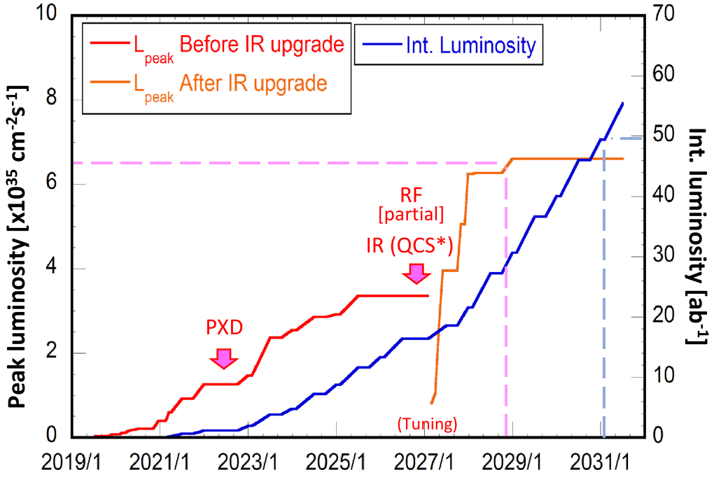
Updated plan for SuperKEKB submitted to the MEXT Roadmap Committee
2026
2022
Four steps: Intermediate luminosity (1-2 x 10³⁵ /cm²/sec, 5ab⁻¹);
High Luminosity (6.5 x 10³⁵/cm²/sec, 50 ab⁻¹) with a detector upgrade
Polarization Upgrade, Advanced R&D (See talk by M. Roney)
Ultra high luminosity (4 x 10³⁶/cm²/sec, 250 ab⁻¹), R&D Project
Notes:
To be discussed at Snowmass 2021

Slide 5
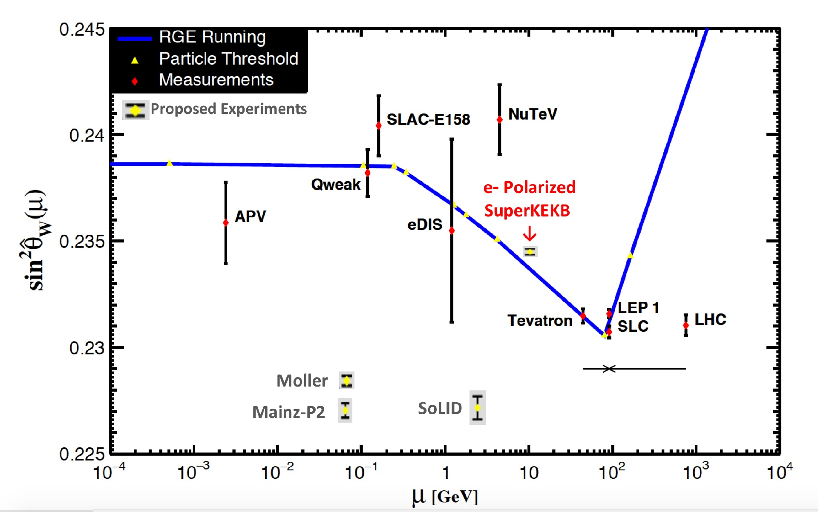
Upgrading SuperKEKB with Polarized e- Beams
Physics case: precision sin² θ_{W} measurements from
b, c, e, μ & τ, probing its running and universality
(see M. Roney’s talk in this session). Planning 70% polarization
with 80% polarized source (cf 75% @SLD)
NEW HARDWARE FOR POLARIZATION UPGRADE:
Low emittance polarized Source: electron helicity can be flipped bunch-to-bunch by controlling circular polarization of source laser illuminating a GaAs photocathode (à la SLC). Inject vertically polarized electrons into the 7 GeV e- Ring, needs low enough emittance source to be able to inject.
Spin rotators: Rotate spin to longitudinal before Interaction Point (IP) in Belle II, and then back to vertical after IP using solenoidal and dipole fields
Compton polarimeter: monitors longitudinal polarization with <1% absolute precision, higher for relative measurements (arXiv:1009.6178) - provides real time polarimetry. → Use tau decays from e⁺e⁻→ τ ⁺ τ⁻ measured in Belle II to provide high precision absolute average polarization at IP.
Belle II
Planning for implementation ~2026 in mid-decade upgrade window for new final focus; This upgrade proposal to be included in KEK Roadmap for MEXT to be submitted 2021
e- spin vector around ring

Slide 6
Backup Slides

Slide 7
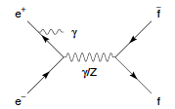
Precision Neutral Current Electroweak Program with SuperKEKB Upgraded to have Polarized e⁻ Beams
At 10.58 GeV, e⁻ polarization enables A_{LR} measurements sensitive to Z-γ interference
20ab⁻¹ and 70% polarization at IP gives:
World’s most precise sin² θ_{W} (σ (sin² θ_{W} ) ~ 0.00016) and probe of its running
Unprecedented and clean NC universality studies for e, μ, τ, b and c since beam polarization error cancels (e.g. < 0.05% relative error for b-to-c, cf 4% now)
sin² θ_{W} with light quarks at 10.58GeV
Sensitivity to Z’>TeV scale and dark sector parity-violating Z’_{D} below M_{Z}
More information at
arxiv.org/abs/1907.03503
Beyond EW e- polarization at SuperKEKB:
enables more precise τ EDM and (g-2)_{t},
reduces backgrounds in τ→μγ and τ→e γ searches and distinguishes Left & Right handed New Physics currents
can be used to probe dynamical mass generation in QCD via polarized L
To be proposed for implementation ~2026 with upgrade proposal to be included in KEK Roadmap for MEXT to be submitted in 2021

Slide 9
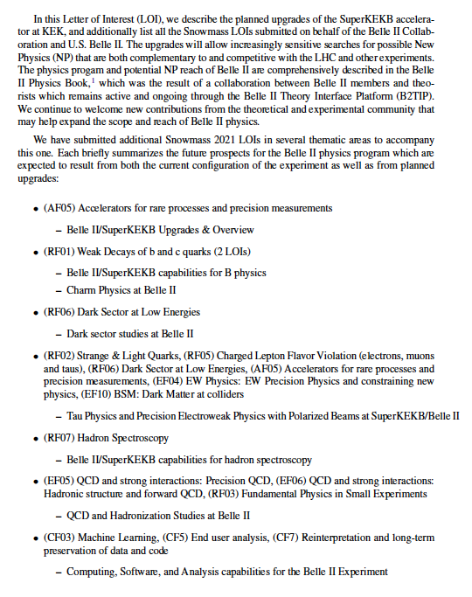

Slide 10
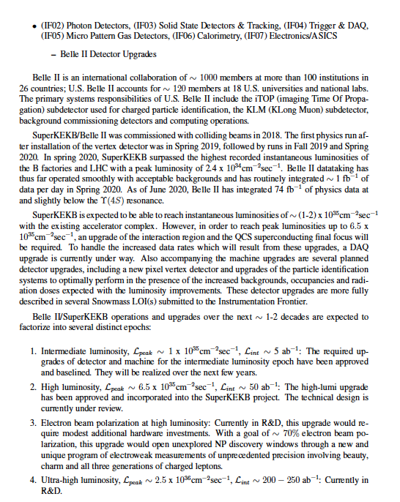

Slide 11
