Slide 1




The start of the Belle II experiment at the SuperKEKB e⁺e⁻ factory
Bostjan Golob
University of Ljubljana/
Jozef Stefan Institute
also with
Introduction
B-Factories
Belle II
Luminosity
Performance
Measurements
University
of Ljubljana
“Jozef Stefan”
Institute
3rd Jagiellonian Symposium on
Fundamental and Applied
Subatomic Physics
Krakow
23 - 28 June 2019

Slide 2
Introduction
Setting the scene
electromagnetic
weak
strong
gravitational
The Standard Model (SM) of basic interactions in Nature -
- one of the experimentally best verified physics theories...
...at the current level of experimental precision and energies reached
Several severe shortcomings, for example
degree of CP asymmetry between particles and anti-particles;
responsible for matter dominated Universe,
tested in subatomic world;
10 orders of magnitude too low to explain the matter / anti-matter
asymmetry of Universe
search for physics phenomena beyond SM,
new particles, and new interactions often addressed as
New Physics (NP)

Slide 3
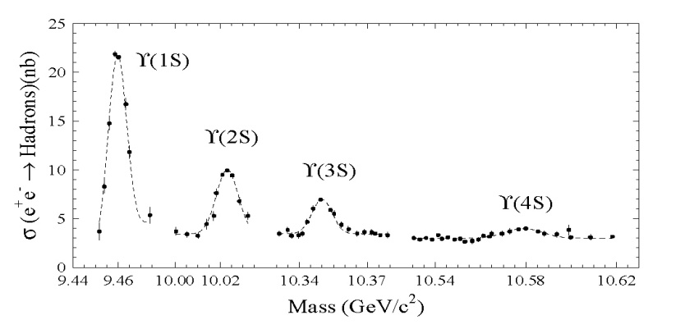
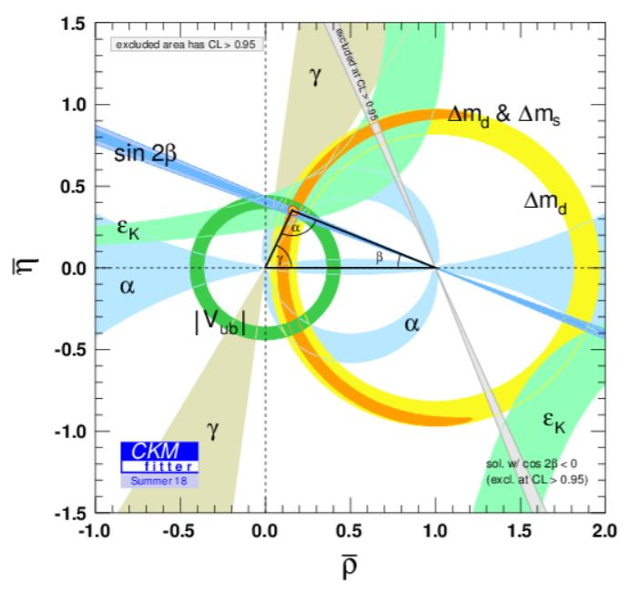
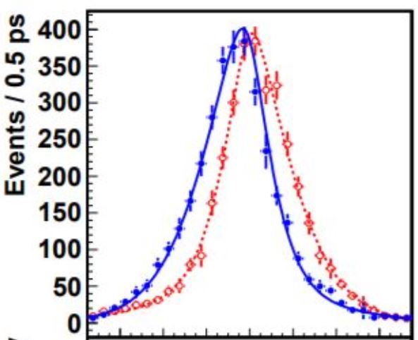
B Factories
TEST of Kobayashi-Maskawa
Mechanism
B-Factories, e⁺e⁻:
BaBar (SLAC)/Belle (KEK)1999 – 2010
L_{max}=2.1 ⋅10³⁴ cm⁻²s⁻¹
Belle: N(BB) ≈770 ⋅10⁶
sin2φ₁ from B →J/ψ K_{S}
B⁰→
J/ψK_{S}
B⁰→
J/ψK_{S}
√s=10.58 GeV
e⁻
e⁺
Υ(4S)
n.b.: only to Δm_{d}
32 measurements
contribute!
B
-6 -4 -2 0 2 4 6
Δt [ps]
Υ(4S)
Δz ~ cβγτ_{B}
~ 200μm
B
I. Adachi et al. (Belle Coll.), Phys. Rev. Lett. 108, 171802 (2012)
p(e⁻)=7 GeV p(e⁺)=4 GeV
βγ≠0

Slide 4
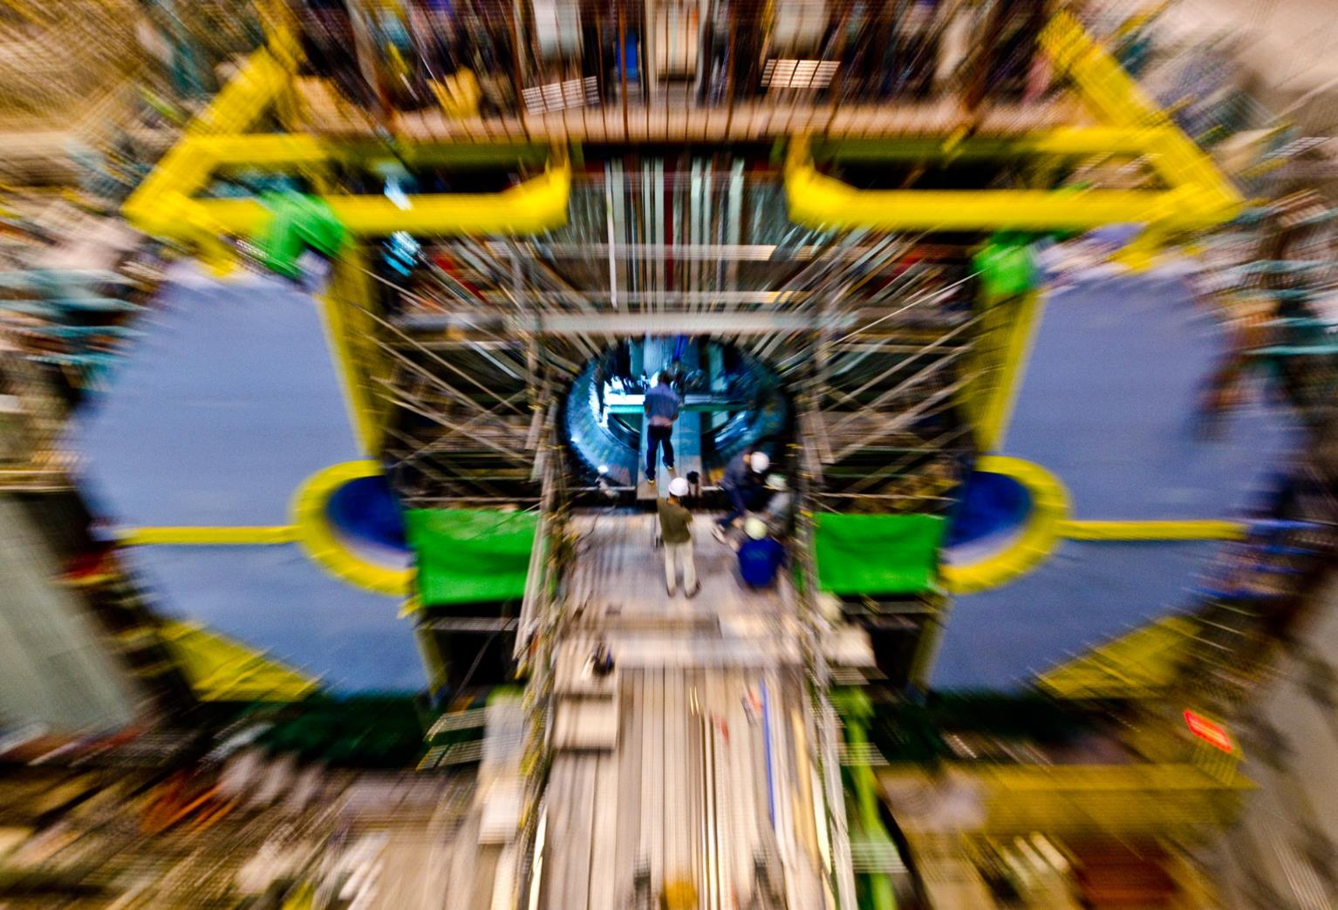
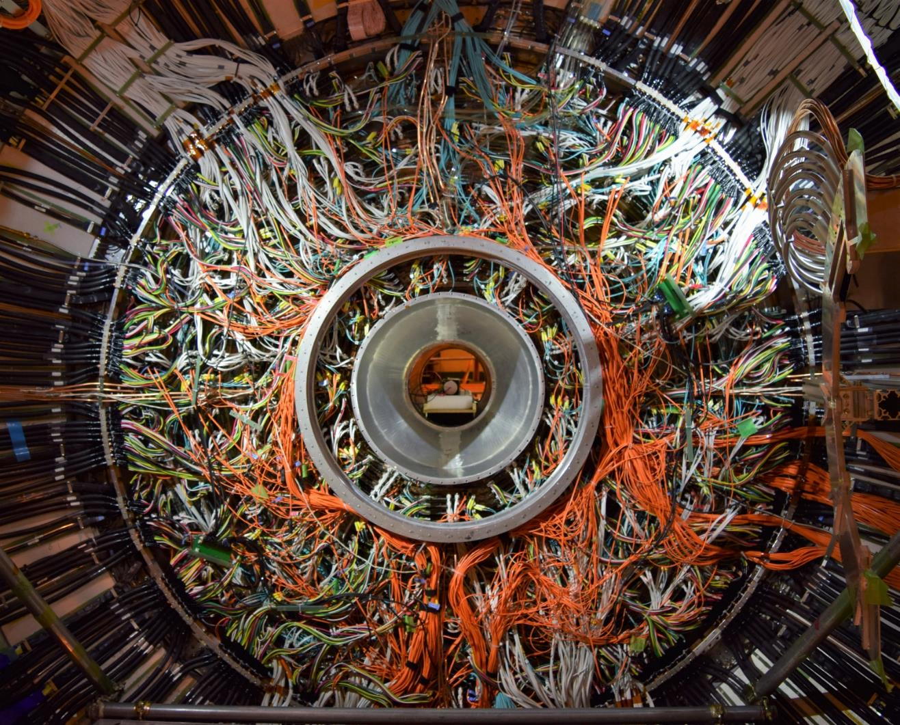
Belle II
Super B-Factory:
SuperKEKB & Belle II (KEK) 2018 →
Access B decays with ε_{rec} Br >~10⁻⁹
(e.g.
ε_{rec} Br(B →η‘K_{S}) ~ 1 ⋅10⁻⁶
ε_{rec} Br(B →X_{d}γ) ~ 1 ⋅10⁻⁷
ε_{rec} Br(B →X_{u}τν) ~ 4 ⋅10⁻⁸
ε_{rec} Br(B →K⁽*⁾νν) ~ 7 ⋅10⁻⁹
)
L=2 ⋅10³⁴ cm⁻²s⁻¹
→
L=8 ⋅10³⁵ cm⁻²s⁻¹
N(BB) ≈ 50 ⋅ N _{Belle}(BB)
explore possible deviatons from
SM prediction
appearing in some rare decays

Slide 5
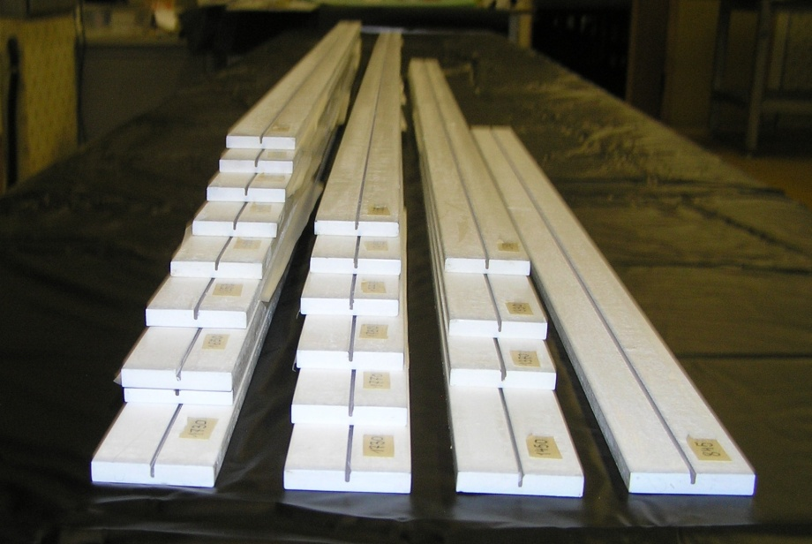
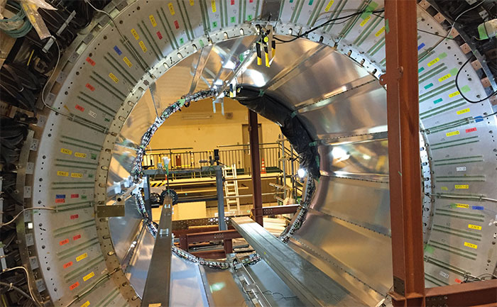
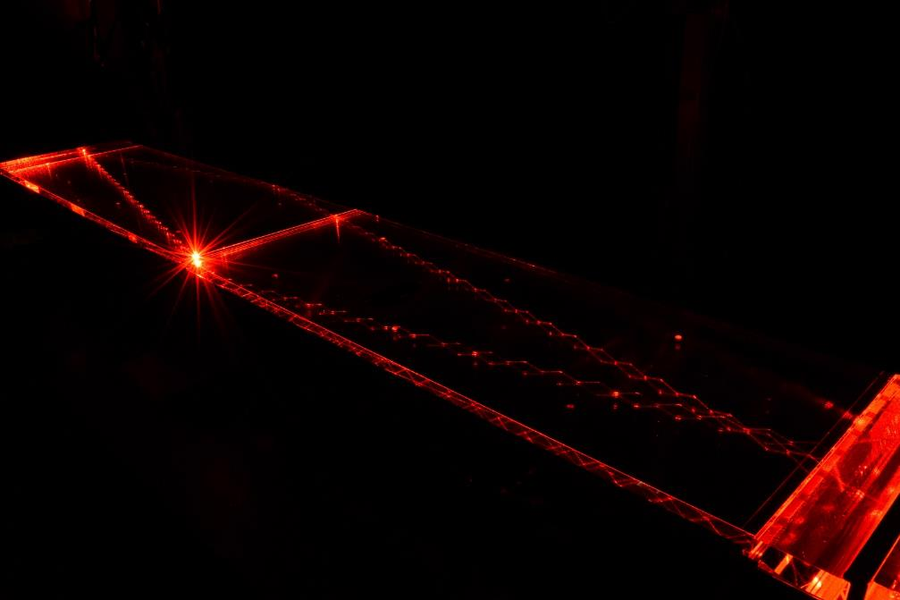
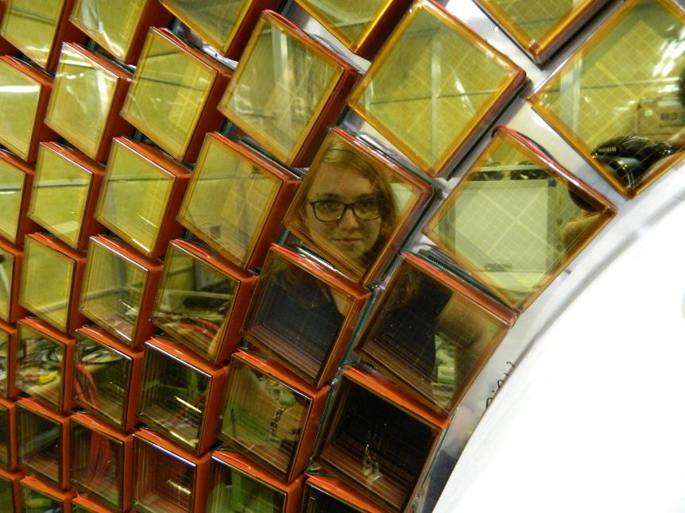
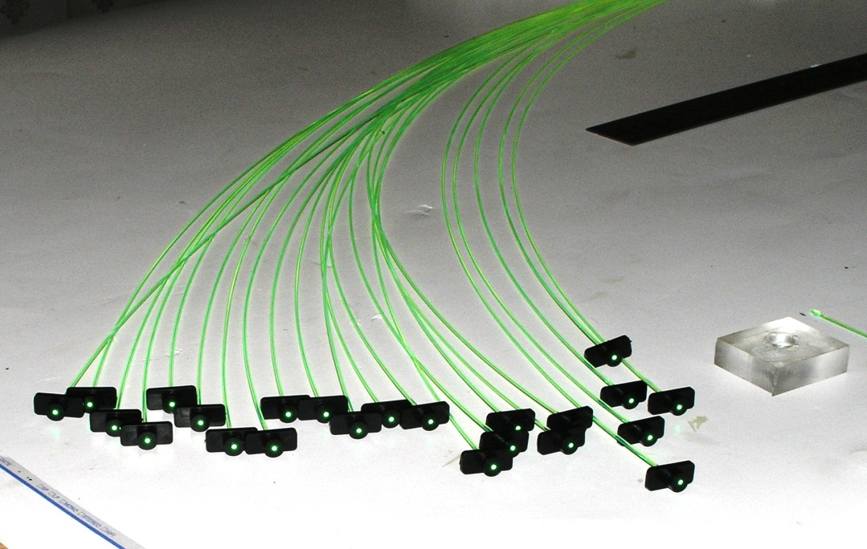
Belle II
Detector Belle II
KL and muon detector:
Resistive Plate Counter (barrel outer layers)
Scintillator + WLSF + MPPC (end-caps , inner 2 barrel layers)
EM Calorimeter:
CsI(Tl), waveform sampling (barrel)
Pure CsI + waveform sampling (end-caps)
Particle Identification
Time-of-Propagation counter (barrel)
Prox. focusing Aerogel RICH (fwd)
electrons (7GeV)
Beryllium beam pipe
2cm diameter
Vertex Detector
2 layers DEPFET + 4 layers DSSD
positrons (4GeV)
Central Drift Chamber
He(50%):C2H6(50%), small cells, long lever arm, fast electronics

Slide 6
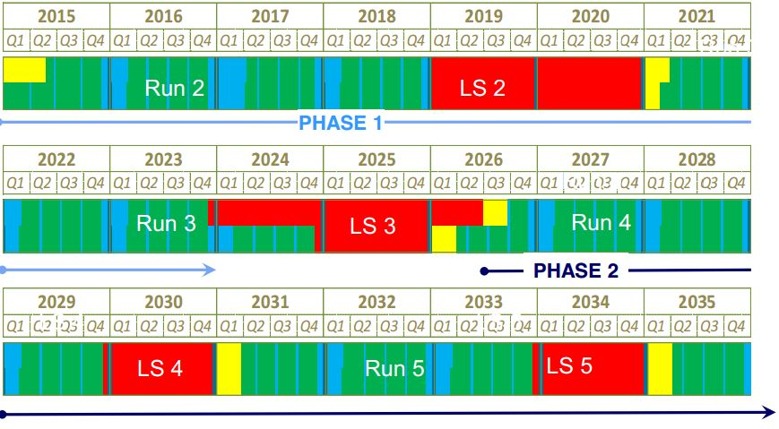
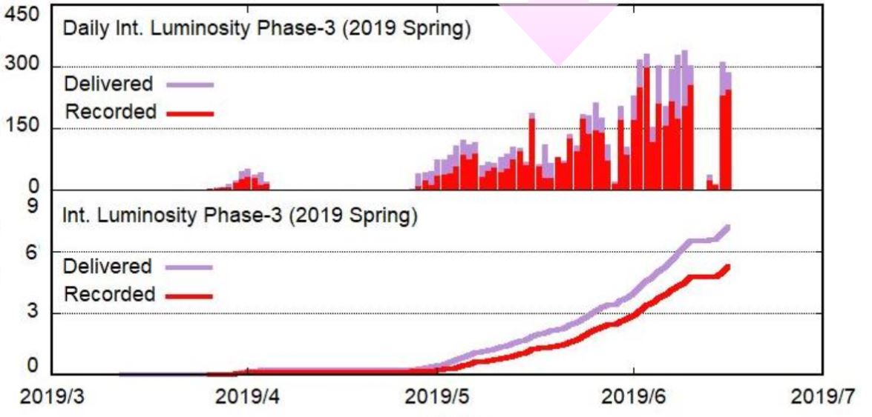
Luminosity
Luminosity plans
end
^{07/19}
start
^{03/19}
start
^{10/19}
end ?
^{07/19}
Phase 1
Phase 2
Phase 3 →
Phase 1:
w/o QCS
w/o Belle 2
Phase 2:
w/ QCS
w/ Belle 2
(no VXD)
Phase 3:
full Belle 2
daily ∫L dt [pb⁻¹]
QCS, Belle 2
VXD
~ 50 ab⁻¹
LHCb LS2
∫L dt [fb⁻¹]
LHCb LS3
HL LHC
current issues:
fire (4/2019, not related to SuperKEKB,~2 weeks recovery)
injection bkg (reduced with machine and collimators tuning)
storage backgrounds (mainly beam-gas, vacuum scrubbing, additional pumps)
Plan:
reach KEKB luminosity in June 2020
> 100 fb⁻¹ by end of 2020 spring run

Slide 7
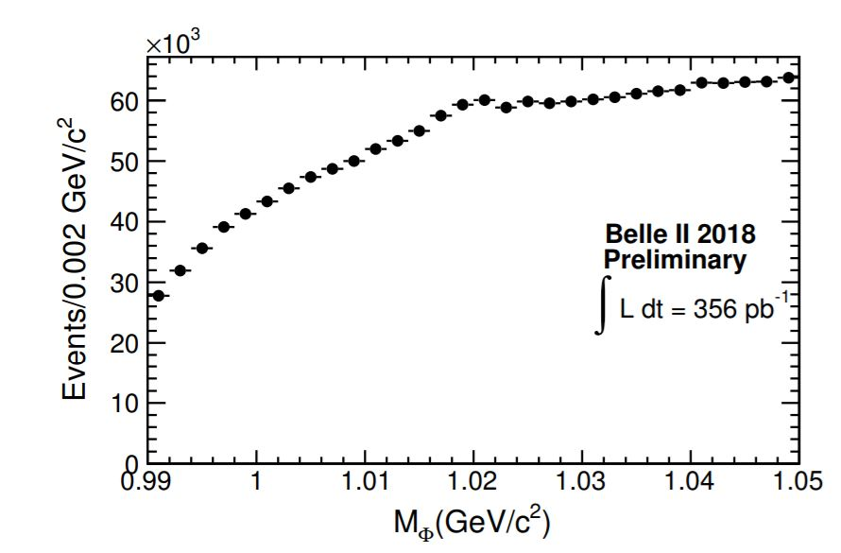
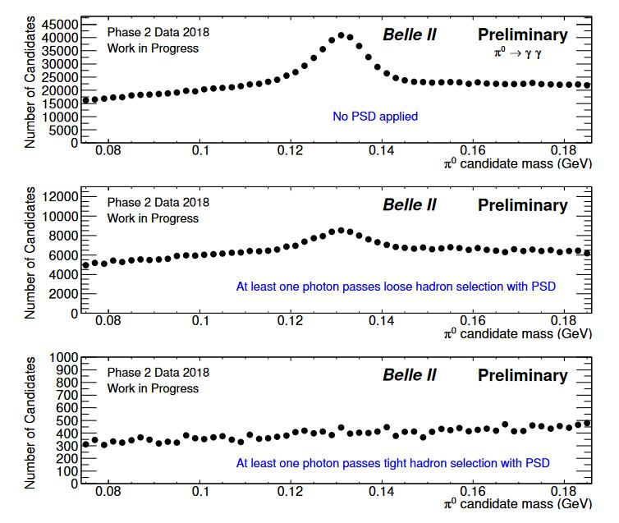
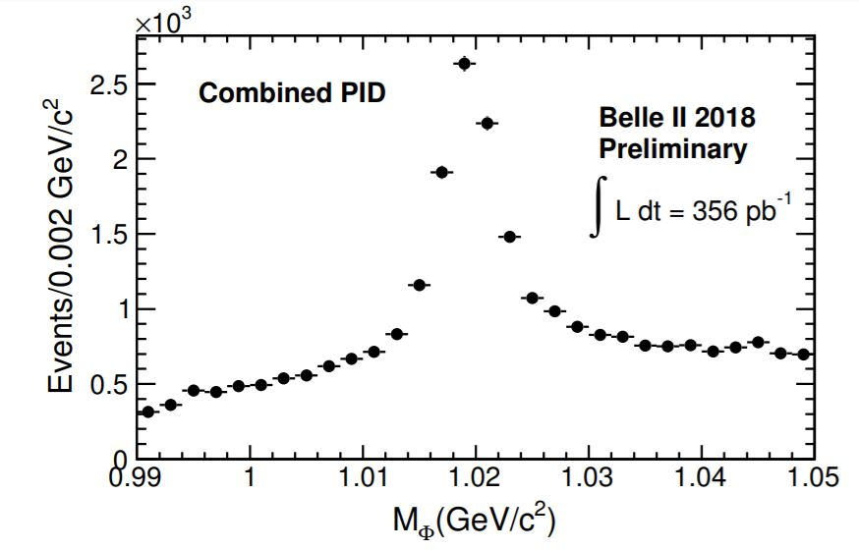
Performance
Physics performance
A. Sangal et all. (Belle II Coll.), BELLE2-NOTE-PL-2018-035
S. Longo, J.M. Roney et all. (Belle II Coll.), BELLE2-NOTE-PL-2018-027
π⁰ → γγ
φ →K⁺K⁻
no requirement on γ
at least one γ passing loose PSD
at least one γ passing tight PSD
hadron veto in ECL using
Pulse Shape Discrimination
combined pid
(TOP, CDC, ARICH)

Slide 8
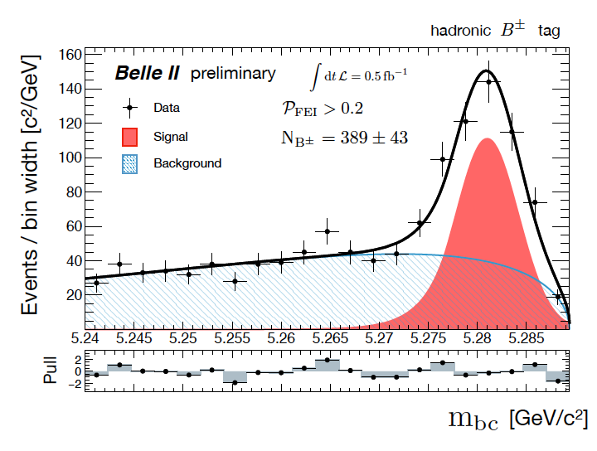
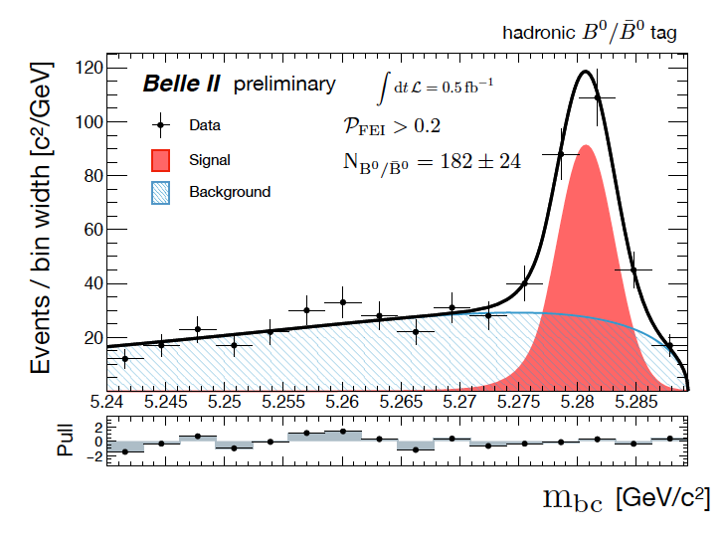
Performance
Full Event Interpretation
only a single BB pair produced @ Υ(4S)
FEI performed using MVA
ε_{tag} ~ 0.2%-0.3% @ P~50%-60%
recontruction of final
states with undetected particles
B_{tag}
detected
hadrons
e⁻
e⁺
ν
B_{sig}
K⁻
D⁽*⁾
l
π ⁺
B⁺
B⁰
W. Sutcliffe, F. Bernlochner, B2NOTE-2018-031-1

Slide 9
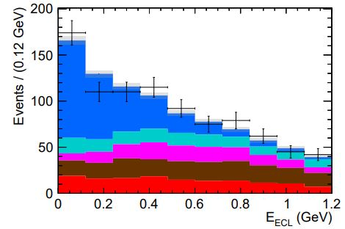
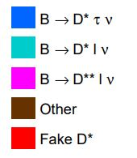
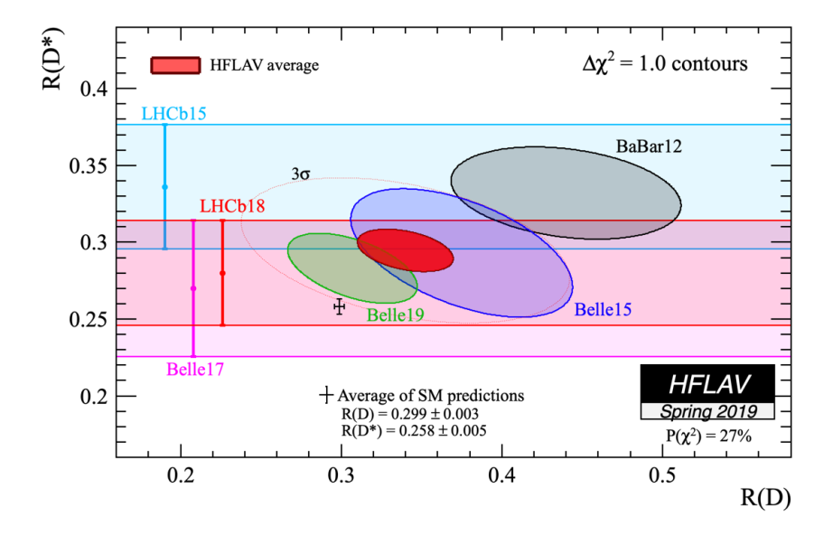
Measurements
Lepton Flavor Universality
B →D⁽*⁾ l ν
u
B⁻
D⁽*⁾⁰
τ ⁻, l = e⁻, μ⁻
b
c
D*⁺ l ⁻
N_{sig}=376 ±36
W ⁻
ν
R(D*)_{SM} = 0.252 ±0.003
S.Fajfer et al.,
Phys.Rev.D85(2012) 094025
R(D)_{SM}= 0.300 ±0.008
H. Na et al.,
Phys.Rev.D 92, 054410 (2015)
A. Abdesselam et al. (Belle Coll.),
arXiv:1904.08794
R(D)= 0.307 ±0.037 ±0.016
R(D*) = 0.283 ±0.018 ±0.014
Belle II
(50 ab⁻¹)
SM
WA
E. Kou, P. Urquijo eds., The Belle II Physics Book
to be published in Prog. Theor. Exp. Phys.

Slide 10
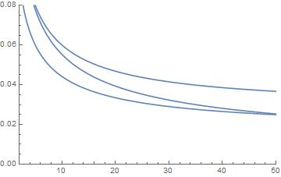
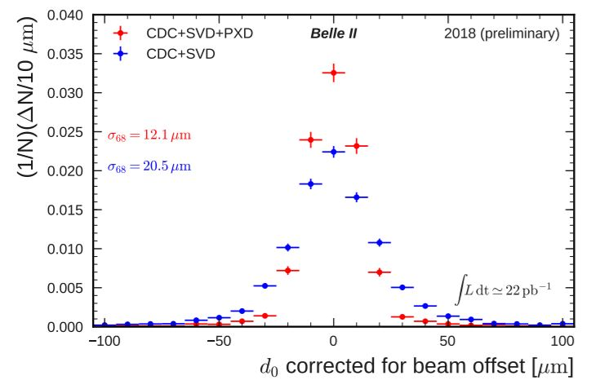
Measurements
CPV in b →sqq
some uncertainties cancel in ΔS
vtx reconstr. improved with better tracking;
ε_{rec} Br(B →η‘K_{S}) ~ 1 ⋅10⁻⁶
41 new phases in MSSM;
b →sqq B → J/ψ K_{s}
σ(sin2φ₁^{eff})
E. Kou, P. Urquijo eds., The Belle II Physics Book
to be published in Prog. Theor. Exp. Phys.
ΔS=sin2φ₁^{eff} - sin2φ₁
⊗
σ~12 μm
ω(π⁺π⁻π⁰)K_{s}
φ(K⁺K⁻)K_{s}
Belle: σ~30 μm
η‘(γγππ)K_{s}
⊗
⊗
σ(sin2φ₁) from B → J/ψ K_{s}
⊗ current th. uncertainty
∫L dt [ab⁻¹]
N. Braun et all. (Belle II Coll.), BELLE2-NOTE-PH-2018-040
M. Beneke, PLB620,143 (2005)

Slide 11
Summary
Belle & BaBar: confirmed CKM mechanism
SuperKEKB: start of data taking in 2018
luminosity gradually increasing
Belle II: ~900 members (~45% from Europe), 26 countries
detector operating as expected
search for NP
Lepton Flavor Violation
Lepton Flavor Universality
new sources of CPV
light dark matter
:
Physics (far) beyond current
theoretical understanding (SM)
Severe constraints on possible
beyond SM theories

