Slide 1
SuperKEKB and Belle II backgrounds
Tom Browder, University of Hawaii at Manoa
SuperKEKB overview
Luminosity Master Equation
(large crossing angle, nanobeam case)
State of Commissioning
Backgrounds
Mysteries + Plans
Apologies: I have extensively borrowed slides from Akai-san, Ohnishi-san, Sven-san, Nakayama-san

Slide 2
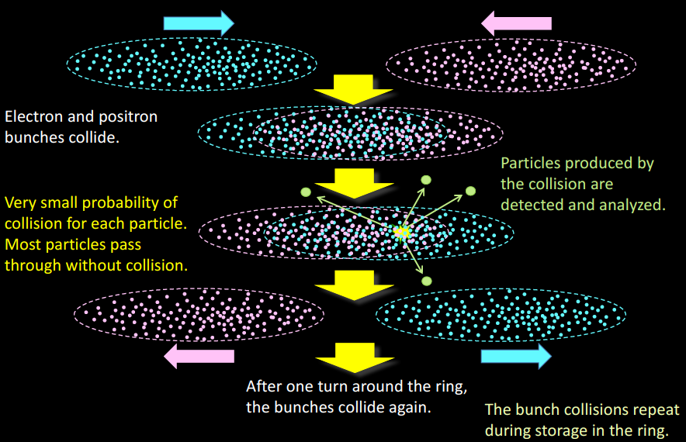
What happens in an electron-positron collider (N.B. pictures not to scale)
K. Akai

Slide 3
Recall the first and most basic “luminosity master equation”
Here σ is the electron-positron cross-section of the process of interest (a constant of Nature), L is the luminosity, which is determined by accelerator performance.
Let’s do a simple but instructive example:
So we would produce one B Bbar pair per sec (1 Hz) at this luminosity.
A Snowmass year has 10⁷ sec➔So in one Snowmass year, we produce 10⁷ b b pairs at this luminosity. This is not enough and we are not satisfied.

Slide 4
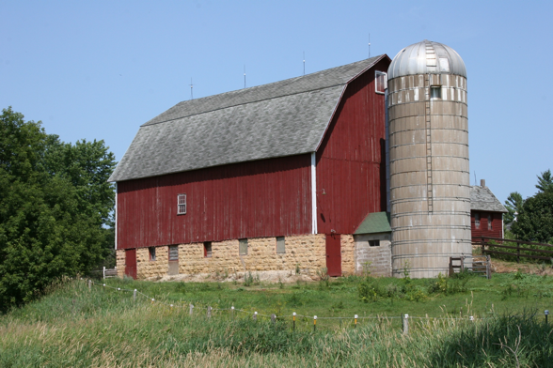
Comment on cross-sections.
No barns in Hawaii Or in Tsukuba !
1 barn = 10⁻²⁸m² and is about the size (area) of an A=100 nucleus (huge !!).
Unit invented by “Midwestern farm boy” nuclear physicists at Purdue University. Also trying to confuse the enemy during WWII. (source: FNAL symmetry magazine)
Most cross-sections in particle physics as opposed to nuclear physics are somewhat smaller than a barn and are measured in mb (“millibarns”), μb (“microbarns”), nb (“nanobarns”), pb (“picobarns”) units.
Note that hadronic cross-sections are larger but the event environment is challenging i.e. point-like particles versus smashing “Swiss watches”

Slide 5
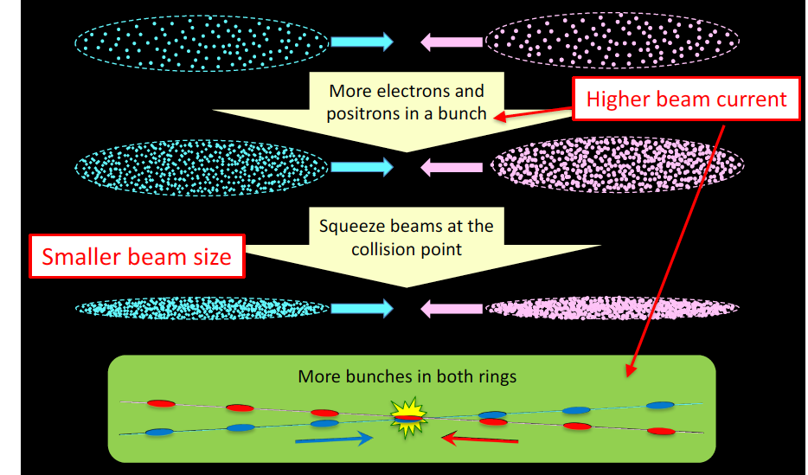
Possible Paths to Higher Luminosity
K. Akai

Slide 6
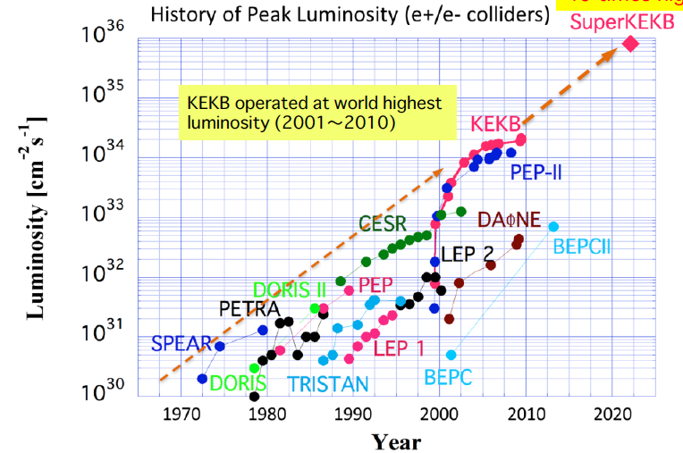
Notes:
Going for a factor of 40 improvement. Note the steady progress of CESR (more than a decade) or PEP-II or KEKB (one decade) on the vertical semi-log scale.

Slide 7
Add a factor of two more current to each beam. However, the largest improvement is from “nano-beams”.

Slide 8
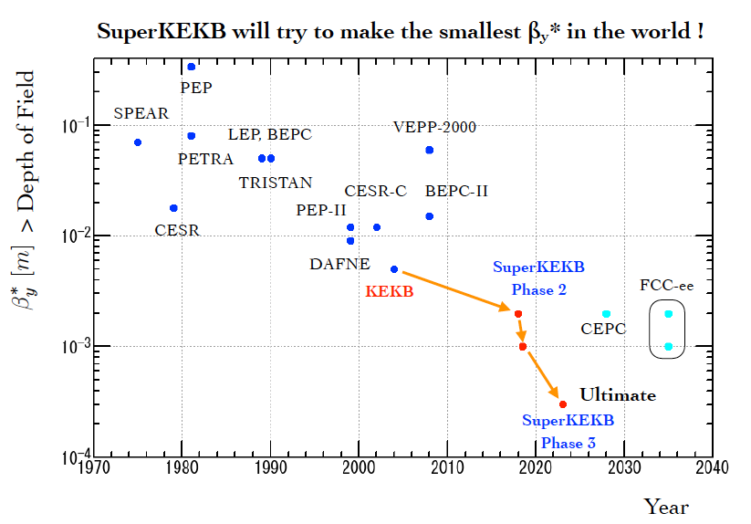
Ohnishi’s world view: It’s all about how much we can squeeze the beam with the superconducting final focus. (Note vertical scale is logarithmic)

Slide 9
More Luminosity Master Equations
Here f₀=99.4 kHz
Example: the TDR vertical emittance of the LER is 8.64 picometers with β_{y}*=0.27mm
B2SS exercise: Calculate the vertical and horizontal beam size(s) for Phase 2 cases.

Slide 10
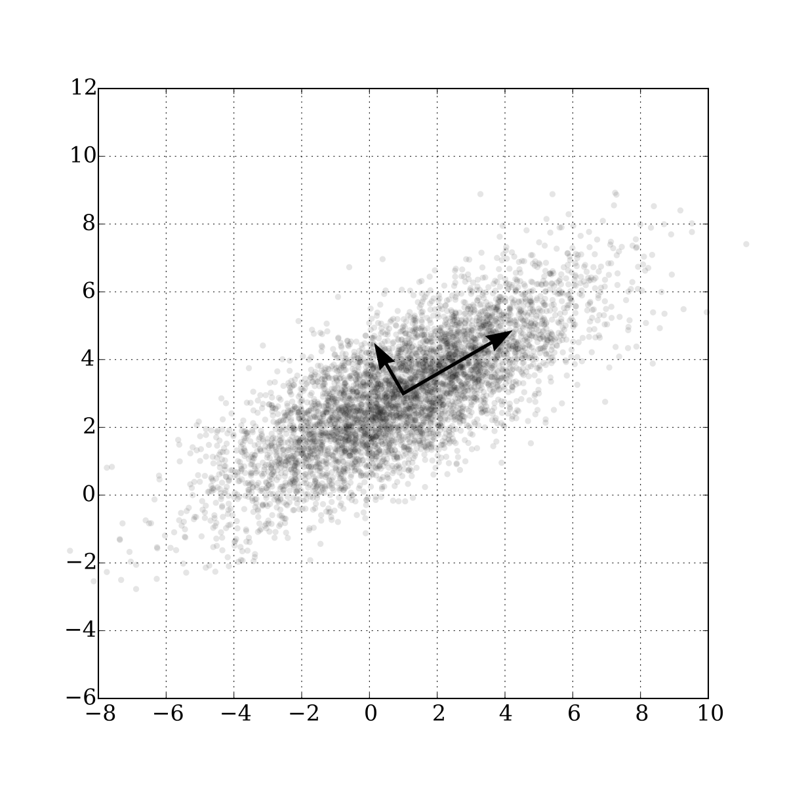
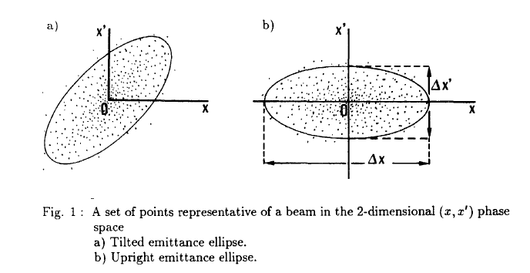
Emittance, an invariant in charged particle storage rings.
Slope p_{y}
Position y
Buon, 1990
Liouville’s Theorem states that the area of the phase space ellipse is invariant as the beam propagates around the storage ring.

Slide 11
Scaling laws from the Luminosity Master Equations
B2SS exercise: Verify this result. (Even I could do it !)
This is the beam-beam interaction parameter. (the derivation assumes flat beams and a large crossing angle).
Scaling laws: luminosity goes up as beta* is squeezed, beam-beam interaction becomes weaker

Slide 14
“A whole new 3 km LER ring”

Slide 15
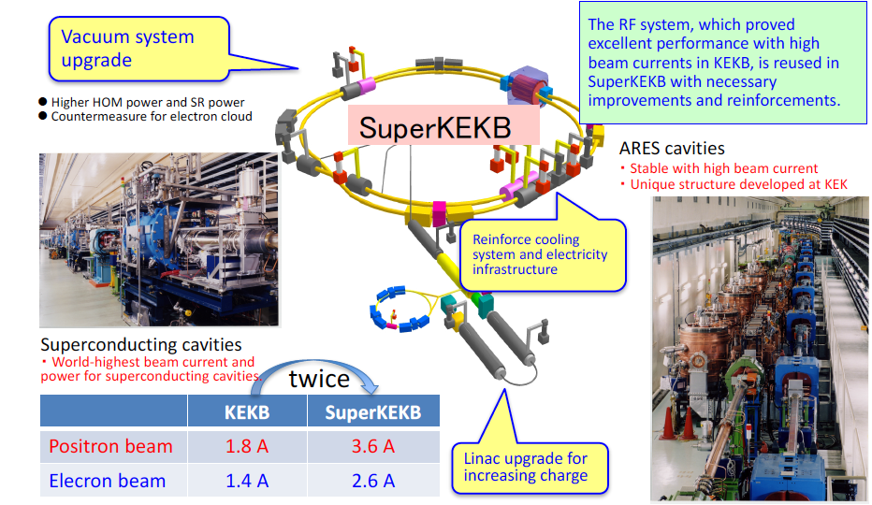
Increase beam currents: try to “keep it cool” – don’t want to melt vacuum chamber components !
Need RF cavities to replace energy lost to SR
Energy lost per turn is 1.86 MeV in the LER and 2.43 MeV in the HER
B2SS: What is the energy lost per turn in a 500 GeV, 3km circumference machine ? How about a 100 km machine ?

Slide 16
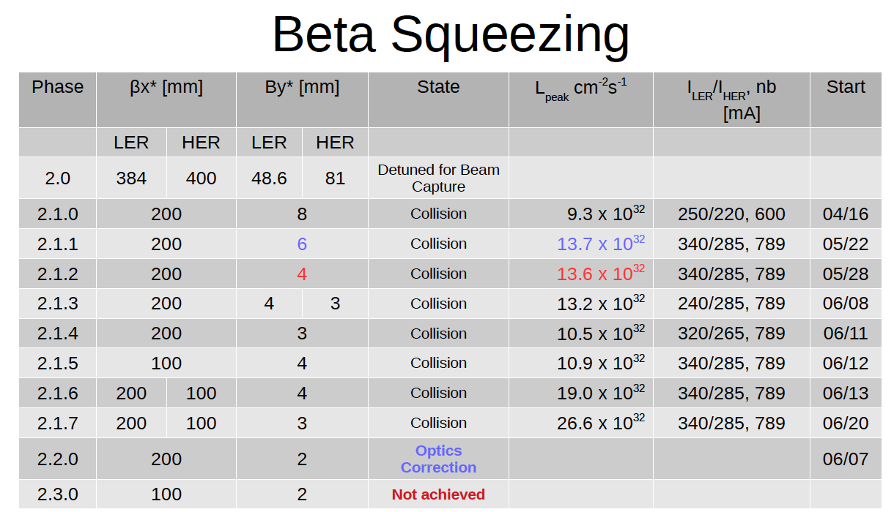
What happened in Phase 2
Slide from Morita-san
Plagued by QCS quenches (quenches of the superconducting magnet with long recovery time). 18 Quenches in one two-day period.➔Lower the Belle II diamond abort thresholds.

Slide 17
Detector Commissioning and Powerful Background Measurement Tools
TPC’s for directional MeV neutron detection. He3 tubes for thermal neutrons.
+Belle II

Slide 18
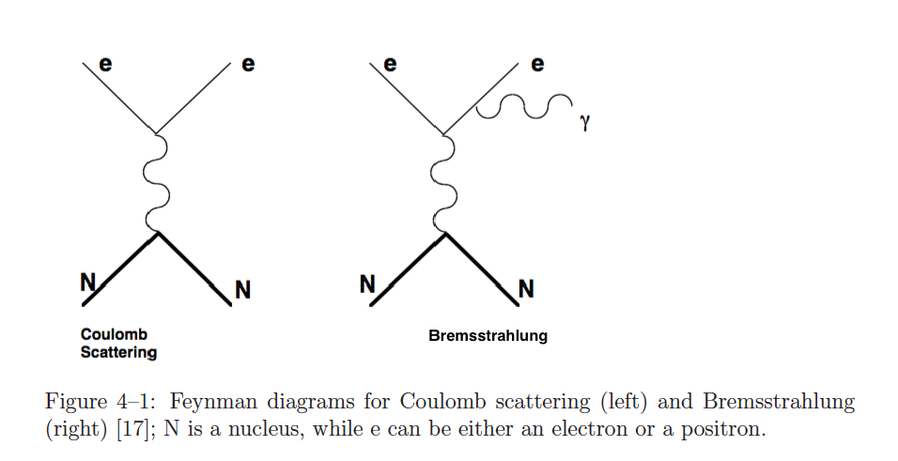
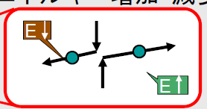
Mechanisms for Beam Background
Indep. of vacuum
Depends on vacuum, Z of residual gas
Intra-bunch Coulomb scattering changes energy and leads to particle loss,
Touschek scattering.
A. Fodor
Depends on luminosity
Depends on luminosity
Radiative Bhabha scattering: e⁺e⁻ →e⁺e⁻ γ
H. Nakayama

Slide 19
B2SS: How do beam-gas backgrounds (and other bkgs) depend on beam current ?
Outgassing due to SR on the walls.
Compare to background from Touschek scattering.
N.B. SR (synchrotron radiation) bkg produced in dipoles or orbits offset in quads, concentrated at low photon energy, travels in straight lines and has a linear beam current dependence.

Slide 20
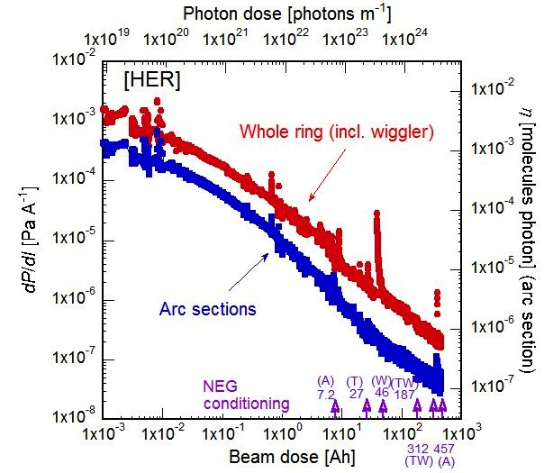
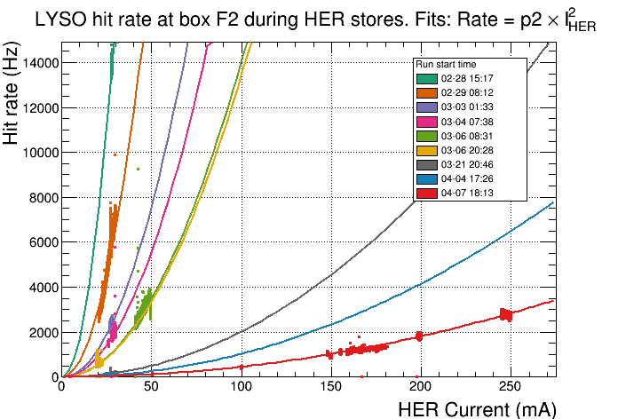
SuperKEKB vacuum scrubbing to reduce HER beam gas backgrounds in Belle II
Phase 1
HER integrated beam dose > 500 A-h
BEAST background in the HER vs time
A. Beaulieu
Y. Suetsugu et al (SuperKEKB vacuum group)
N.B. This is a log-log scale plot
BEAST data shows the HER backgrounds decreasing as vacuum scrubbing proceeds.
Notes:
HER Vacuum scrubbing

Slide 21
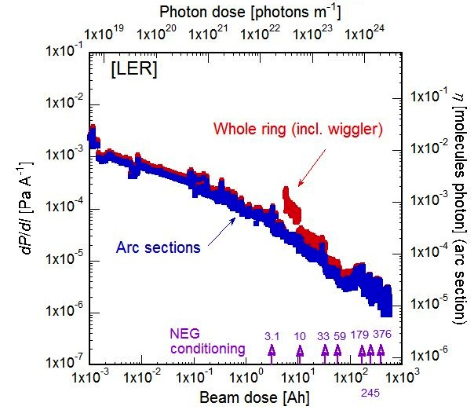
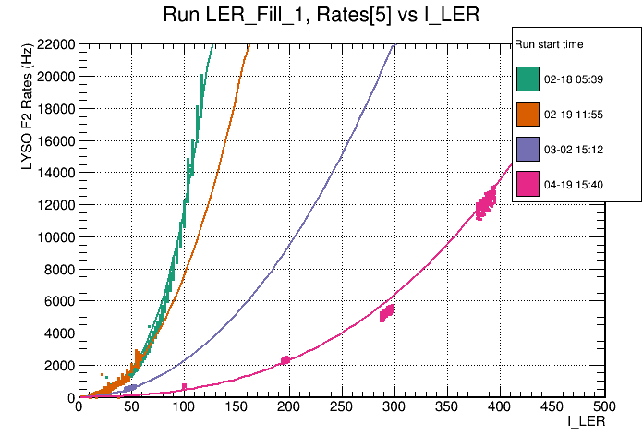
SuperKEKB vacuum scrubbing to reduce LER beam gas backgrounds in Belle II
“Brand new” 3km long beampipe
Phase 1
LER integrated beam dose > 500 A-h
BEAST background in the LER vs time
A. Beaulieu
Y. Suetsugu et al (SuperKEKB vacuum group) [N.B. log-log plot]
BEAST data shows the LER backgrounds decreasing as vacuum scrubbing proceeds.
Notes:
LER vacuum scrubbing

Slide 22
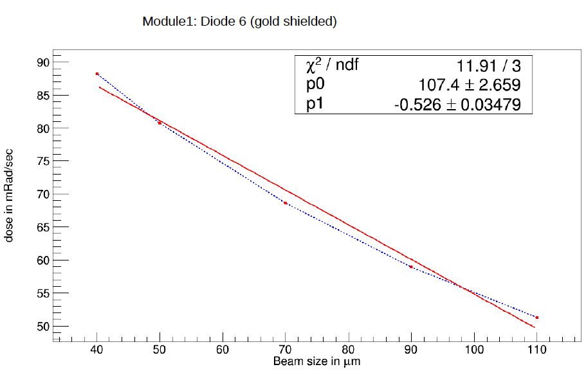
BEAST Phase I Highlight
Phase 1
April 2016: Large Touschek background observed in the LER
Bkg in BEAST
Vertical beam size from size monitor (not measured at IP)
→Will need excellent collimators to handle nano-beam backgounds. (Conclusion in 2016)
Notes:
The collimators will be installed in Phase II

Slide 23
“Don’t worry the backgrounds will bake away”
Phase 1

Slide 24
Phase 1

Slide 25
“Don’t worry, the backgrounds will bake away”
No !

Slide 26
“Scraping” or “Horizontal Tails”

Slide 27
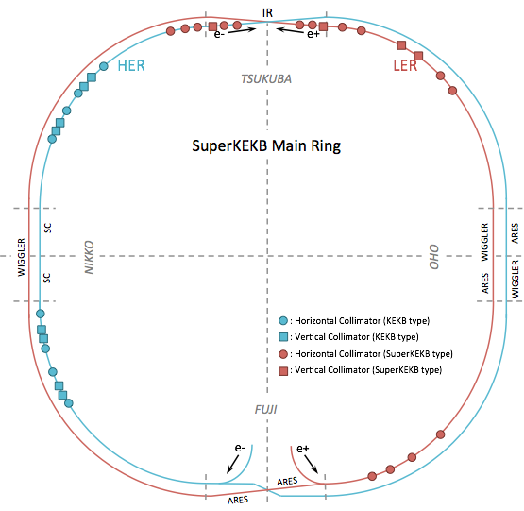
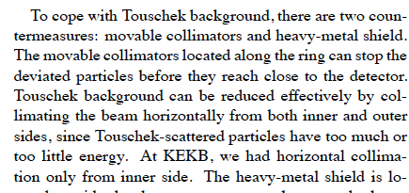
Phase3
Installed for phase2
Phase3
HER
D01: H1, H2, H3, H4, H5
V1
LER
D02: H1, H2, H3, H4
V1
x
LER
D03: H1, H2
(V1, V2)
x
Exist in phase 1
D01
D02
D12
D03
HER
D12: H1, H2, H3, H4
V1, V2, V3, V4
D11
D04
D10
D05
Exist in phase 1
D09
D06
HER
D09: H1, H2, H3, H4
V1, V2, V3, V4
Exist in phase 1
D08
D07
H. Nakayama
Phase3
Notes:
Comment from Kanazawa at IPAC2011

Slide 28
B2SS: What is the background big picture ?
Warning: Need to analyze last two weeks of background studies. Need plots and numbers.
➔Why is this important ? Cannot run Belle II at high luminosity (limited by CDC current).
LER single beam backgrounds are dominant. LER ~O(5) x HER
No sign of luminosity dependent backgrounds !
LER is baked. Backgrounds appear to be Touschek dominated (beam size studies).
HER is baked. There is a large Touschek component but also a “scraping” or beam-tail bkg component is evident.
HER also has an unexpected low-energy photon peak (SR) (seen in PXD and FANGS).
Vertical collimators near the IP are effective for both HER and LER bkgs.
Horizontal collimators may reduce LER bkgs but need continuous injection. (since the lifetimes and injection eff are severely impacted)

Slide 29
Phase 2

Slide 30
However, Data/MC comparison does not include optimized collimators in data.

Slide 32
TPC’s for directional MeV neutron detection. He3 tubes for thermal neutrons.

Slide 33
“Transient” Backgrounds
Injection backgrounds: Not clear what parameters these depend on (analyze the last two weeks of data where injection parameters were systematically varied). Very important for continuous injection. LER injection currently seems to be ok but not the HER.
Beam-dust events (called UFO’s at the LHC): Background spikes accompanied by pressure bursts.
Background “spikes” and “storms”: may be due to drifts of the “betatron tunes” of the accelerator that land on “resonance lines” and interactions with the feedback systems of the accelerator (tune, transverse, orbit).
Unidentified Falling Objects

Slide 35
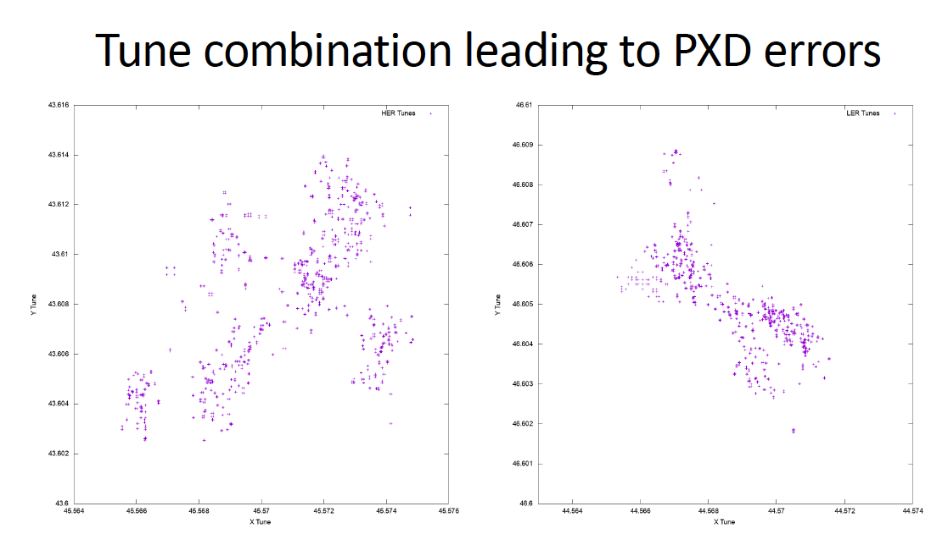
HER Tunes
LER Tunes
Y Tune
Y Tune
X Tune
X Tune
Hendrik Windel

Slide 36
What’s Ahead in Phase 3 (More Commissioning)
0. Analyze our background data
Need to do background reduction with continuous injection (and eliminate tails) during Phase 3 (a new mode of operation). Use new LER and HER collimators. Must be ready to sacrifice lifetime and injection efficiency. [~30% injection efficiency in KEKB]
Need much more luminosity commissioning but must understand CDC hardware limits for Phase 3.
Must stabilize Belle II DAQ and increase up-time to 100%
Need to protect the QCS from quenches (scintillators, diodes) and focus harder.

Slide 37
Backup Slides

Slide 38
1.Touschek scattering
Intra-bunch scattering : Rate∝(beam size)⁻¹,(E_{beam})⁻³
Touschek lifetime: assume 600sec (required by injector ability)
→ total beam loss: 375GHz (LER), 270GHz(HER)
Horizontal collimators to reduce loss at IR (|s|<4m)
collimators before IP (|s|<200m) are very effective
Collimator width
Initial values:
Further optimization to balance IR loss and beam lifetime
Smaller loss rate on the final collimators (|s|<20m) is preferred
After careful optimization of collimators, IR loss is <0.3GHz now
3 orders smaller than ring total loss

Slide 39
Compare the Parameters for KEKB and SuperKEKB
 | KEKB Design | KEKB Achieved : with crab | SuperKEKB Nano-Beam
Energy (GeV) (LER/HER) | 3.5/8.0 | 3.5/8.0 | 4.0/7.0
β_{y} * (mm) | 10/10 | 5.9/5.9 | 0.27/0.30
β_{x} * (mm) | 330/330 | 1200/1200 | 32/25
ε_{x} (nm) | 18/18 | 18/24 | 3.2/5.3
ε_{y} /ε_{x} (%) | 1 | 0.85/0.64 | 0.27/0.24
σ_{y}(mm) | 1.9 | 0.94 | 0.048/0.062
σ_{x}(cm) | 0.052 | 0.129/0.090 | 0.09/0.081
σ_{z} (mm) | 4 | 6 - 7 | 6/5
I_{beam} (A) | 2.6/1.1 | 1.64/1.19 | 3.6/2.6
N_{bunches} | 5000 | 1584 | 2500
Luminosity (10³⁴ cm⁻² s⁻¹) | 1 | 2.11 | 80
Nano-beams are the key (vertical spot size is ~50nm !!)
This is not a typo
Notes:
The jump from CESR to the B factories (PEP-II, KEKB) was not significant in per bunch parameters. However, the number of bunches and the beam currents were much larger. There is greater than an order of magnitude reduction in beam size and emittance.

