Slide 1


Exotic and Conventional Quarkonium Physics Prospects at Belle II
Kiyoshi Tanida
(Japan Atomic Energy Agency)
@The 13th International Conference on
Hypernuclear and Strange Particle
Physics (HYP2018)
28 June 2018

Slide 2
Exotic and Conventional Quarkonium (and baryon) Physics Prospects at Belle II
Kiyoshi Tanida
(Japan Atomic Energy Agency)
@The 13th International Conference on
Hypernuclear and Strange Particle
Physics (HYP2018)
28 June 2018

Slide 3
Contents
Introduction to quarkonia
  (Some of) Achievements in Belle
From Belle to Belle II
  Prospects for XYZ
  Charmonia by ISR, 2-photon, double production
  Bottomonia
Status of Belle II
Charmed baryons and Hyperons
Summary

Slide 4
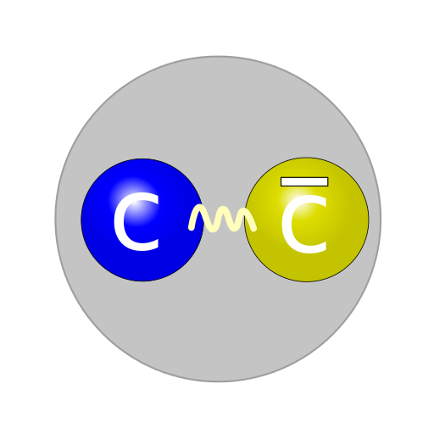
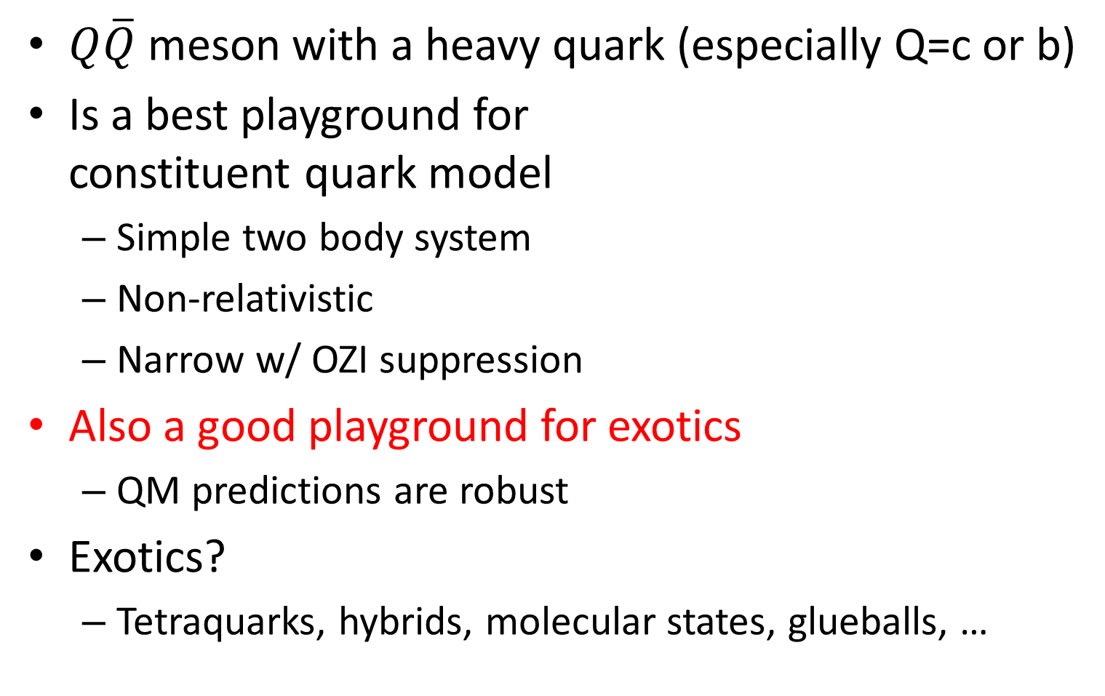
Quarkonium
$Q\overline{Q}$ meson with a heavy quark (especially Q=c or b)
Is a best playground for
constituent quark model
  Simple two body system
  Non-relativistic
  Narrow w/ OZI suppression
Also a good playground for exotics
  QM predictions are robust
Exotics?
  Tetraquarks, hybrids, molecular states, glueballs, …

Slide 5
Production mechanisms in e⁺e⁻
B decays – charmonia
Direct production/Initial State
Radiation (ISR)
  J^{PC}=1⁻⁻
Two photon collision
  J^{PC}=0⁺⁺, 2⁺⁺, …
Quarkonium transitions
  Feed-down from higher states

Slide 6
Quarkonia summary
Good agreement below open flavor threshold
Exotic candidates, so called XYZ states, discovered

Slide 7
(Some of ) Achievements in Belle:
Exotic candidates, XYZ

Slide 8

X(3872)
First and most famous one
  Very narrow width
  On the DD* threshold
  Violates isospin in
  J/ψρ vs J/ψω decays
  J^{PC}=1⁺⁺
S-wave DD* molecule?
  Mixed with charmonium?
Belle,
PRL91,261801(2003)
X(3872)
→ J/ψπ⁺π⁻
M(J/ψπ⁺π⁻) − M(J/ψ)

Slide 9
Charged states (1)
Belle, PRL108,122001(2012)
Most likely scenario: molecular states

Slide 10
Charged states (2)
Belle, PRD 88 (2013) 074026
Several other candidates.
Some may not be resonances
but cusp or other dynamical enhancements
Z(4430)

Slide 11
Remaining questions
Many XYZ states were found, but
  Which ones are exotic?
  If exotic, what kind?
  Molecule? Tetraquark? Hybrid? Something else?
  Goal: classification of these states
J^{P} is not determined yet for most XZ states
  Most important measurement in the coming days
More states?
  Several more should be discovered especially in b sector
  Interesting to compare XYZ_{c} and XYZ_{b}
  Discovery of unexpected?

Slide 12
From Belle to Belle II

Slide 13
SuperKEKB and Belle II
Goal: x50 more statistics than Belle

Slide 15
Prospects for XYZ
Expected statistics
X(3872): width determination possible down to a few 100 keV
Search for states near D*D* threshold
Amplitude analysis to determine J^{P(C)}
Hope to find more unexpected XYZs

Slide 16
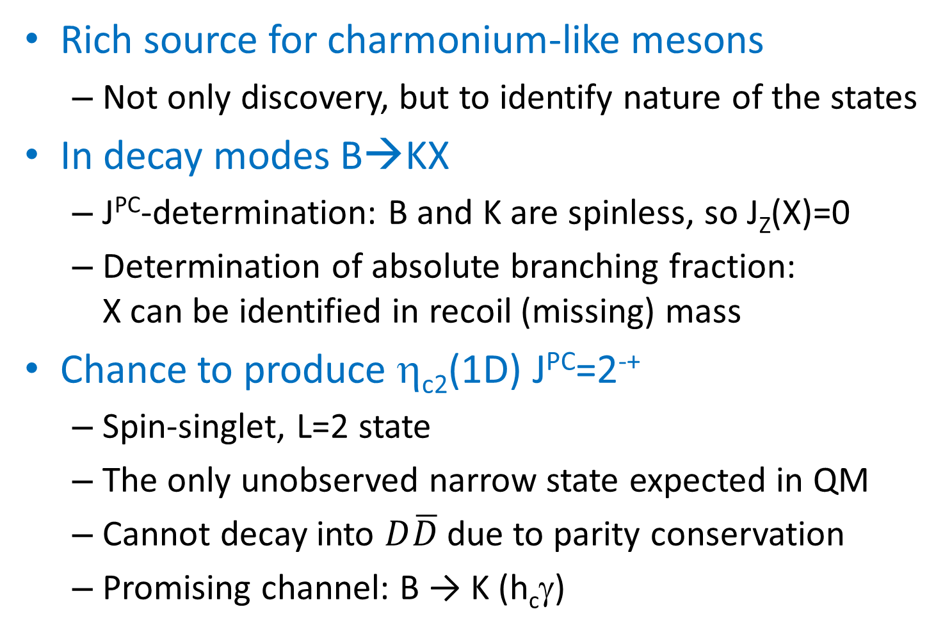
Charmonia by B-decay
Rich source for charmonium-like mesons
  Not only discovery, but to identify nature of the states
In decay modes B→KX
  J^{PC}-determination: B and K are spinless, so J_{Z}(X)=0
  Determination of absolute branching fraction:
  X can be identified in recoil (missing) mass
Chance to produce η_{c2}(1D) J^{PC}=2⁻⁺
  Spin-singlet, L=2 state
  The only unobserved narrow state expected in QM
  Cannot decay into $D\overline{D}$ due to parity conservation
  Promising channel: B → K (h_{c}γ)

Slide 17
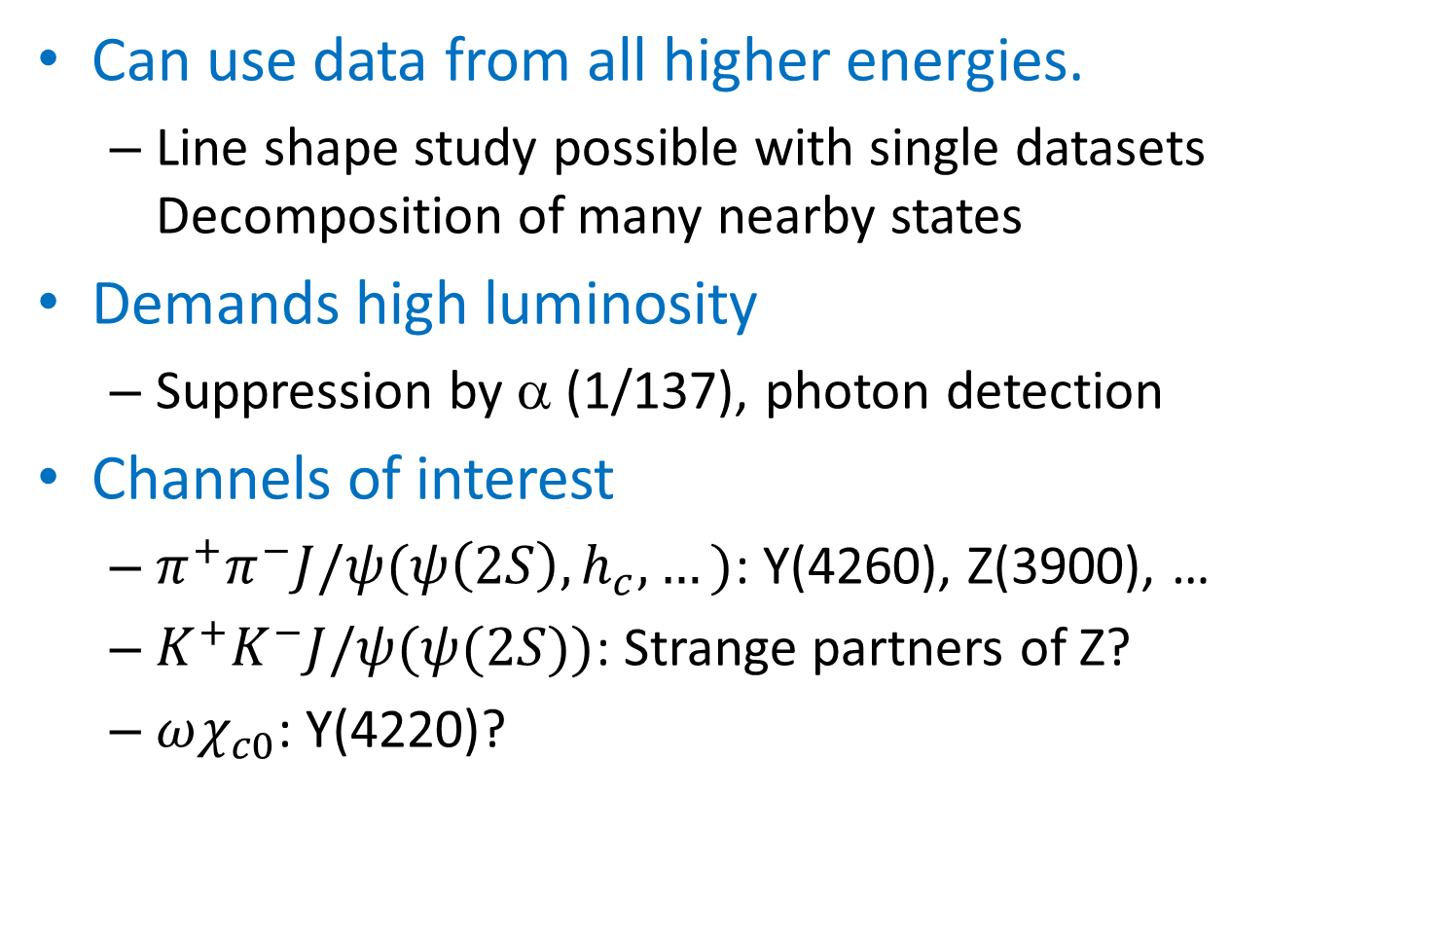
Charmonia by ISR
Can use data from all higher energies.
  Line shape study possible with single datasets
  Decomposition of many nearby states
Demands high luminosity
  Suppression by α (1/137), photon detection
Channels of interest
  $π^{+}π^{−}J/ψ(ψ\left(2S\right), h_{c},…)$: Y(4260), Z(3900), …
  $K^{+}K^{−}J/ψ(ψ(2S))$: Strange partners of Z?
  $ωχ_{c0}$: Y(4220)?

Slide 18
Competition with BESIII
Higher effective luminosity than BESIII
Wider mass range
BESIII Limit
BESIII
approx.

Slide 19
Charmonium by 2-photon
Belle, PRL 104, 112004 (2010)
Statistics not enough – need Belle II data
χ_{c0,2}(2P) properties
Other states?

Slide 20
Double Charmonia production
Only at Belle II
Observed in combinations of J=1 and J=0
  E.g., J/ψ+η_{c}
  Identify charmonia in missing mass → New probe
Belle, PRL 98, 082001 (2005)

Slide 21
Bottomonia
New things @Belle II
  Measurement at Υ(6S) becomes possible (~100 fb⁻¹)
  → Expect more Z_{b} states
  Radiative transitions between bottomonia
Most missing conventional bottomonia below the open bottom threshold should be found; e.g.,
  χ_{b}(3P) triplet
  Υ(2D₃) triplet
  η_{b}(3S), η_{b}(1D), Υ(1D_{1,3})
  F-wave states
  Several others

Slide 22
New states?
Some XYZ_{c} states should have analogs in b sector
  Y_{b} states will be searched for in energy scan.
  Help to identify the nature of these states
Expected new states?
  Yes, there are some: especially for partner states of
  Z_{b} (see next slide)
Possibility for unexpected?
  Yes, it’s always there. Who knows?

Slide 23
W_{b}
Z_{b}(10610) & Z_{b}(10650) are
molecular states?
  Explains the fact they can
  decay both spin triplet states
  and singlet states
If so, there should be
Heavy-quark-spin-symmetry
partner states nearby: W_{b}
  Simplest one: J^{PC}=2⁺⁺ state (B*B*)
Can be searched in radiative transitions & ππ decay from Υ(5S) and Υ(6S)
±

Slide 24
Status of Belle II

Slide 25
Quick history
Phase 1 – complete: Mostly devoted to accelerator
Background measurement @Belle II (Beast)
Phase 2 – ongoing (almost finishing):
Physics run with partial vertex detectors

Slide 26
The first hadron event
0:38, April 26, 2018

Slide 27
Luminosity development

Slide 28
Machine time & integrated luminosity

Slide 29
Performance -- invariant masses
π⁰→2γ
K_{S}→π⁺π⁻
K_{S}, π⁰, and D* are clearly seen with just 5 pb⁻¹.
Detectors are working well!

Slide 30
Near future
Installation of VXD in this Autumn/Winter
Phase 3 run will start early 2019
→ Full physics run.

Slide 31
Luminosity projection

Slide 32
Charmed baryons
& Hyperons
Belle (II) is not only for mesons

Slide 33
Baryons
Much more complicated than quarkonia
  3 particles even in QM
Ground states can be well understood by QM,
but exotic candidates even in 1st excited states
  Notorious examples: Λ(1405), N(1440)
Higher excited states are complete mess
  Missing resonances
  Multiple candidates in QM for known states
  What are ordinary? What are exotic?
J^{P} is not determined for most c,b-baryons
Clearly we need more & more data

Slide 34
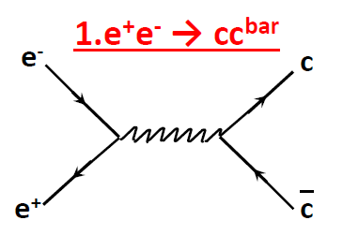
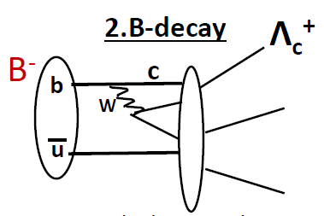
Charm baryon production in B factory
B is efficiently produced via
Υ(4s)
Once bottom is produced, it favorably decays into charm.
BR(B→Λ_{C}X)～5%
Production is flavor blind,
only q² matters
Λ_{C} produced via fragmentation

Slide 35

Huge statistics, good quality
> 1 M events
reconstructed
in Belle
x50 in Belle II
Resolution:
< 10 MeV FWHM
S/N ~ 10
$$Λ_{c}^{+}→pK^{−}π^{+}$$

Slide 36
Belle activities
We have not used the full potential of Belle data yet
  Belle is still actively producing papers on baryons
Results within ~1 year include
  Observation of Ξ_{c}(2930) [Eur. Phys. J. C 78, 252 (2018)]
  Ω_{c} excited states [Phys. Rev. D 97, 051102 (2018)]
  Decay branching ratio of Ω_{c} [Phys. Rev. D97, 032001 (2018)]
  Search for pentaquark P_{s} in Λ_{c}⁺→π⁰φp
  [Phys. Rev. D 96, 051102(R) (2017)]
  Λ_{c}⁺→Σππ branching fractions [arXiv:1802.03421]
  Observation of Ω(2010) [arXiv:1805.09384]
  3 more papers are coming in a month or so

Slide 37

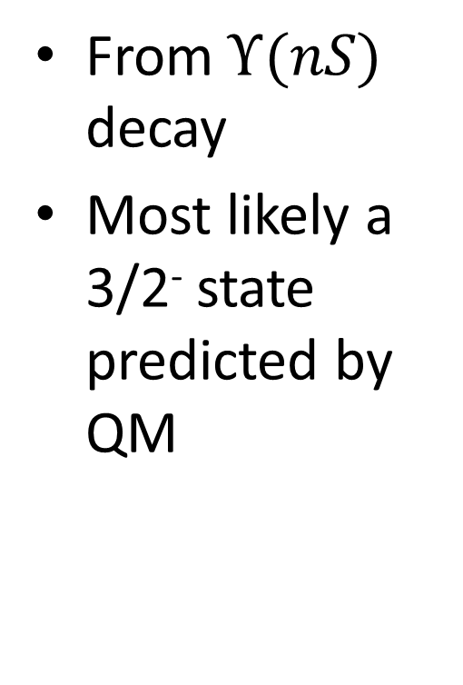

An example: Ω(2010)
  [arXiv:1805.09384]
$$Ξ^{0}K^{−}$$
From $Υ(nS)$ decay
Most likely a 3/2⁻ state predicted by QM
$$Ξ^{−}K_{S}^{0}$$

Slide 38
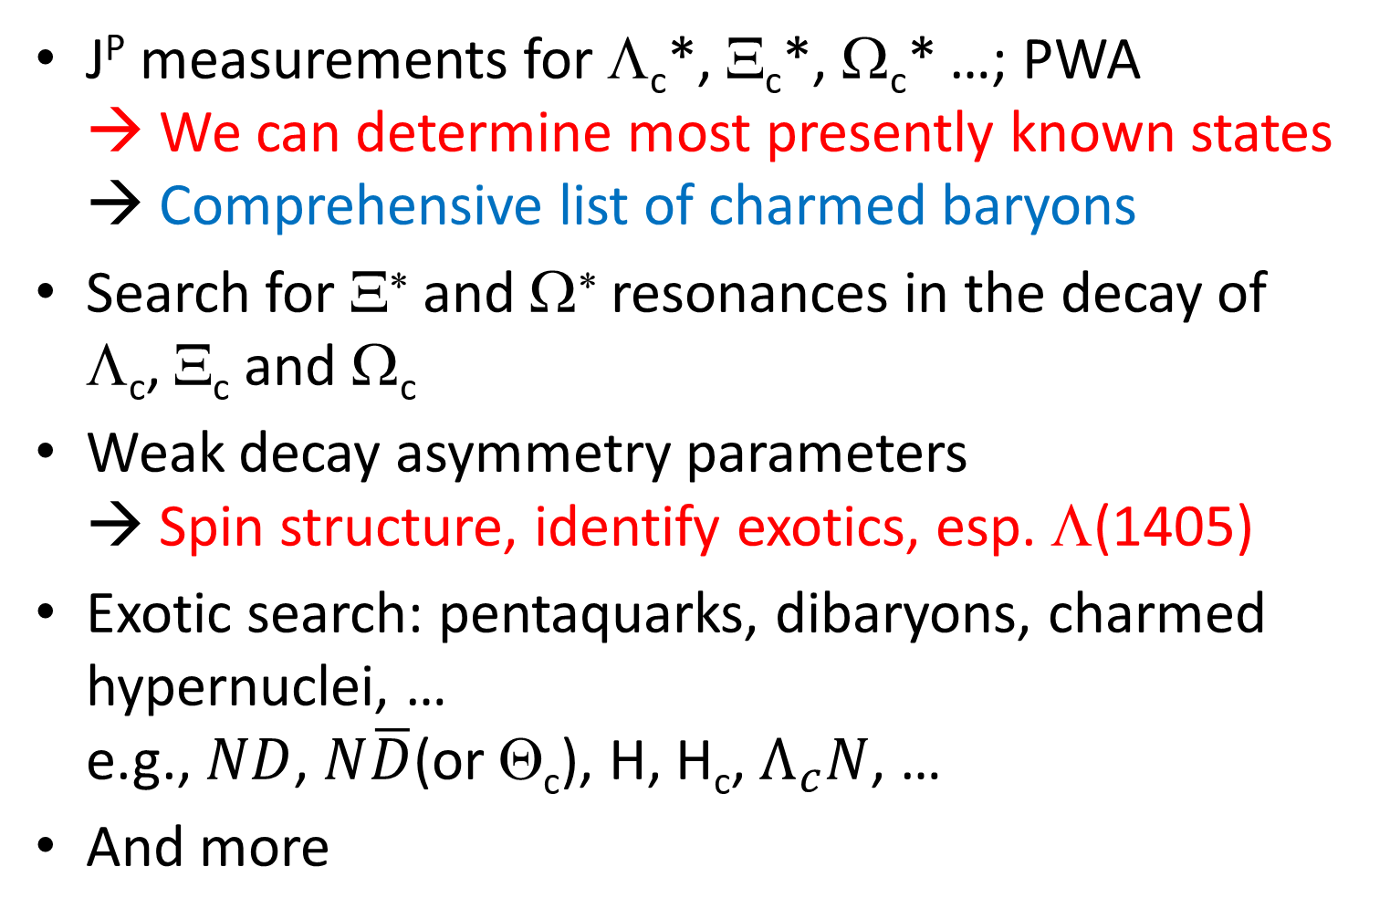
Belle II possibilities
J^{P} measurements for Λ_{c}*, Ξ_{c}*, Ω_{c}* …; PWA
→ We can determine most presently known states
→ Comprehensive list of charmed baryons
Search for Ξ∗ and Ω∗ resonances in the decay of
Λ_{c}, Ξ_{c} and Ω_{c}
Weak decay asymmetry parameters
→ Spin structure, identify exotics, esp. Λ(1405)
Exotic search: pentaquarks, dibaryons, charmed hypernuclei, …
e.g., $ND$, $N\overline{D}$(or Θ_{c}), H, H_{c}, $Λ_{c}N$, …
And more

Slide 39
Summary
Discoveries of exotic quarkonia (candidates) in Belle
Belle II will acquire x50 more statistics
  Identify the nature of known candidates
  Expecting a lot of further discoveries
Belle II just started to take data from spring 2018
  First collision on April 26th, took ~300 pb⁻¹ since then
  Clear signals of K_{S}, π⁰, and D* are seen with just 5 pb⁻¹
Full physics run will start from early 2019
Belle II is also good for baryons.
  Chance to identify baryons exotics using polarization

Slide 40
Backup

Slide 41
Hyperon polarization study
To measure hyperon polarization in Λ_{c} decay
  Semileptonic: Λ_{c} → Y + e(μ) + ν
  Non-leptonic: Λ_{c} → Y + π
  Main target is Y=Λ(1405)
Why it is interesting?
  s quark from charm decay is polarized
  Naively, polarization transfer from quark to hyperon
  = How much fraction of spin of hyperon is carried out by the quark. E.g., quark model predicts P(Λ)=P(s)~-0.9
  We can discuss hyperon spin structure.
  For Λ(1405), 3 quark state should have P~+0.3, while 5 quark state (or KN bound state) should have P~0.

Slide 42











Existing data (from PDG)
Λ_{c} → Λ + e(μ) + ν: P＝α＝－0.86±0.04 OK
Λ_{c} → Λ + π⁺: P＝－0.91±0.15 OK
Λ_{c} → Σ⁺ + π⁰: P＝－0.45±0.32 OK?
  Contribution of strange quark should give P~+0.3, but there is a contribution of up quark P~-0.6, giving P~-0.3 in total
$$u$$
$$u$$
$$c$$
$$s$$
$$Σ^{+}$$
$$u$$
$$W$$
$$\overline{d}$$
$$π^{0}$$
$$d$$
$$d$$
Seemingly, the naïve model can explain the existing data

Slide 43
Semileptonic vs nonleptonic modes
Theoretical cleanness vs experimental easiness
Semileptonic: no peak in invariant mass because of missing ν.
  BG may be severe, very complicated analysis
  Tagging Λ_{c} in missing mass?
  Up to 100 counts in the present Belle, a few thousands expected in Belle II.
  → Detection may be possible with Belle data,
  polarization needs Belle II statistics
Non-leptonic:
  Study possible with Belle data, but interpretation is the issue
  Measure mass dependence → identify 2-pole structure??
  Λ(1520) as a control sample

Slide 44

An example: Ξ_{c}(2930)
$$B^{±}→Λ_{c}{\overline{Λ}}_{c}K^{±}$$
[Eur. Phys. J. C 78, 252 (2018)]

Slide 45
Dalitz plot
[Eur. Phys. J. C 78, 252 (2018)]
Spin could be determined if there were enough statistics…

