Slide 1



Track Fitting for the BELLE II Experiment
Stefano Spataro
for the Collaboration
ISTITUTO NAZIONALE
DI FISICA NUCLEARE
Sezione di Torino
Tuesday, 10th July 2018

Slide 2
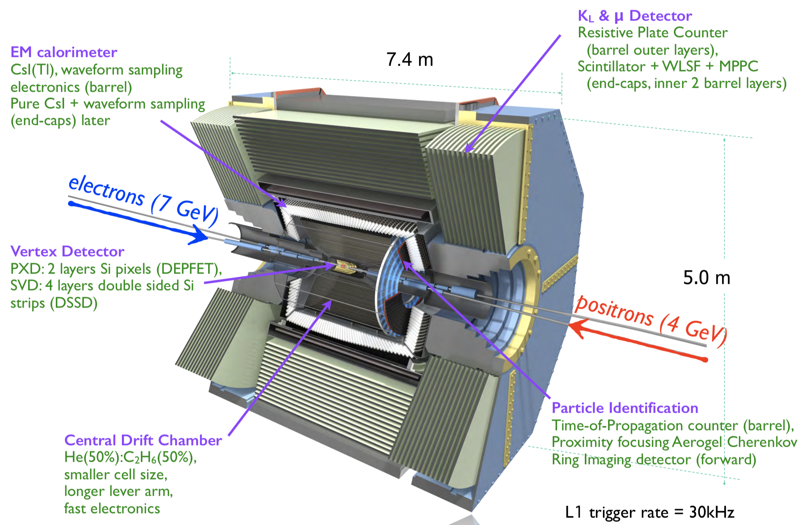
The Belle II Experiment

Slide 3
Tracking Design
TRACK
FINDING
CKF: Combinatorial Kalman Filter
DAF: Deterministic Annealing Filter
In this Talk

Slide 4
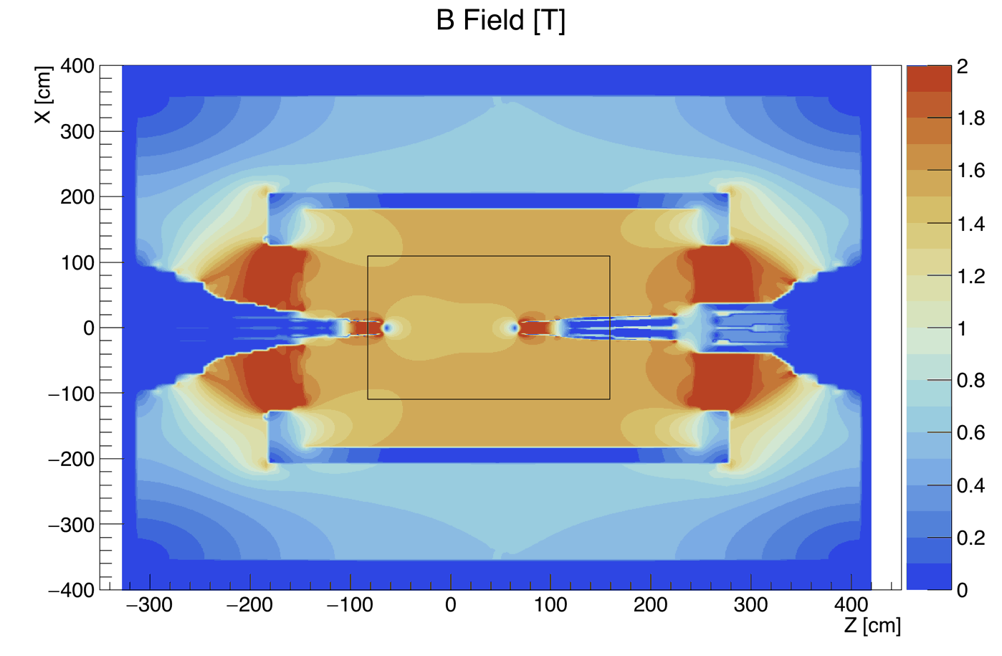
Global Track Fitting
GENFIT: Generic Track Reconstruction Toolkit
Open Source C++ Modular track-fitting framework
Several implemented algorithms inside (DAF is used in our case)
Not homogeneous Magnetic Field
Energy loss (different for each particle)
Different detector hits:
  CDC: wire + drift time (L/R ambiguity)
  SVD: position along strips
  PXD: planar hits (XY)
Originally developed inside PandaRoot framework at TUM
Major update (GENFIT2) based on acquired experience with Belle II
Now used by large community (Belle II, PANDA, GEM-TPC, FOPI, SHiP)
Nucl. Instr. Meth. A 620 (2010) 518-525 – J. Phys.: Conf. Ser. 608 (2015) 012042

Slide 5
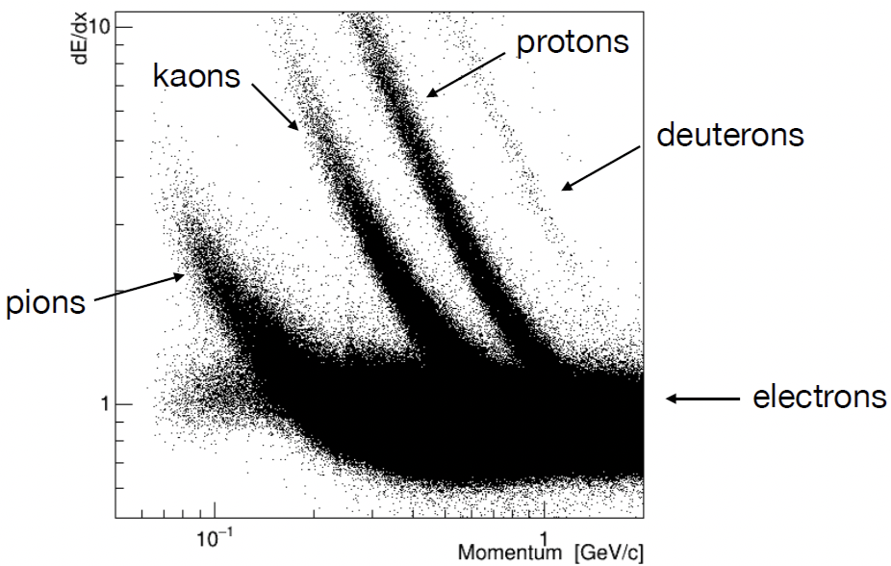
Energy Loss Importance
Different particles, different energy loss
Different particles, different time of flight, different drift time in CDC
At high momentum not large differences
At low momentum, wrong mass hypothesis can lead to wrong results
DATA

Slide 6
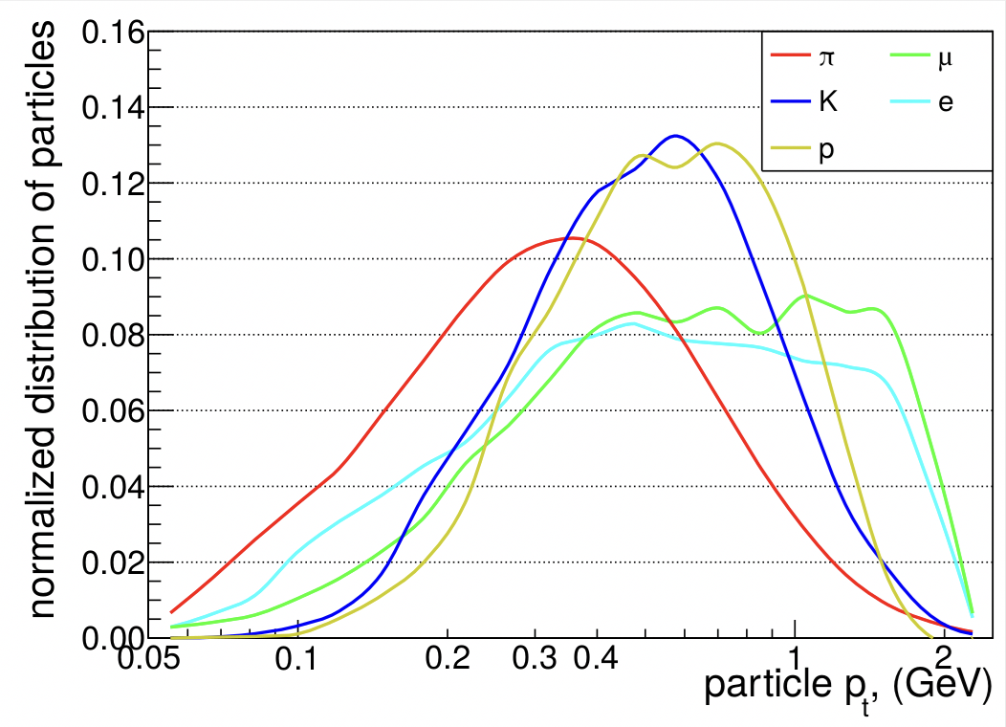
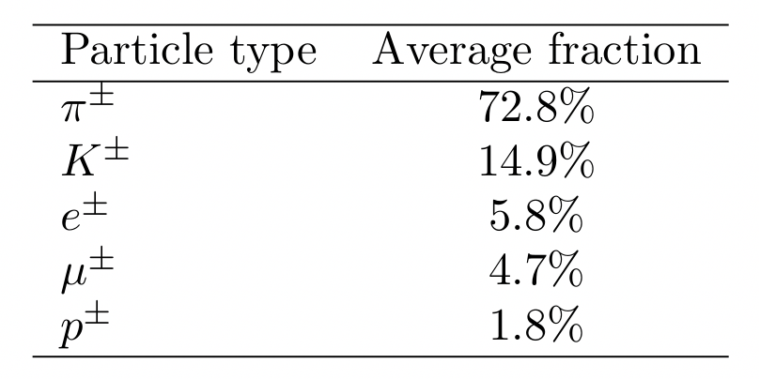
Our Momentum Range of Interest
Y(4S) Montecarlo sample
Large fraction of pions
Particles below 1 GeV/c (mostly)
WARNINGS
Low multiplicity samples (e⁺e⁻, µ⁺µ⁻,…) reach larger momentum values
Energy loss depends on total momentum (and not on p_{t})

Slide 7
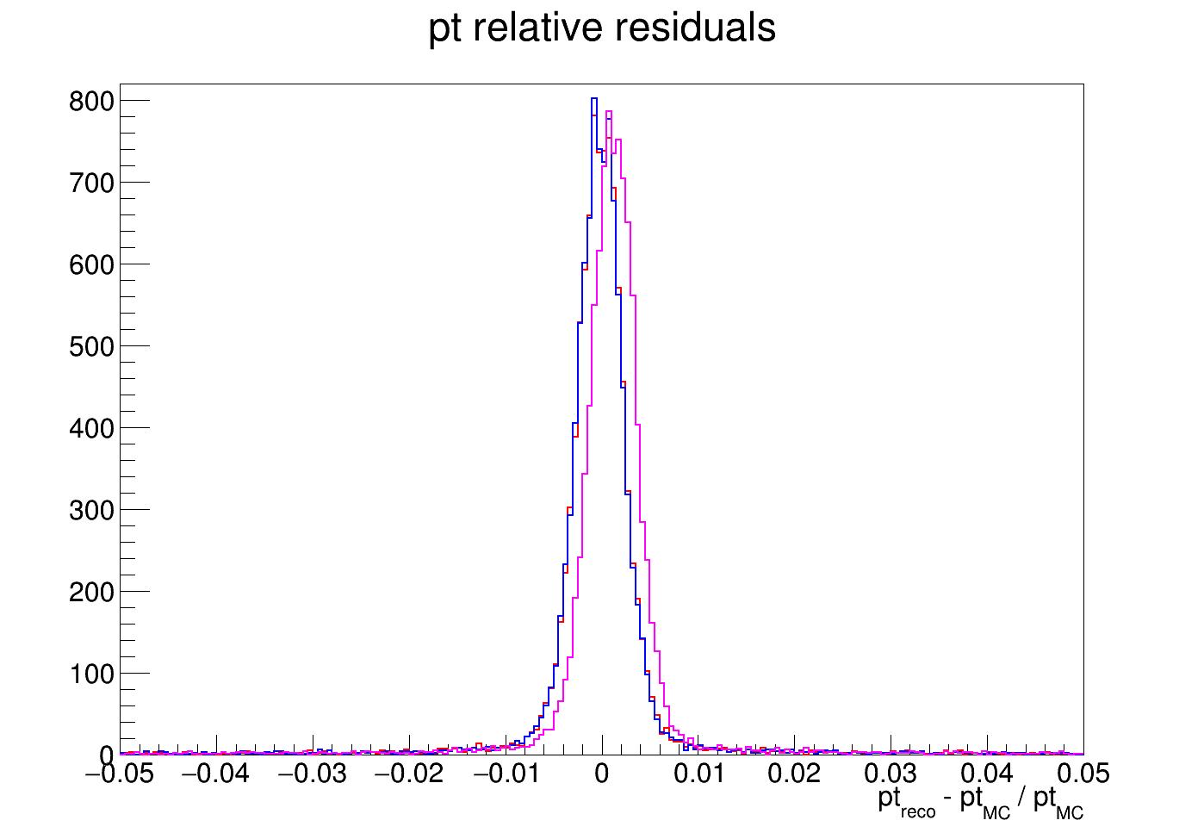
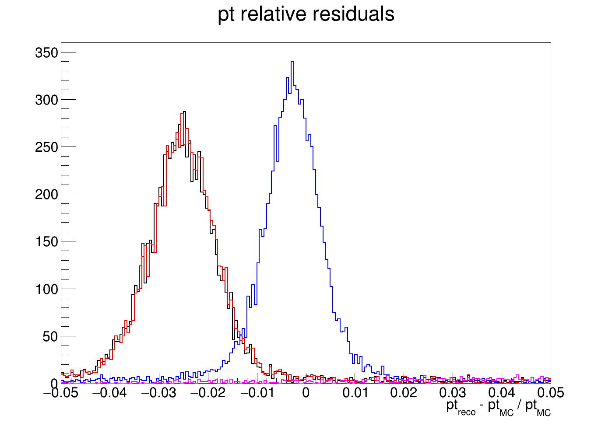
Different Particle Hypotheses Fit
Kaons at θ = 60°
MC particle gun
fixed momentum
p_{t} = 1 GeV/c
Kaons
Kaons
Fitted as:
Muon
Pion
Kaon
Proton
at high momentum
different hypotheses provide
similar results
p_{t} = 0.3 GeV/c
Kaons
Fitted as:
Muon
Pion
Kaon
Proton
at low momentum
wrong hypotheses provide
large bias in momentum
outside the axis

Slide 8
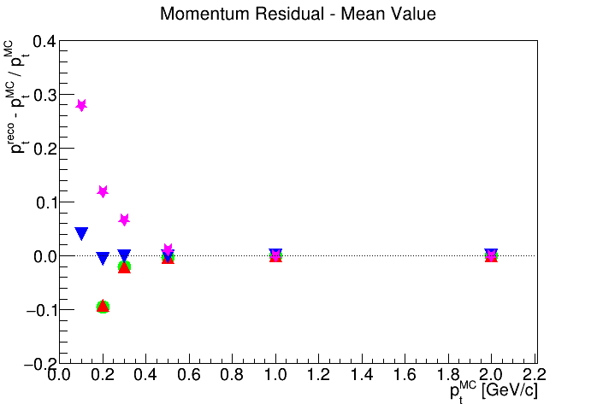
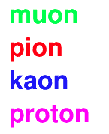
Mean Peak Position for Kaon Tracks
Momentum overestimation
Kaons fitted as
Works pretty well
No differences at large p
Momentum underestimation

Slide 9
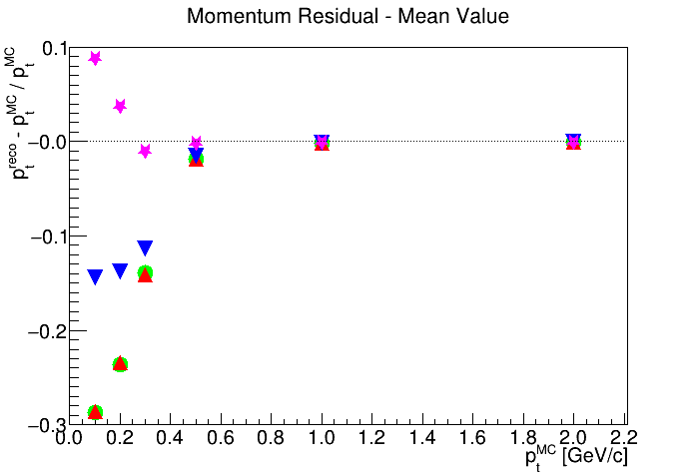
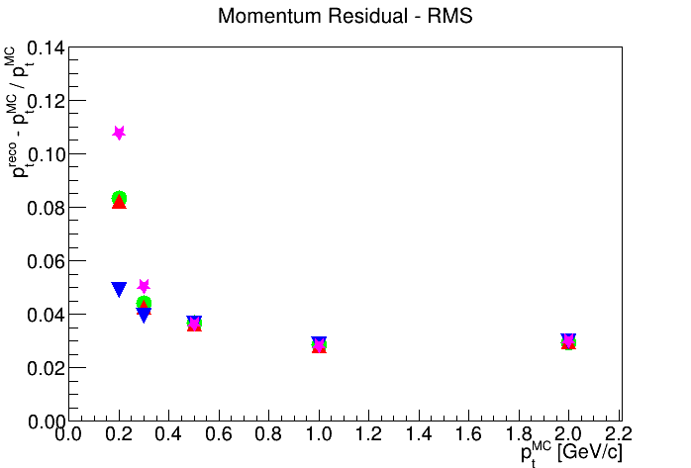
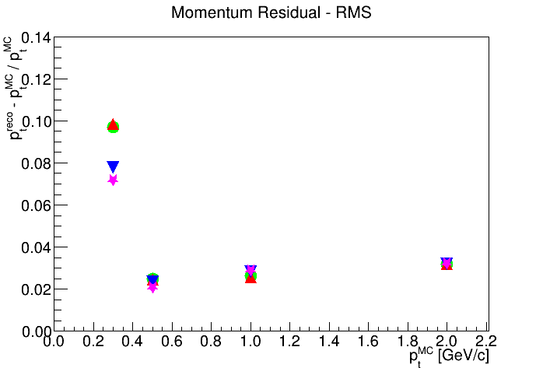
Comparison between different hypotheses
Kaons
mean value
Protons
mean value
Kaons
RMS
Protons
RMS

Slide 10
Implementation in Belle II
Determinist Annealing Filter - 3 hypotheses in parallel
Electrons
𝜋 fit Muons
Pions
K fit Kaons
Protons
Deuterons
← Need dedicated bremsstrahlung handling (ongoing)
← Substantially equivalent to pions
← Only needed for few analyses, no central production
p fit
Resources with 3 (𝜋, K, p) and 4 (𝜋, K, p, d) hypotheses
compared to only 𝜋 hypothesis
 | Disk Space Ratio |  | CPU Time Ratio
 | 3/1 hyp | 4/1 hyp | 3/1 hyp | 4/1 hyp
Track Fitting | 2.59 | 3.12 | 2.89 | 3.75
Global mDST | 1.17 | 1.22 | 1.07 | 1.09
Track Fitting values scale linearly with number of hypothesis
Global increase of ~10% in CPU time and ~20% in disk space

Slide 11
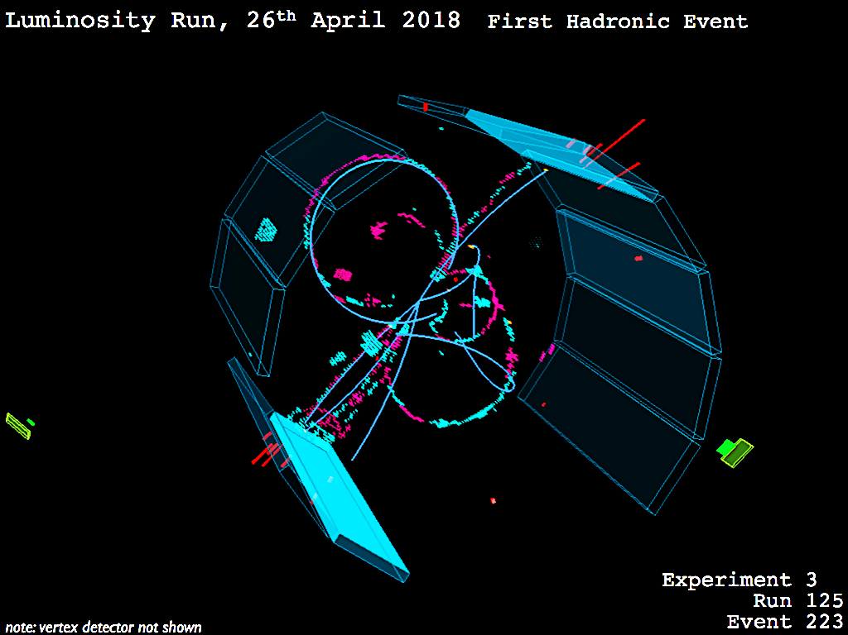
Does it work also with real data?

Slide 12
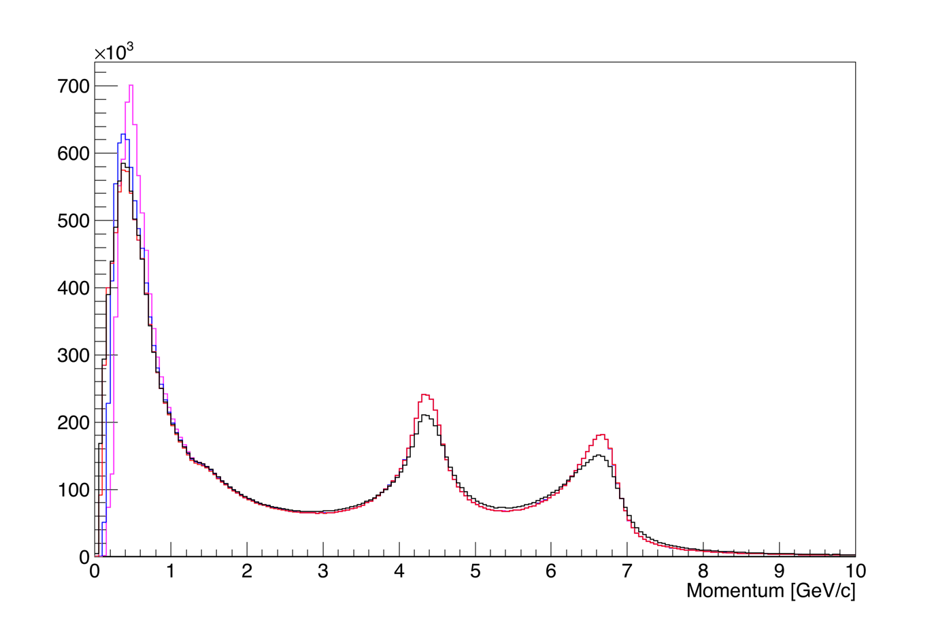
First round of data from collisions
Non optimal beam profile, preliminary detector calibration, SVD+PXD only in a small acceptance, no Bhabha suppression on purpose
Hypothesis fit differences only at low momentum
Helix fit (from pattern recognition)
𝜋 fit
K fit
p fit
fit improves
resolution
Bhabha electron peaks

Slide 13
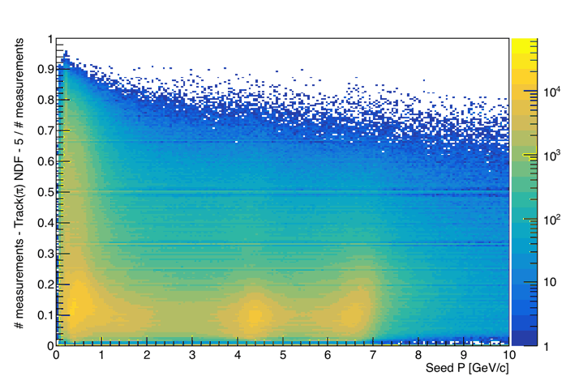
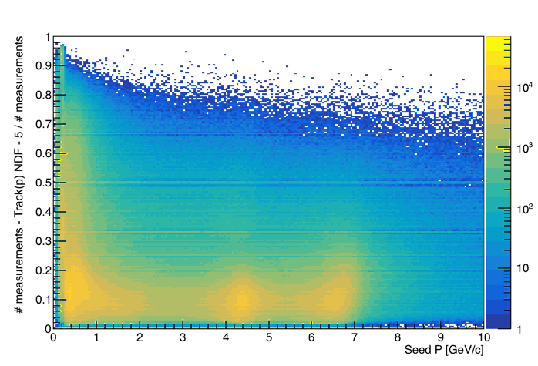
What about tracking hits?
𝜋 fit
Percentage of removed hits from DAF
# measurements – weighted NDF – 5
~10% hits are removed in the fit
0 → All measurements used in the fit
Almost all hits removed in the fit
p fit
At very low momentum the proton hypothesis cannot fit the track (too much energy loss)
DAF set a low weight to almost all the hits

Slide 14
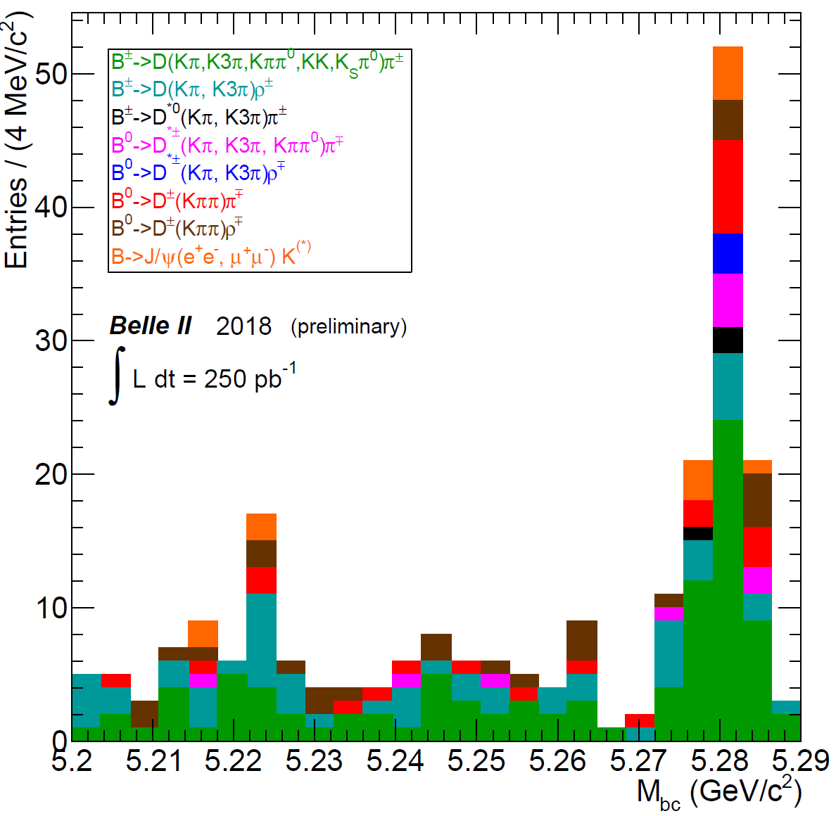
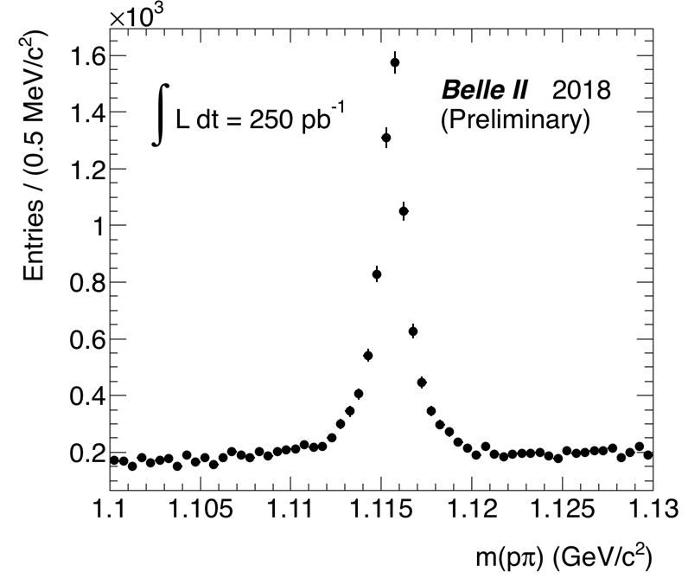
What about particles?
Nice invariant mass peaks at the correct positions!
K_{S}→𝜋⁺𝜋⁻
Λ⁰→p𝜋
B→…

Slide 15
Summary
In Belle II global tracking is performed my means of the GENFIT2 package
Track Fitting takes into account realistic magnetic field, different kind of detector hits, and energy loss for different particles
Tracks are fitted with three mass hypotheses (𝜋, K, p), a compromise between performances and computing resource consumption
A momentum dependent mass hypothesis in the fit can reduce CPU time and disk usage, in particular for p >1 GeV/c tracks
Determinist Annealing Filter removes outliers and downweighs distant hits, possibility to detect wrong mass hypotheses
Ongoing studies on electron corrections
and optimization of the computing resources for fitting

