Slide 1


Exotic hadron physics at Belle II
Y. Kato (KMI, Nagoya)

Slide 2
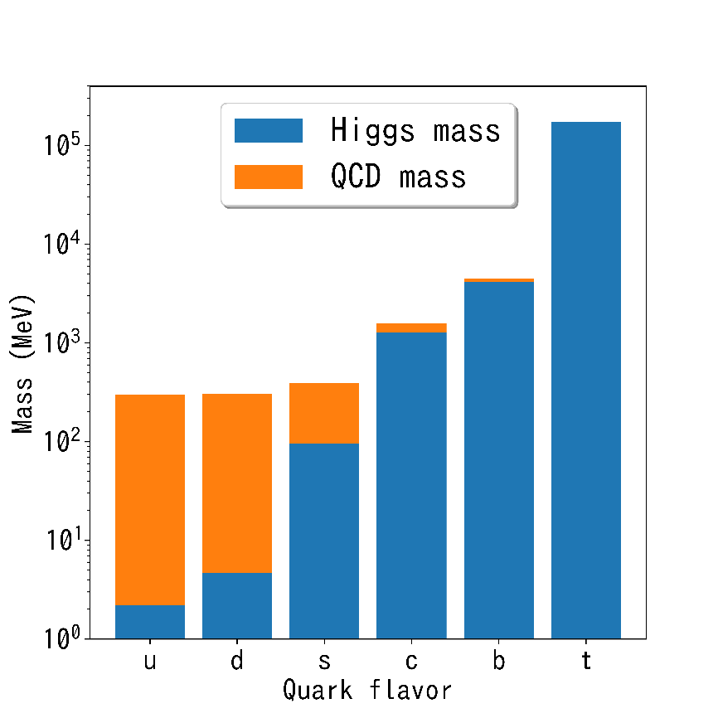
Hadron physics
~99.9% of the mass of matter is originated from nucleons (=hadrons).
~99% of mass of nucleon is coming from non-perturbative QCD dynamics (mass generation).
Isolated quark has NEVER been observed (quark confinement).
Mechanism to make these happen simultaneously is not understood.
Q
Q
Q
Q
Q
Q
Q
Q

Slide 3
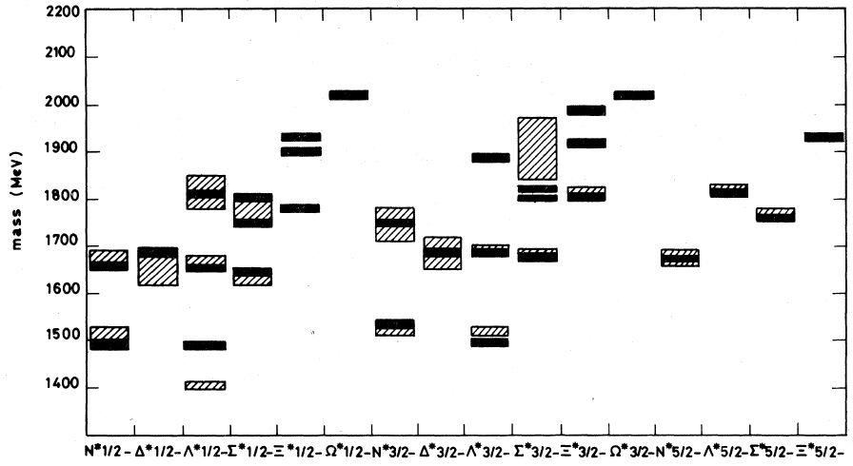
Constituent quark model and beyond
Simple model:
・ Give ~300 MeV mass to each quark by hand
・ Put into the confinement potential.
・ Hyper-fine interactions.
Works fine surprisingly!
Phys.Rev. D18 (1978) 4187
“Constituent quark” must be a good degree of freedom… but not the end.
・Why does it work so well?
・Where is the adaptive limit?
・Any other degrees of freedom?
Exotic hadrons
Heavy hadrons

Slide 4
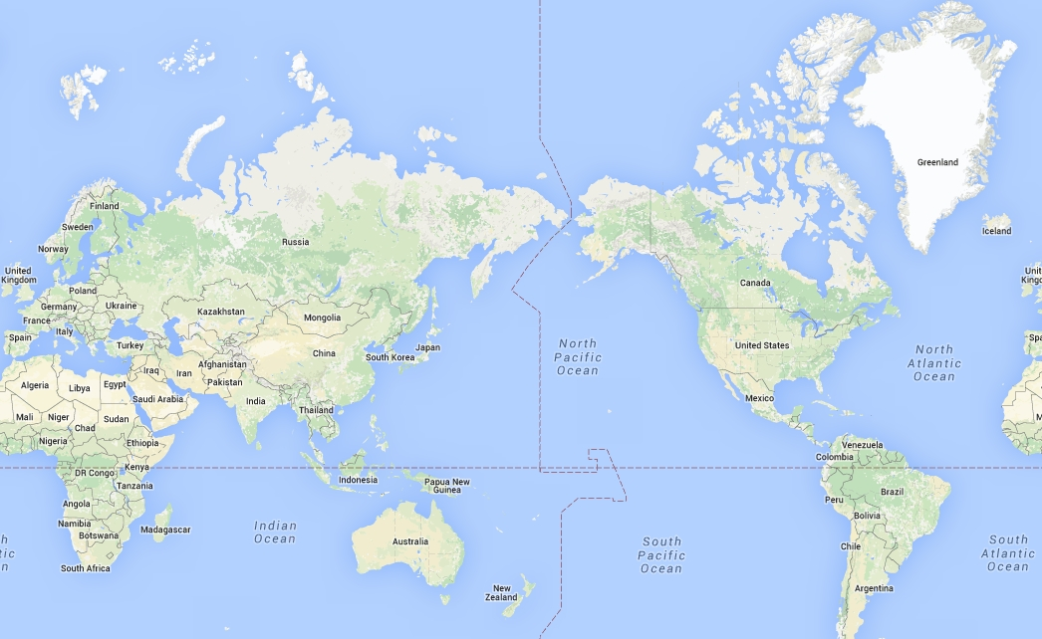
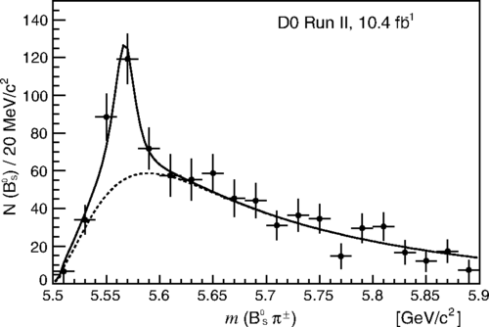
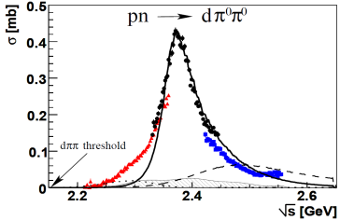









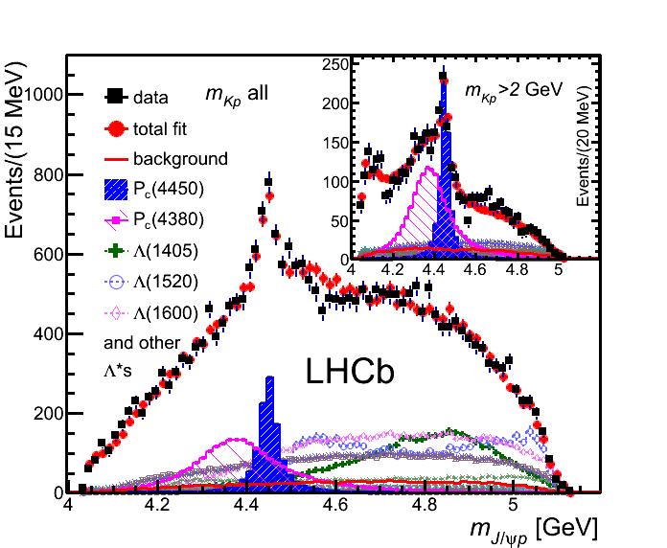
Exotic hadron facilities in the world
Phys. Rev. Lett. 117, 022003
d*(2380) (2011)
Di-baryon
Phys.Rev. Lett.106(2011) 242302
[X(5568)] (2017)
bsud tetra quark
・
・
・
・
・
・
pp 1.9 TeV
pp 7, 8, 13 TeV
e⁺e⁻ 10.58 GeV
e⁺e⁻ 10.58 GeV
P_{c}(4450/4380) (2015)
Pentaquark
e⁺e⁻ ~4 GeV
Y(4260) (2006)
Charmonium-like
X(3872) (2003) etc
Charmonium-like
Z(3900) (2013) etc
charmonium-like
・ Mostly from collider experiments
・ General purpose detector
What we can do with Belle II?
Phys. Rev. Lett. 115, 072001

Slide 5
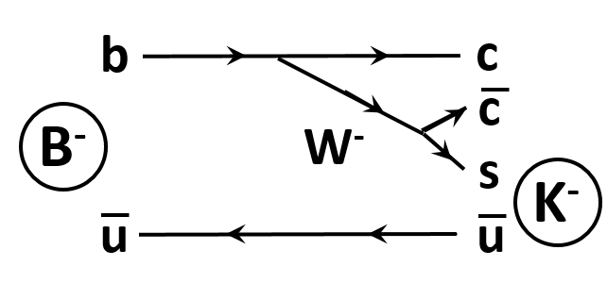
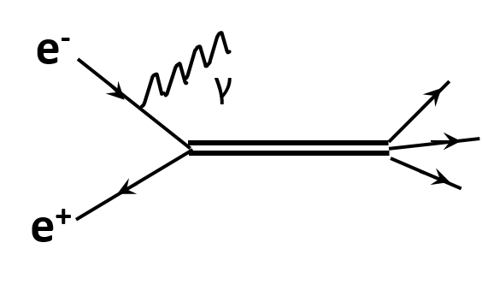
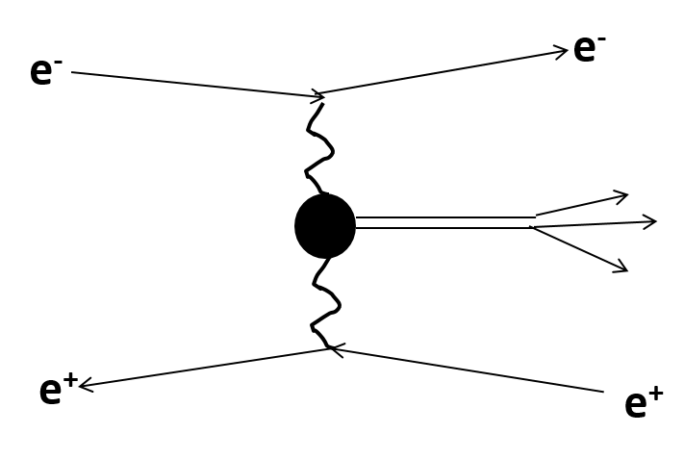
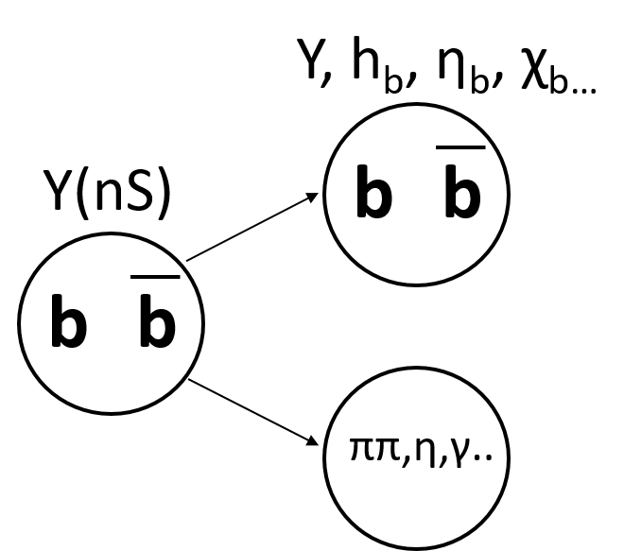
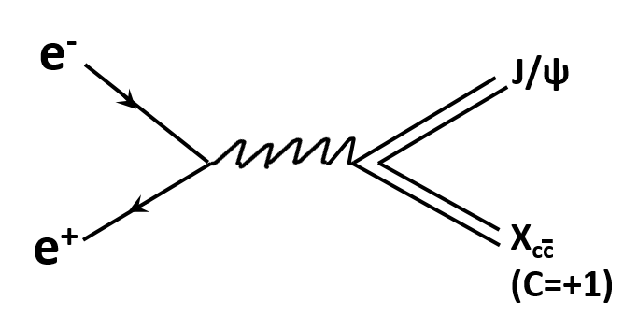
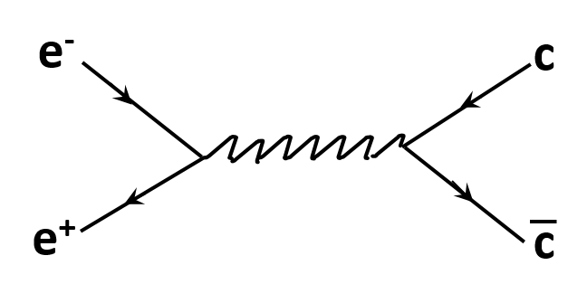
B-factory = hadron factory!
X_{cc}
X_{cc}
B meson decay
・1⁺, 0^{-/+} ….
・X(3872), Z(4430)….
・Open charm hadrons
Initial state radiation
・J^{PC}=1⁻⁻
・Y(4260)
Two photon collision
・J^{PC}=0⁺⁺, 2⁺⁺.....
・Extract two photon width
Double charmonium
・C-even charmonium
e⁺e⁻→ cc
Charm mesons/baryons
Bottomonium transition
Z_{b} states

Slide 6
“New hadrons” from B-factories
Hadron Type
 | Charmonium (-like) =cc | Bottomonium (-like) =bb | D, D_{(s)} cu, cs | Charmed baryon cud, csd, css.. | Hyperon ssu, sss…
B-decay | η_{c}(2S) ψ₂(3823) X(3872) X(3915) Z_{c}(4050) Z_{c}(4250) Z_{c}(4430) Z_{c}(4200) |  | D*₀(2400) D₁(2430) | Ξ_{c}(2930)
Initial State Radiation | Y(4260) Z(3900) Y(4008) Y(4360) Y(4660)
Double charmonium | X(3860) ≒ χ_{c0}(2P) X(3940) X(4160)
Two-photon | χ_{c2}(2P)
e⁺e⁻→cc^{bar} |  |  | D*_{s0} (2317) D₀(2550) D_{J}*(2600) D_{J}(2740) D₃*(2750) D*_{s1}(2700) D*_{s1}(2860) D_{sJ}(3040) | Σ_{c}(2800) Λ_{c}(2940) Ξ_{c}(2980) Ξ_{c}(3080) Ω_{c}(2770) Ξ_{c}(3055)
Y(nS) decay |  | Z_{b}(10610) Z_{b}(10650) η_{b}(1S) η_{b}(2S) h_{b}(1P) h_{b}(2P) |  |  | Ω(2012)
Charm baryon decay |  |  |  |  | Ξ(1620)
Belle
BaBar
Reaction
2. Baryons which contain a charm quark
1. Charmonium-like states
which can not be identified as simple cc : XYZ
In particular, focus on X(3872).
~ 40 new hadrons!
(Some states may be missed)

Slide 7
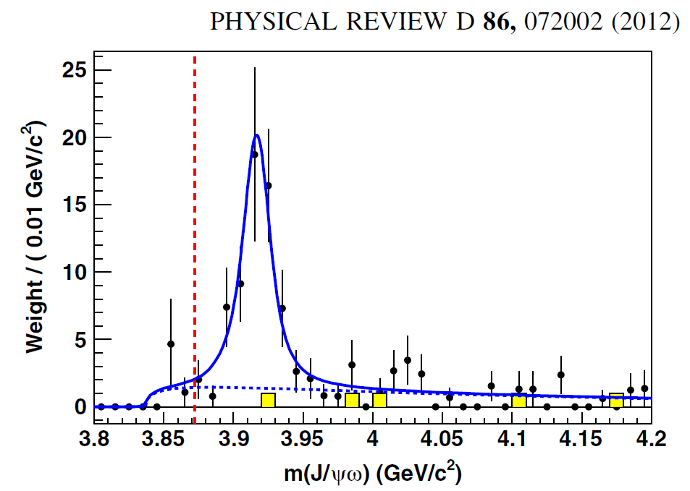
Charmonium-like XYZ: An overview
Before the B-factory era, charmonium are well understood
by the constituent quark model.
B-factories discovered many charmonium-like hadrons
deviated from quark model
Some states have charge, which can not be achieved by cc
X(3872)→J/ψπ⁺π⁻
X(3915)→J/ψω
Y(4260)→J/ψπ⁺π⁻
Z(4430)⁺→ψ(2S)π⁺
arXiv:1511.01589
Phys. Rev. Lett. 91.262001
Phys. Rev. D 88, 074026 (2013)
Their natures are not understood well: homework from B-factory

Slide 8
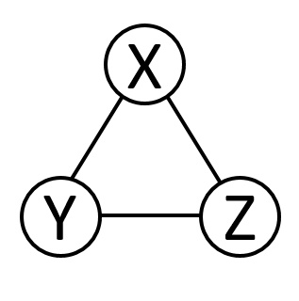
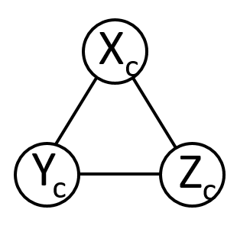

Role of Belle II for exotic hadrons
Molecule?
Tetraquark?
Hybrid?
Mixing?
c
c
c
c
+
・ Nature of each XYZ?
・ Understand (part of) XYZ in a unified way?
・ Understand charm and bottom in a unified way?
・ Finally, study
- Constituent quark (or gluon) mass
- Confinement potential
in the different environment
c
D
D*
D
D*
c
u
d
g
New multiplet?
Further new multiplet?

Slide 9
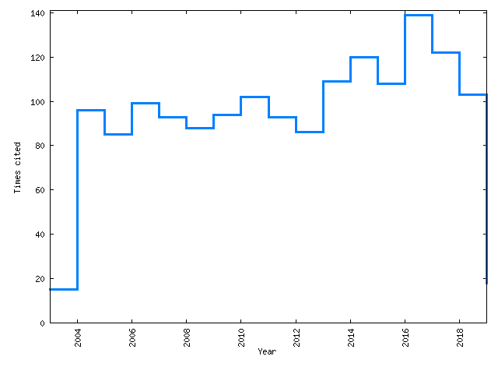
X(3872):Discovery by Belle
B⁺ →K⁺ J/ψπ⁺π⁻
J/ψ
X
B⁺
π⁺
K⁺
π⁻
Citation/year
Phys. Rev. Lett. 91.262001
100
2004
2008
2012
2016
Most cited among > 500 papers in Belle (~1570@INSPIRE)
Still 100 citation/year

Slide 10



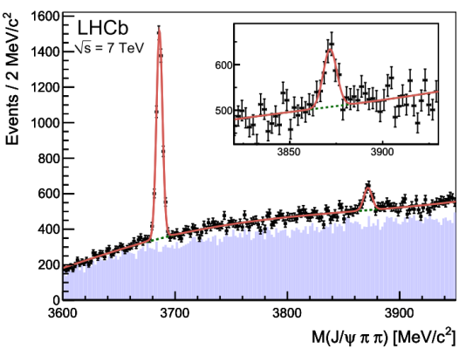
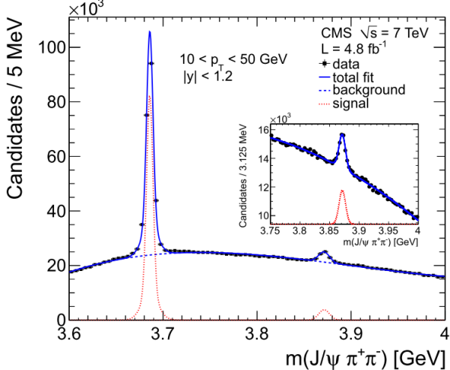
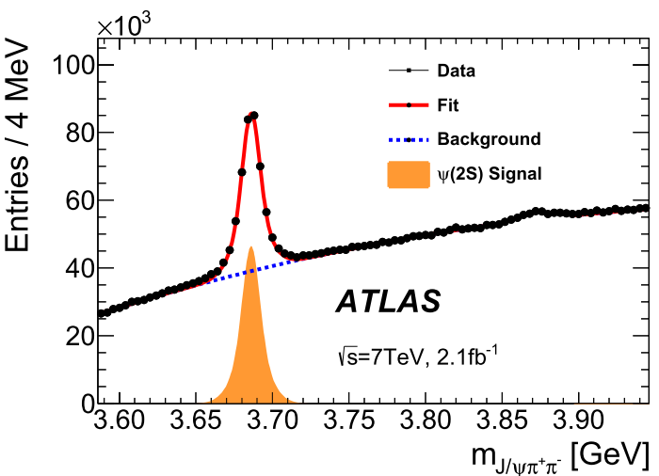
Confirmed by many experiments
Phys.Rev.Lett.93:072001,2004
Phys. Rev. Lett. 93, 162002
Phys.Rev.D71:071103,2005
Eur. Phys. J. C. 72 (2012) 1972
JHEP 04 (2013) 154
・Existence is established.
・Understanding of the property.

Slide 11
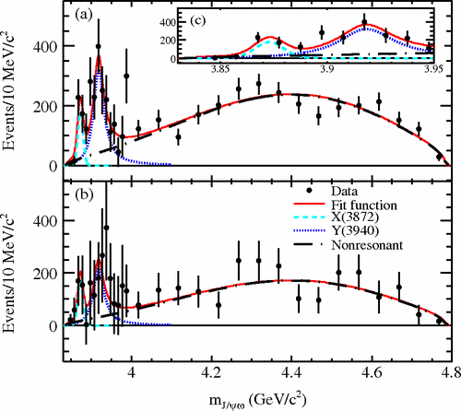
X(3872) characteristics
・ No quark model prediction in this mass region.
・Decay into both of J/ψρ (I=1) and J/ψω (I=0): isospin breaking
・ J^{PC} = 1⁺⁺ (LHCb, Phys. Rev. Lett. 110, 222001)
・ Mass is consistent with DD* with O(0.1) MeV precision.
Suggesting DD* molecule state.
- Isospin breaking can be explained by D⁺D^{*-} and D⁰D^{*0} mass difference
- J^{P}=1⁺ is consistent with S-wave D (0⁻), D* (1⁻)
Phys. Rev. D 82, 011101(R)
Phys. Rev. Lett. 91.262001
M(ππ) in J/ψππ
M(J/ψω)

Slide 12
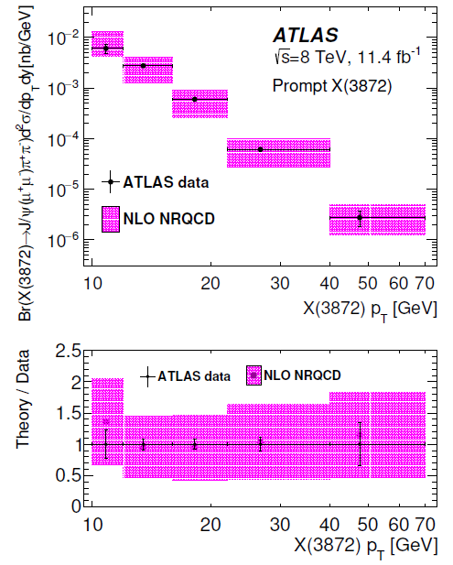
Counter evidence of pure molecular state
JHEP01(2017)117
・ Differential cross section for “prompt production”
(Not from B meson) is measured by LHC.
・ Should be suppressed for molecular, which is a soft object.
・ Consistent with expectation for pure cc state ( χ_{c1}(2P) )
・ Suggesting X(3872) as superposition of molecular and cc
Assuming χ_{c1}(2P)
Production and decay are essential to understand exotic state

Slide 13
Missing information
・ Many decay modes are observed:
J/ψ ρ, J/ψ ω, J/ψ γ, ψ(2S) γ, DD*, DDπ⁰ . .
・ Their decay widths and branching fractions are not known.
- Only the product of two branching fractions are measured.
- Only upper limit of 1.2 MeV is determined.
・ These two variables are essential to increase dynamic information
K⁺
B⁺
X
Br(B⁺→K⁺X(3872)K⁺) × Br(X(3872)→f)

Slide 14
Strategy to understand X(3872) by KMI
Belle II measurement
Br(B⁺→X(3872)K⁺)
X(3872) Total width
Known variables
Br(B⁺→X(3872)K⁺)×Br(X(3872)→f)
Br(X(3872)→f)
Γ(X(3872)→f)
σ(X(3872))×Br(X(3872)→f)
σ(X(3872))
LHC, Tevatron…
Newly determined variables
Increase dynamical information drastically!

Slide 15
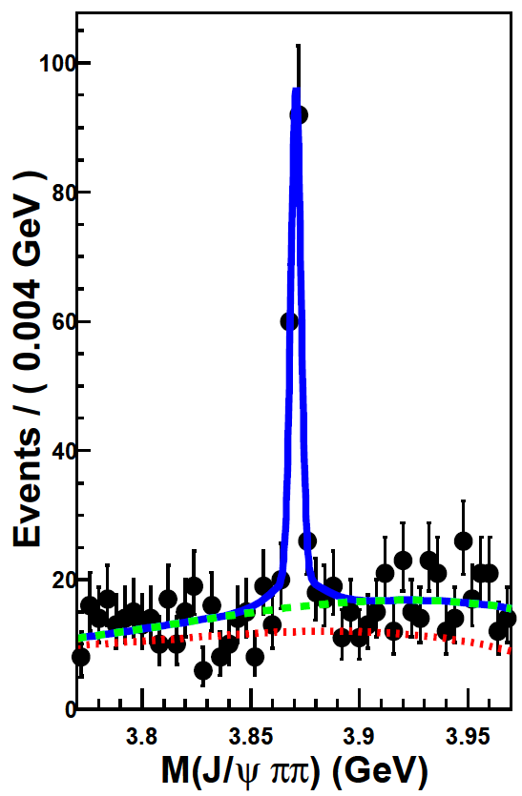
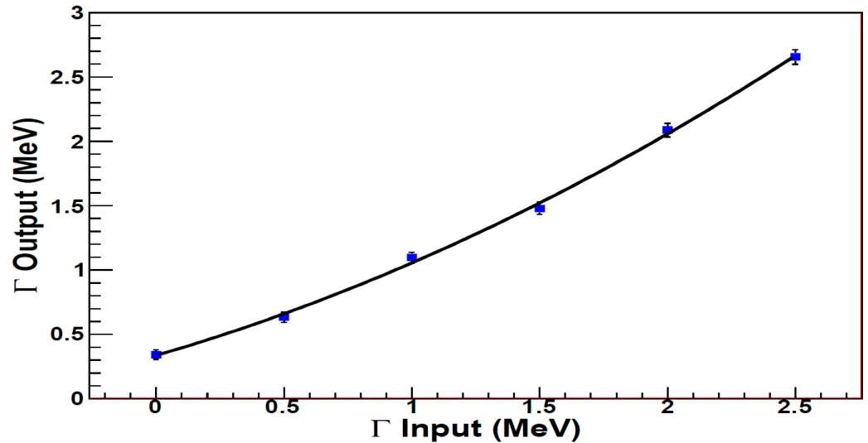
Total width ( previous study )
・ Current upper limit of 1.2 MeV is from Belle, using X(3872)→J/ψπ⁺π⁻ decay.
- Fit mass distribution with Breit-Wigner convolved with mass resolution.
- Mass resolution for J/ψπ⁺π⁻ is ~2.0 MeV.
・ Bias was observed in the simulation.
- Difficult to measure the width <1.0 MeV with 2.0 MeV resolution.
・ Good mass resolution is essential to measure the small width.
Phys. Rev. D 84, 052004

Slide 16
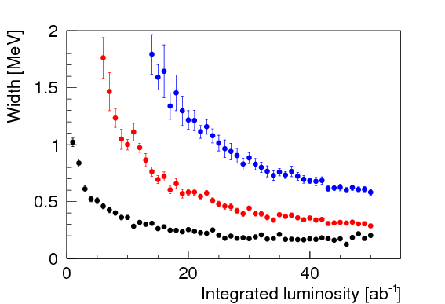
Total width with X(3872)→DDπ⁰ decay mode
・ In general, the mass resolution is better for smaller mass difference.
・ The mass difference is smallest in DDπ⁰ mode.
・ The mass resolution is 680 keV: ~3 times better than J/ψπ⁺π⁻ mode.
- No width measurement at Belle (1) due to poor statistics
・ No bias seen up to O(100 keV) in the simulation.
・ The expected 90% UL is 180 keV.
Decay | Mass difference (MeV/c²)
J/ψπ⁺π⁻ | ~500
DDπ⁰ | 7
5σ sensitivity
3σ sensitivity
90% UL
Preliminary
current UL

Slide 17
Br(B⁺→K⁺X(3872)
・Extract Br (B⁺→X(3872) K⁺) → Do not look for X(3872) decay
- Reconstruct X from Missing mass:M_{x}² = (P_{beam}-P_{BTag}-P_{K+})²
Belle1 full statistics result
< 2.6×10⁻⁴
Reconstruct
Detect
K⁺
Hadronic decay
B⁻
B⁺
X
Phys. Rev. D 97, 012005
・ 7σ measurement with Belle II (naïve expectation)
・ More realistic simulation on going.

Slide 18
Charmed baryons

Slide 19
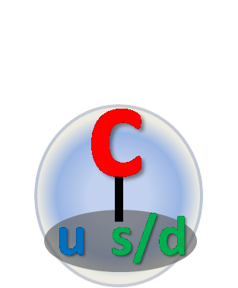
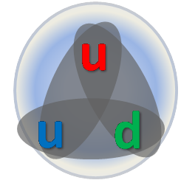
Physics of charmed baryons
・Charm quark is heavy: (1500 MeV/c²) > u,d,s quarks (300-500 MeV/c²)
・spin-spin interaction∝1/m₁m₂
・Di-quark correlation in light quarks
- New degree of freedom with color (what is the mass?)
- More simple to understand baryon
Nucleon
Charmed baryon
Every pair can not be distinguished.
Light di-quark and charm quark.

Slide 20
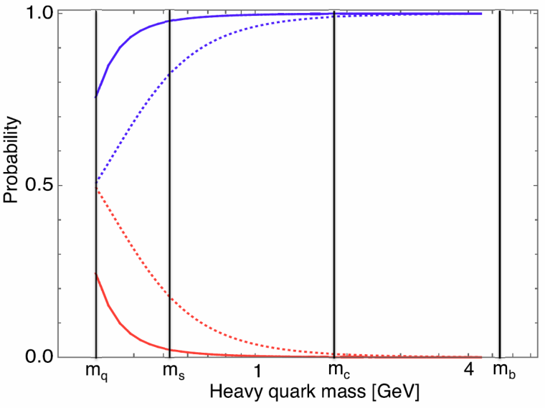
Excitation modes
・There are two kind of excitation modes.
- λ mode: excitation between c quark and u-d di-quark.
- ρ mode: excitation in the di-quarks.
T. Yoshida et al. PRD 92, 114029 (2015)
½-
λ mode
The fraction of λ mode
for the 1st excited state.
ρ mode
・ No clear indication of ρ and λ mode yet.
・ First excitation has L=1 → There should be two J^{P}=1/2⁻ states.
・ Experimentally, discover charmed baryons, study the property
and check global consistency with di-quark picture.

Slide 21
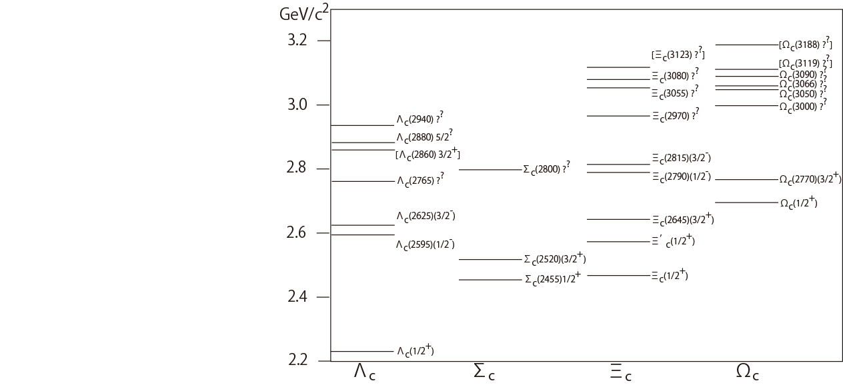
Observed charmed baryons
LHCb
Belle
BaBar
CLEO
Review paper:
https://doi.org/10.1016/j.ppnp.2019.01.001
- State with [] observed in single exp.
- J^{P} with () is QM prediction
(udc)
(udc,uuc,ddc)
(usc,dsc)
(ssc)
arXiv:1810.03748

Slide 22
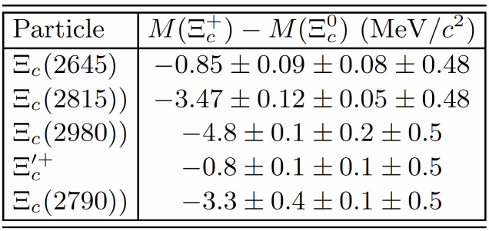
Achievements and missing things
・ All the ground states and many excited states observed.
・ J^{P} for a few states determined.
・ Many decay modes observed.
- Identification of λ - ρ mode.
・ Very precise mass determinations.
- Isospin splitting depends on baryons.
However…
・ Still two 1/2⁻ states not observed!
- Even for λ mode, it is from QM.
- J^{P} determination is essential.
ΛD
Σ_{c}K
Ξ_{c}(3055)⁺
Ξ_{c}(3080)
Ξ_{c}(3080)⁺
Ξ_{c}(3055)
Ξ_{c}(2980)
Phys. Rev. D 94, 032002
Phys. Rev. D 89, 052003

Slide 23
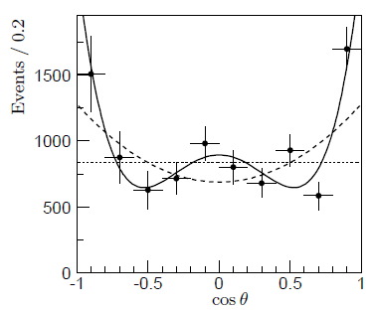
J^{P} determination at Belle
M(Σ_{c}π)
Λ_{c}⁺(2880) Σ_{c}π decay angular distribution
Λ_{c}(2765)
J=5/2
Λ_{c}(2880)
J=3/2
J=1/2
Λ_{c}(2940)
Phys. Rev. Lett. 98, 262001
About 5σ exclusion for spin 1/2, 3/2
The decay angular distribution for spin 5/2.
・ Decay angular distribution depends on helicity fraction (ρ_{ii}).
Difficult to predict ρ_{ii} in continuum production.
・ If a charm baryon is not polarized (ρ_{ii} have same value), angular distribution becomes flat.
→ It is difficult to distinguish spin 1/2 and no polarization.

Slide 24
Spin determination at Belle II
・ B-meson two body decay constrains the helicity to be ½
as B meson has spin zero and proton has spin ½. This largely reduce uncertainty
・ Statistics at current B-factory is not good enough for higher excited states.
p
B
Y_{c}*
J=1/2
J=0
J=?
Example
B→Σ_{c}⁰ p^{bar}, Σ_{c}→Λ_{c}⁺π⁻
Λ_{c}⁺π⁻ angular distribution
Higher excited states observed!
B→Ξ_{c}(2930)Λ_{c}, Ξ_{c}(2930)→KΛ_{c}
Σ_{c}⁰
10.1103/PhysRevD.78.112003
S=1/2, exclude 3/2 by ~4σ
Eur. Phys. J. C (2018) 78: 252.

Slide 25
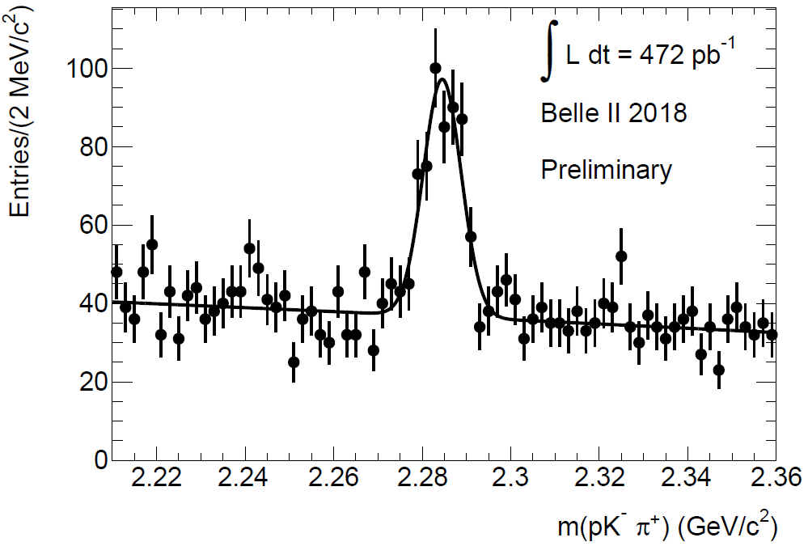
Λ_{c}⁺ in Belle II phase2 data!

Slide 26
Summary
・ B-factory experiment is an ideal field for the hadron spectroscopy
・ Homeworks from B-factories: Understanding XYZ exotics
・ Understand Di-quark degree of freedom in charm baryons
- Spin, observe new states..
Stay tuned for Belle II phase3!

